Slide 1

Solve Climate By 2030
From Climate Despair to Local Action
Dr. Eban Goodstein: Graduate Programs in Sustainability, Bard College,
Dr. David Blockstein, Solve Climate by 2030
solveclimateby2030.org

Slide 2
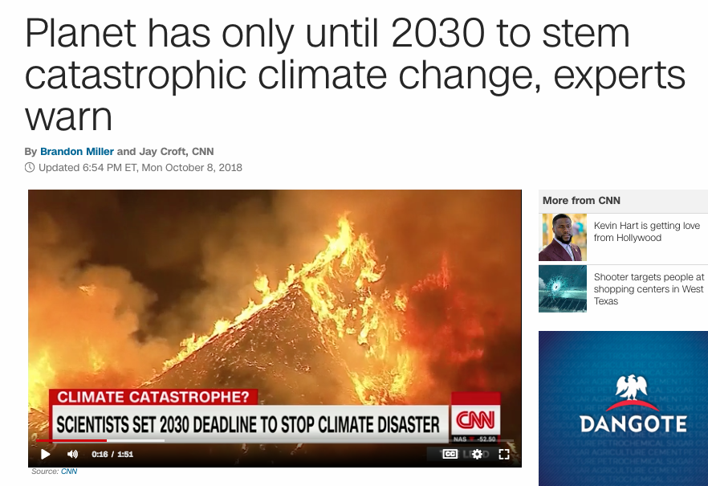

Slide 3





Solve Climate By 2030
April 7, 2020 – Power Dialogs
A nationally coordinated on-line event with hundreds of participating schools in every state: 52 hour-long, university-hosted webinars on state-specific solutions, followed by community dialogs focused on how students and others can take action.
University and
Business Sponsors

Slide 4
100,000 students focused on climate solutions on April 7

Slide 5
“Solve Climate” Means….
By 2030, be well on the way towards a 100% renewable economy
Electric power from solar, wind, hydro, geothermal, + “storage” (batteries)
Transportation transitioning rapidly toward Electric Vehicles (EV’s)
This solves the energy half of climate change.

Slide 6
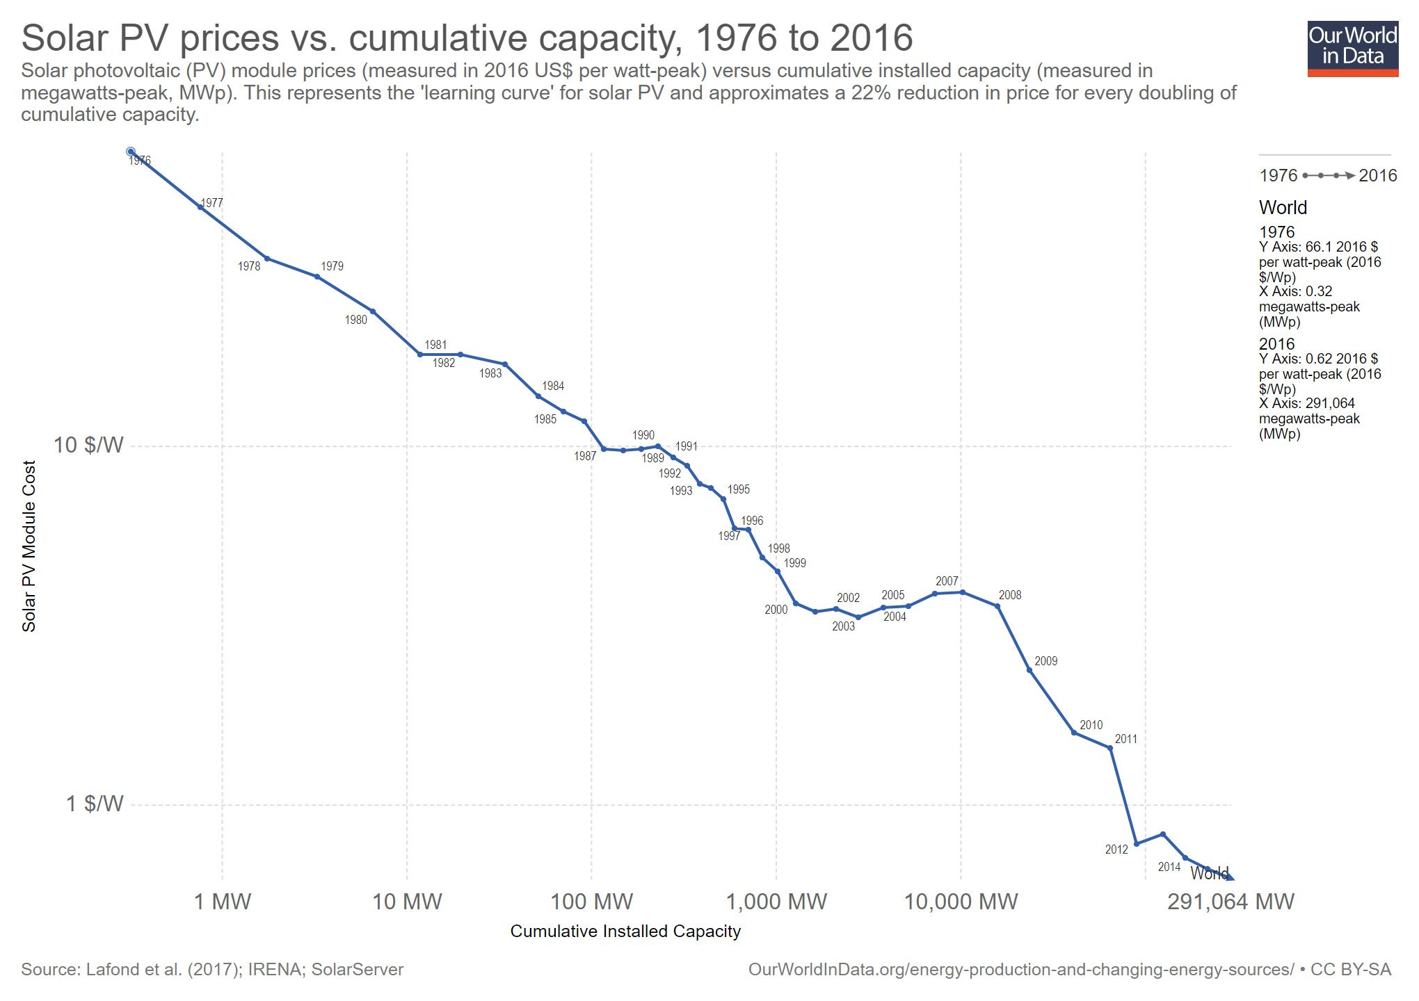
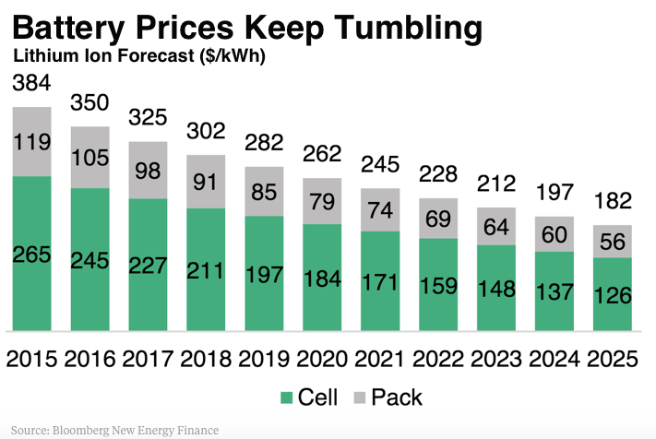
Imagine
The 2020’s as a decade of disruptive energy transformation driven by cheap, distributed solar + storage

Slide 7
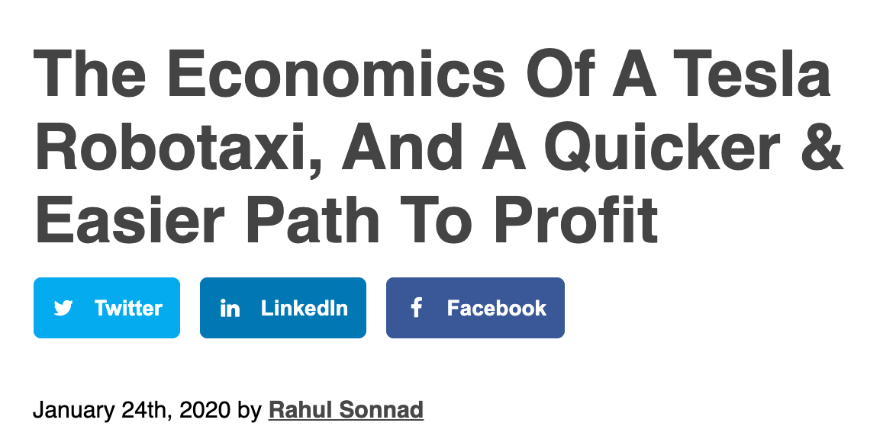
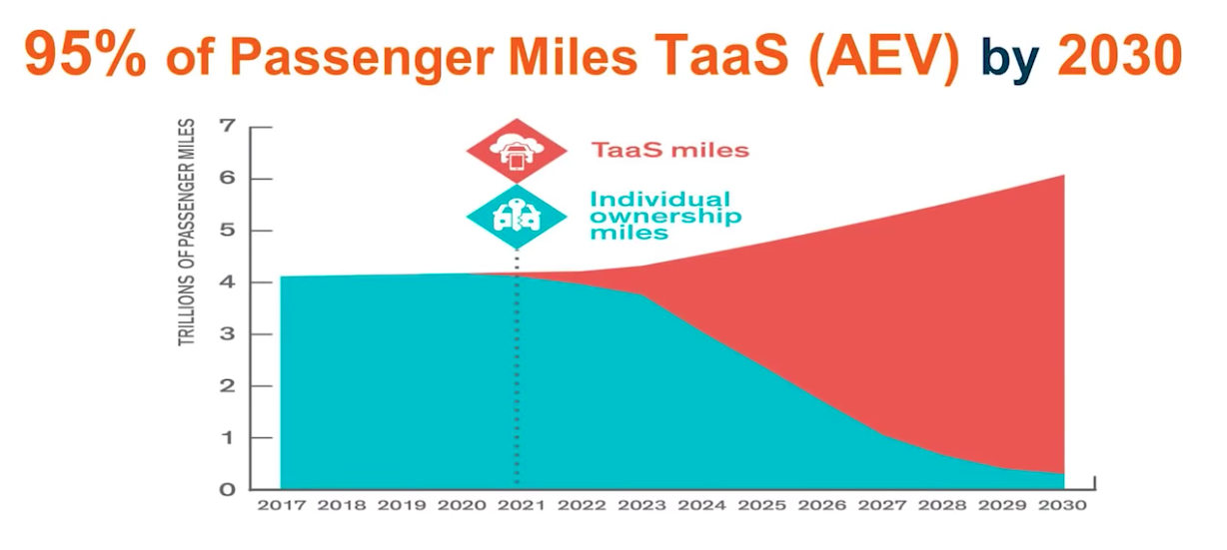






Imagine further
Cheap transport from driverless electric taxis and fleet

Slide 8
Technology Tipping Point
Local and State Action is now much more important in solving climate.
Removing barriers to rapid deployment is now key.

Slide 9
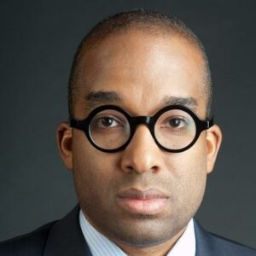
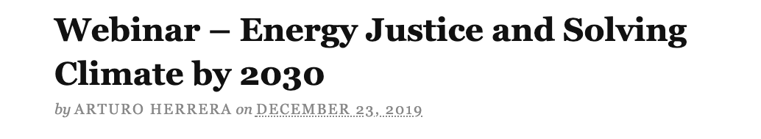
Rapid Global Energy Transition
Equitable access to affordable clean power and affordable clean mobility?
Clean energy jobs for all?
Jobs for workers in declining industries?
Critical for the Climate-- Big Justice Questions

Slide 10
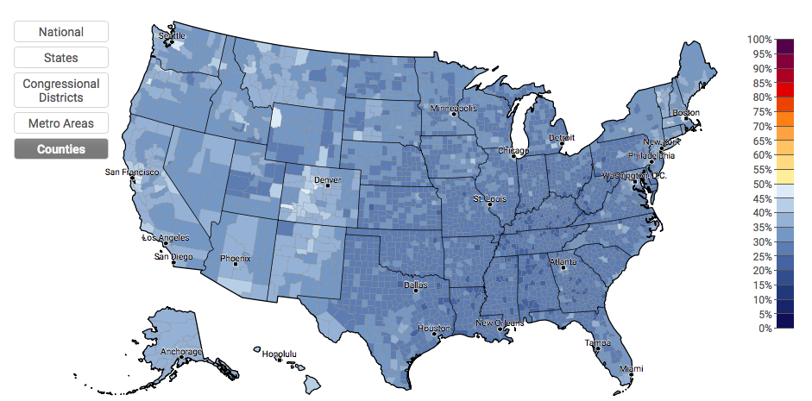
Talk Solving Climate by 2030
Estimated % of adults who discuss global warming at least occasionally, 2016
Source: Yale Center on Climate Communication

Slide 11

Get People Talking
April 7, 2020 – The Power Dialog
A nationally coordinated on-line event with hundreds of participating schools in every state: 52 hour-long, university-hosted webinars on state-specific solutions, followed by community dialogs focused on how students and others can take action.
#SolveClimateby2030
#PowerDialog
#MakeClimateAClass
University and
Business Sponsors

Slide 12
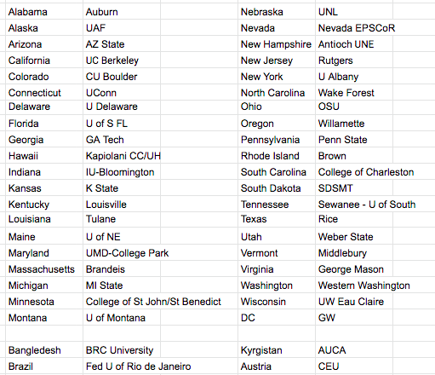
Power Dialog State Leads, 2/8
www.solveclimateby2030.org

Slide 13
April 7, 2020 – The Power Dialog
5:00 pm Local: National Introduction from Bard (video)
5:10 pm Local: State-wide Panel Webinars - 3 ambitious but feasible policy actions and ideas for each state
6:10 pm Local: In-Person Participant Discussions - moving to climate solutions in our state, community and campus
Output:
100,000+ participants informed and motivated to act
Theory of Change:
College & High School Faculty Assign the Power Dialog as Homework
Follow up discussion in class
Bard will provide templates for discussion

Slide 14
April 8 and Beyond
#MakeClimateaClass – classroom discussions
Encourage webinar participants to take action
Share what you learned
Take friends to Earth Day climate events
Help get everyone registered to vote
Ask politicians and candidates to take action
Get involved in a campaign this summer
Compilation of state recommendations into a national agenda
Earth Day 2020 – partnership with Earth Day Network
International partnerships
What else?

Slide 15
How you can be involved
Still need hosts in a few states
Host a large viewing and discussion in your institution
Promote Power Dialog viewings to other institutions
Promote #MakeClimateaClass – classroom discussions widely across your state
Contribute resources to our website
What else?

Slide 16
Resources
TAKE ACTION
Beyond Gloom and Doom: How to Take Action for Clean Energy
VIDEOS
SLIDE PRESENTATIONS
Dr. Eban Goodstein: How to Solve Climate by 2020: Solar Dominance + Civic Action
BLOG POSTS
PODCASTS
K-12 RESOURCES
State wide web pages – policy initiatives in your state
www.solveclimateby2030.org

Slide 17
ONLINE, COLLABORATIVE INTERNSHIP
Social Media for Climate Activism
Five HOURS PER WEEK, Feb 3-April 15, 2020

Slide 18
www.solveclimateby2030.org
Eban Goodstein, ebangood@bard.edu
David Blockstein; SolveClimate2030@gmail.com 301-906-4958
C2C Fellows
Thank you!

Slide 19
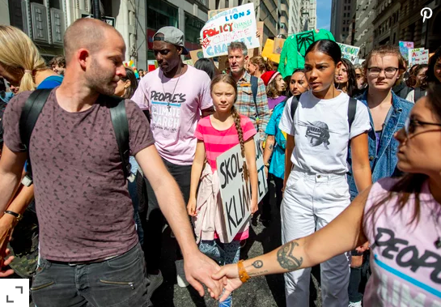
Solve Climate By 2030

