Slide 1
TASTE Food: The Automated Scope 3 Tool for Tracking Emissions from Food A Python-based Categorization Tool For Calculating Institutional Indirect Emissions From Purchased Food
AASHE Conference
Rebecca Grekin, Dr. Jacques de Chalendar, Prof. Sally Benson
Energy Science & Engineering Department at Stanford University
October 29th, 2024

Slide 2
AASHE 2024 Code of Conduct
Act responsibly, behave courteously and respect the rights and dignity of others at all times while in attendance.
Notify AASHE Staff of any concerning/unsafe situations ASAP.
Provide clear, helpful and honest feedback.
The following actions are prohibited:
Harassment or intimidation by words, gestures, or body language
Verbally abusive behavior, including angry or vulgar language, swearing, name-calling or shouting
Sexually explicit conversation or behavior
Solicitation or spam of uninterested participants
Full Code of Conduct can be found in the #AASHE24 Mobile App

Slide 3

Session Feedback
In the #AASHE24 Mobile App, you can leave feedback for this session. Feedback helps us improve our content year over year.
No mobile device? Stop by the Registration desk and we’ll be happy to note your feedback.
Scan to download the #AASHE24 Mobile App

Slide 4
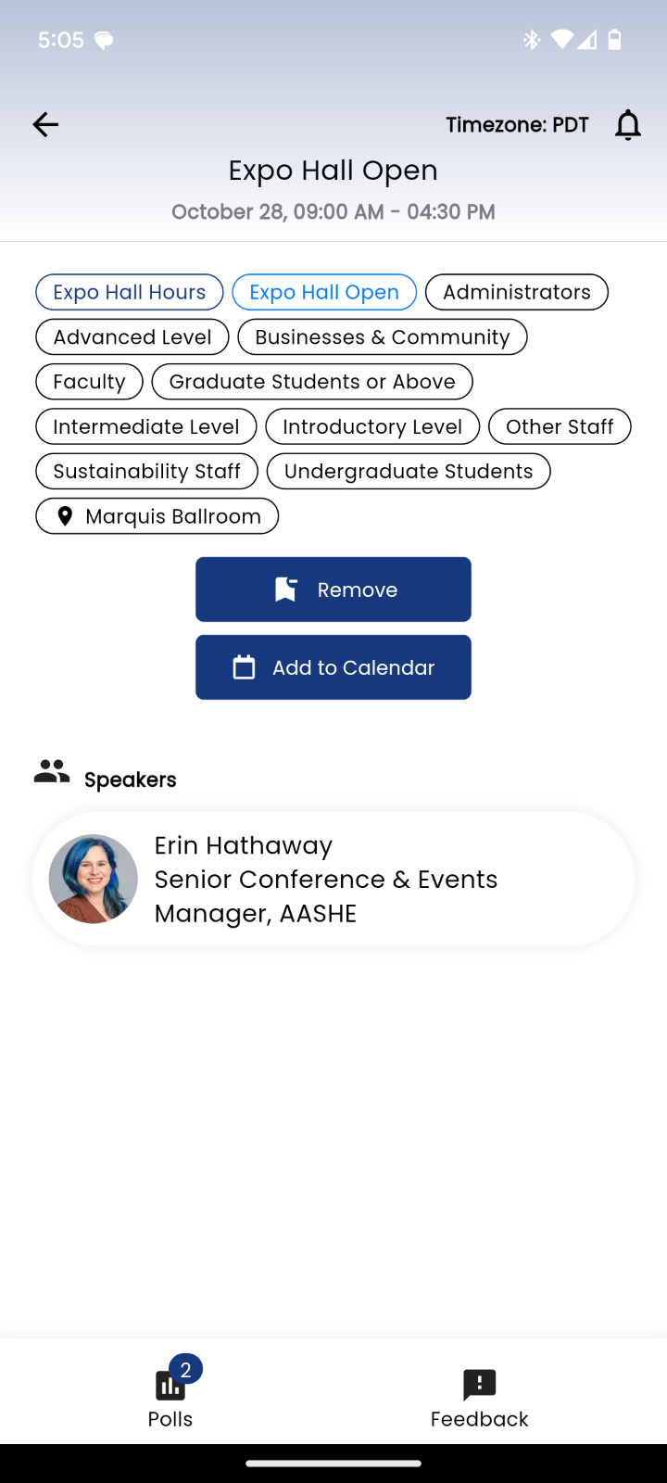
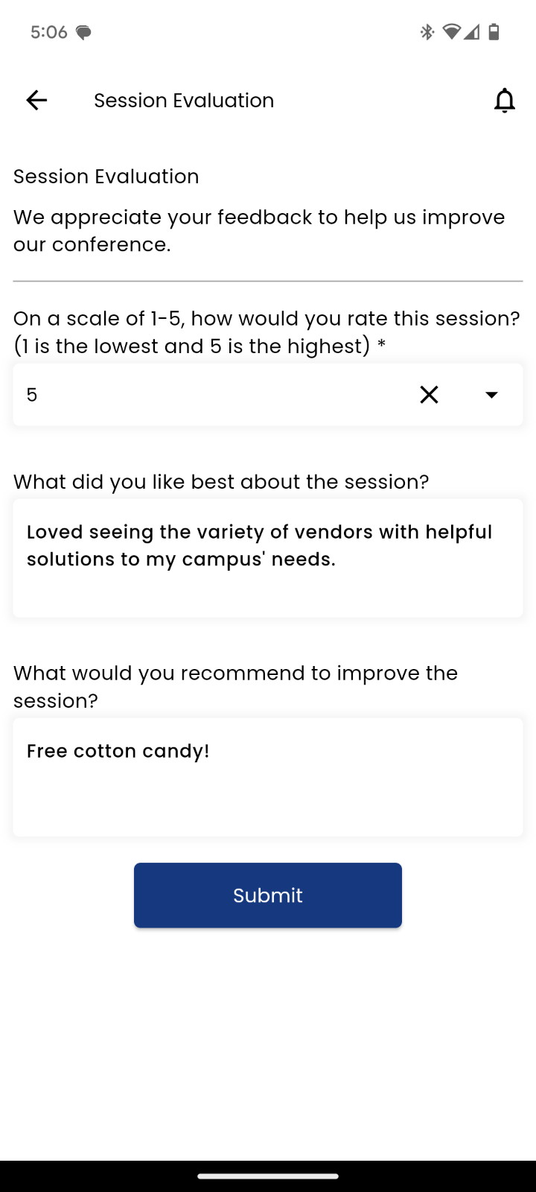
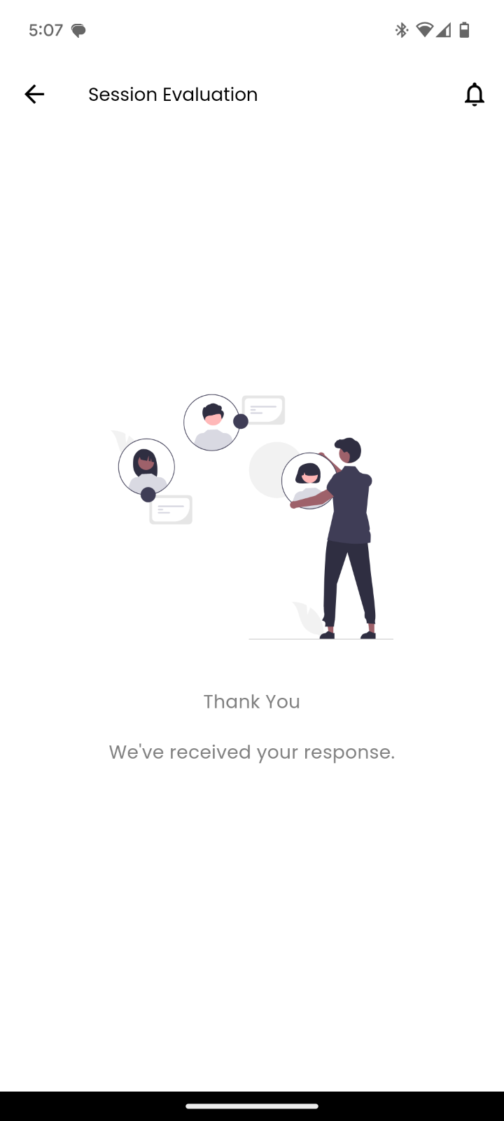
Scan to download the #AASHE24 Mobile App

Slide 5

Rebecca Grekin
Ph.D. Candidate, Stanford University
rgrekin@stanford.edu

Slide 6
Quick Show of Hands
Who here hasn’t started and is interested in learning how to track emissions from food purchases?
Who here is already tracking food emissions from their institution?
Who is reporting food emissions with SIMAP?
Who is reporting plant based and organic food purchases with AASHE STARS?
Who is reporting using WRI Cool Food Pledge?
Who is reporting using something else?
Notes:
I hope to have pieces that are relevant to both of these demographics
If using something else, come talk to me after the presentation or send me an email and let me know what you’re using!

Slide 7
Factors Influencing Food Purchasing at Universities are Varied and Complex
Nutrition
Scope 3 Commitments
Availability
Food Purchasing at a University
Waste Reduction Goals
Dietary Restrictions
Religious Constraints
Reporting:
AASHE STARS
WRI Cool Food Pledge
SIMAP
Etc.
Costs
Student Preferences
Dining Hall Side
Administrative Side/Metrics
Notes:
making decisions about what food to buy is hard if you don’t have metrics that I’ve detailed on the right side. These metrics can be hard to measure and quantify, but what if reporting doesn’t need to be as difficult?

Slide 8
Scope of emissions are defined by level of control entity has on each category
(Direct) Scope 1
Entity facilities
Entity vehicles
(Indirect) Scope 2
Purchased electricity, steam, heating & cooling for own use
(Indirect) Scope 3
Upstream
Purchased Goods and Services
Capital Goods
Fuel and Energy Related Activities
Transportation and Distribution
Waste Generated in Operations
Business Travel
Employee Commuting
Leased Assets
Downstream
Transportation and Distribution
Processing of Sold Products
Use of Sold Products
End-of-life Treatment of Sold Products
Leased Assets
Franchises
Investments
Notes:
Entity here is defined as a group that is interested in calculating its emissions, which could be a company, a university, a government, or even a person.

Slide 9
Food is a significant contributor to anthropogenic emissions which cannot be mitigated without first being measured
Emissions from food production and consumption were ~ 1/3rd of the 2015 global anthropogenic greenhouse gas emissions ^{[1]}
Estimating institutions’ food purchasing carbon emissions is difficult because current methodologies require food purchases categorization
Current approaches for estimating food emissions are complicated, time-consuming, error-prone, and not reproducible
[1] Crippa, M., Solazzo, E., Guizzardi, D. et al. Food systems are responsible for a third of global anthropogenic GHG emissions. Nat Food 2, 198–209 (2021). https://doi.org/10.1038/s43016-021-00225-9
Notes:
Why do we care about emissions that are associated the food a university purchases? Let’s break down what I mean by these last two bullet points

Slide 10
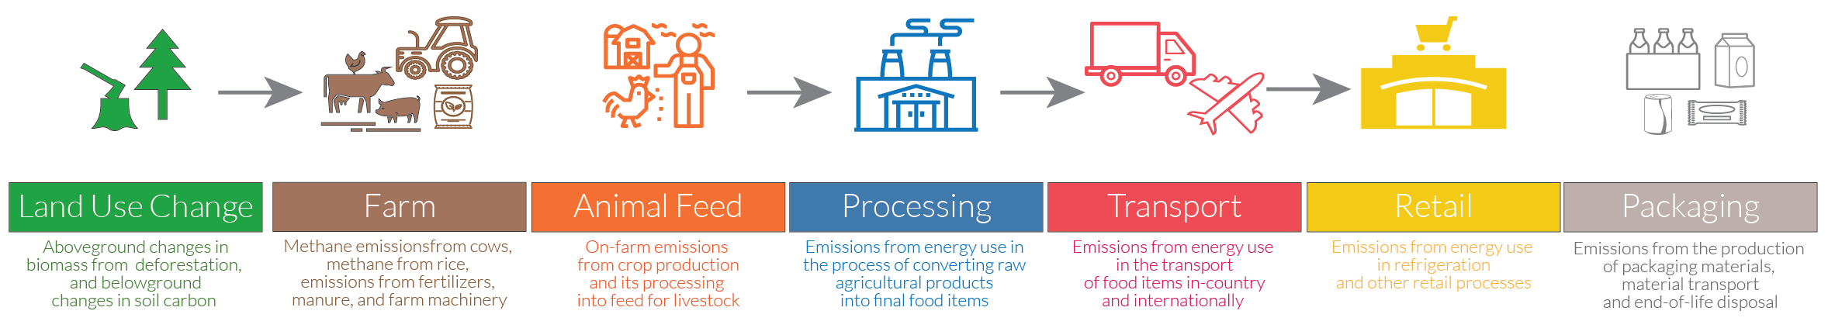
Life Cycle Analyses allow for emissions factors (EFs) for categories of foods
$${CO_{2}}_{item purchased}=kg_{item purchased} ∗emissions factor \left[\frac{kg CO_{2}}{kg_{item purchased}}\right]$$
$${CO_{2}}_{item purchased}={ \$}_{item purchased} ∗emissions factor \left[\frac{kg CO_{2}}{\$_{item purchased}}\right]$$
LCA is a process that analyzes emissions associated with a product or process by determining emissions associated with each stage of that product or process during its entire lifetime
Most EFs are spend-based or weight-based and are available for aggregate food categories such as vegetables, fruits, beef, etc.
Notes:
Of course, with how incredibly interconnected the world is now, each of these phases can occur in vastly different parts of the world. A very important concept to be aware of when talking about life cycle analyses, particularly if you’re trying to compare one analysis to another are the boundaries being considered.
There are two most common sets of boundaries that are usually considered and these are either cradle to gate or cradle to grave life cycle analyses.
Cradle to gate is an analysis of the emissions from the beginning of the material production or extraction through all the steps until the product if completed, but before the use phase. This is called to gate because you can imagine that its all the components of the life cycle until it gets to the gate of the factory that it is ready to leave.
The other type is cradle to grave, and this one includes all the phases of the life cycle until the so called death of the product. As you can image these types of calculations can get really complicated really quickly. And this is because sometimes it’s hard to know when to stop figuring out the emissions associated with a step. For example, if a machine is used in the manufacturing phase, should you figure out it’s life cycle analysis to attribute some portion of that to the product being made? To help answer that question, it’s important to introduce the concept of the scopes of emissions.

Slide 11
If you do not have supplier specific emissions factors, you must use category emissions factors
 | Beef | Pork | Chicken | Fish | Milk | Cheese | Eggs | Grains | Vegetables | Fruits | Potatoes | Beans | Nuts | Liquids | Coffee and tea | Oils | Sugars | Spices
Emissions Factor (kg CO2/kg food) | 41.3 | 9.8 | 4.4 | 5.0 | 2.2 | 8.7 | 3.7 | 1.5 | 0.5 | 0.4 | 0.4 | 1.6 | 4.3 | 0.5 | 9.4 | 3.5 | 1.6 | 9.4
Life cycle analyses exist for some food items within a category and these are aggregated to determine emissions factors for categories of food purchases
Supplier specific emissions factors can be particularly difficult with food

Slide 12
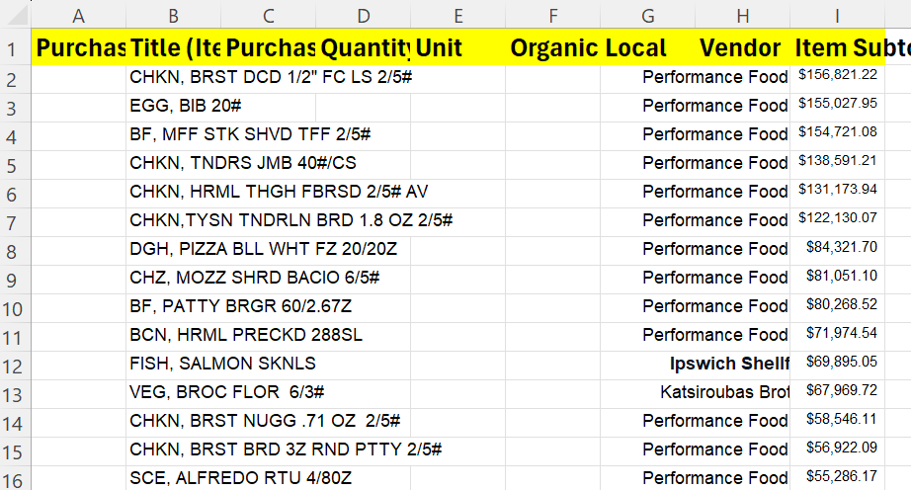
Current approaches for estimating food emissions are complicated, time-consuming, error-prone, and not reproducible
Data is often an excel with all the items purchased in the whole year
In the past, people have to hand categorize, this person often changes from year to year, and different people sort thing differently
Notes:
Oftentimes, food purchasing data looks something like what is on the left here. If you’re lucky you’ll be able to get an excel sheet with all the food purchased in a year, but this excel sheet will often have thousands of items, if not tens of thousands of items depending on the size of your university. In order to use the category emissions we just talked about on the last slide, you have to categorize your data that looks like the left side into the categories for which there are emissions factors. In the past, to do this categorization, the items often needed to be hand categorized usually by someone from the sustainability office, but if you’re lucky a student. Who does this categorization at a university often changes year to year and different people often sort things differently regardless of how much guidance documents are provided. For example….

Slide 13


Where would you put this?
Fruits
Vegetables

Slide 14
Where would you put this?
Lasagna No Beef
Beef
Cheese
Grains
Notes:
But now think about how you might categorize this if lasagna, no beef was line 6389 in a data sheet and that you’ve been doing this for 4 hours straight. Might you not notice the no in front of the beef? Would you remember exactly how you categorized this item in line 6389 when it shows up again in line 8247? These are some examples of why although hand categorization in the past was the best option, it is still error prone, not reproducible and incredibly time intensive.

Slide 15
All this led to the Creation of TASTE Food
The Automated Scope 3 Tool for Tracking Emissions from Food
Notes:
Which was part of my master’s research at Stanford looking at scope 3 emissions from purchased goods and using food as a case study.

Slide 16
What does TASTE Food do?
SIMAP
Food Purchasing Data
TASTE Food
Categorized or Tagged Data
AASHE STARS
University Specific Analyses
Notes:
TASTE Food has been in use since 2019 and we’ll go into each of these parts in a lot more detail during this session, but at a high level overview, basically what TASTE Food does is it takes in food purchasing data that has been formatted into a template and is able to categorize and or tag foods based on different applications which you may be wanting to analyze your food data for. I’ve been partnering with the folks at SIMAP since 2021 to develop a version of the tool which is compatible with SIMAP. So basically one of the outputs you can get from TASTE Food can be directly uploaded into SIMAP. TASTE Food also has the ability to aggregate either spend or weight into the different categories which allows for university specific analyses if you for example want to compare the impact of different emissions factors. *click* And over the last year or so I’ve been working with AASHE to develop a version of the tool which can be used for AASHE Stars reporting which is able to tag food items as plant based and organic! And which I’m very excited to be launch today and which is now available online alongside the SIMAP version.

Slide 17
You Can’t Improve What You Can’t Measure: Automatic Food Categorization with TASTE Food
Initial Spark: 2019
Stanford Dining hall data set provided by Stanford Residential and Dining Enterprises
2,802+ metric tons
2,732+ unique items
$10+ million
2021
7 university data sets provided through partnership with SIMAP Nitrogen Working Group
12,555+ metric tons
27,130+ unique items
$32.5+ million
2023
Total of:
16 universities
17,388+ metric tons
53,058+ unique items
$105.5+ million
2024
Total of:
52 universities
18,130+ metric tons
107,549+ unique items
$124.7+ million
Future
Planned for use and recommended for several other national and international universities and organizations
Notes:
Here’s a quick history of the tool, it starts at Stanford as part of my master’s research back in 2019, in 2021 I partnered with SIMAP and today it has been used by more than 52 universities with more than 18,000 metric tons of food purchasing data run through the tool and more than 100,000 unique item names and more than $124 million in spend. This has been a very exciting journey because with more universities and institutions keeping track of their emissions from food purchasing the more we can mitigate and make data-driven decisions about future purchasing and emissions mitigation.

Slide 18
What is TASTE Food Useful for?
Lowering activation energy for universities with limited resources who have not previously been able to invest time and energy into looking at food emissions/purchasing
Allowing for “apples-to-apples” comparisons among different institutions
Providing the information necessary to set commitments in the future about food purchasing

Slide 19
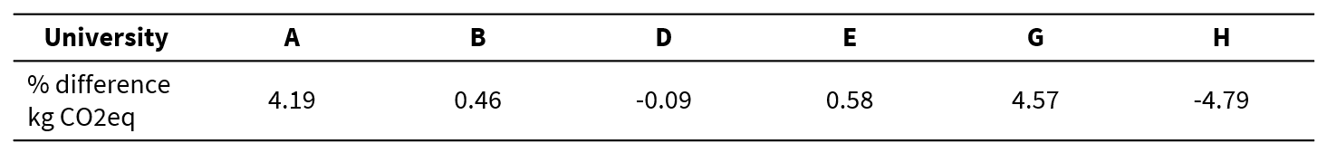
Validation conducted with 6 partner Universities who use SIMAP
Provided previously hand categorized data
Not trying to get differences to zero
$$\% difference emissions=\frac{{emissions}_{hand categorization} −{emissions}_{tool categorization}}{{emissions}_{hand categorization}}∗100$$

Slide 20
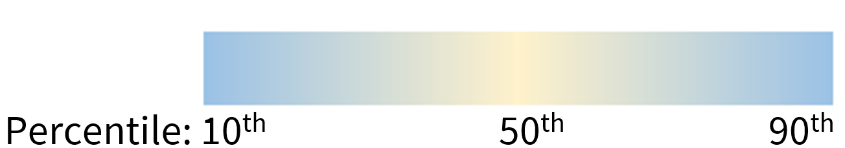

Validation – Emissions attributed to each food category
Blue cells indicate data points that are further from the median values for the percent differences in emissions assigned to each food category for each university
Negative values mean more weight was attributed to that category in tool categorization than in hand
$$\% difference emissions=\frac{weight_{hand categorization} −weight_{tool categorization}}{weight_{hand categorization}}∗100$$
Notes:
the blue cells are concentrated in the lower portions of the table, for which the food categories on the left are ordered in terms of emissions factors, where the highest emissions factors are at the top and the lowest emissions factors are at the bottom. Thus, very large differences in weight assigned to the categories at the bottom do not translate to large changes in calculated emissions for the data set as a whole. Overall, the categorization script was found to provide an accurate characterization of both the food purchases as well as the emissions when compared to previously hand-categorized data sets. Although the categorization script omits some of data because it cannot categorize it, this number of items is relatively small and represents in aggregate only 0.39% of the total weight analyzed among these universities. Most of the differences in categorization between the script and hand-categorization are in the less emissions intensive categories which translates to small impacts in overall emissions calculations.

Slide 21

Questions?
Are you willing to help with the validation of the next version of TASTE Food?
https://bit.ly/TASTE_Food_Help

Slide 22
Getting into specifics
Notes:
So now, let’s talk a little bit about the specifics of how to use TASTE Food

Slide 23
SIMAP AASHE STARS
SIMAP Basic Food
18 categories
Weight-based analysis
Up to 3 categories per item
Focus on Plant-Based, Organic, and otherwise sustainably sourced foods
Spend-based analysis
Notes:
There are currently two versions of the tool, one aimed at use with SIMAP and one for use with AASHE STARS. There have been several talks throughout the last 2 days about both AASHE Stars and SIMAP, but as a quick refresher. Items are only categorized for more than one category if a 50% of the item’s weight is the two categories, or 33% of the weight is one of three categories.

Slide 24
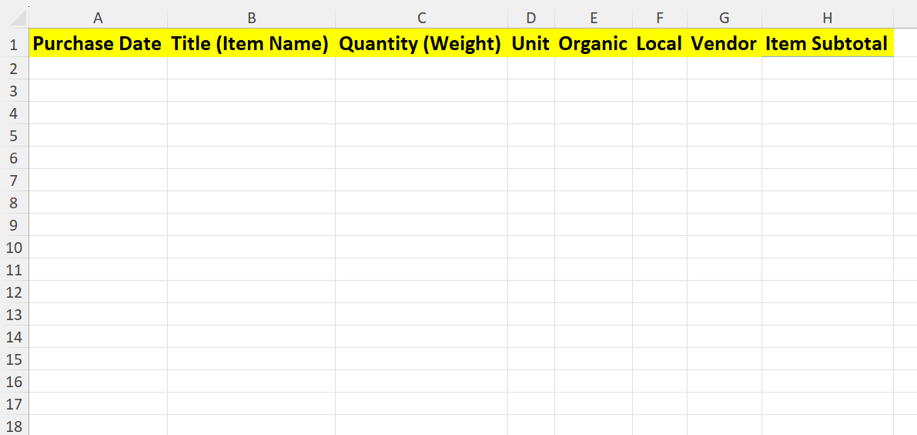
Inputs: Simple Excel, the only required column for categorization is Title (Item Name)
Accepted Units: US gallon, liter, kilogram, pound
(Same as SIMAP Accepts)

Slide 25
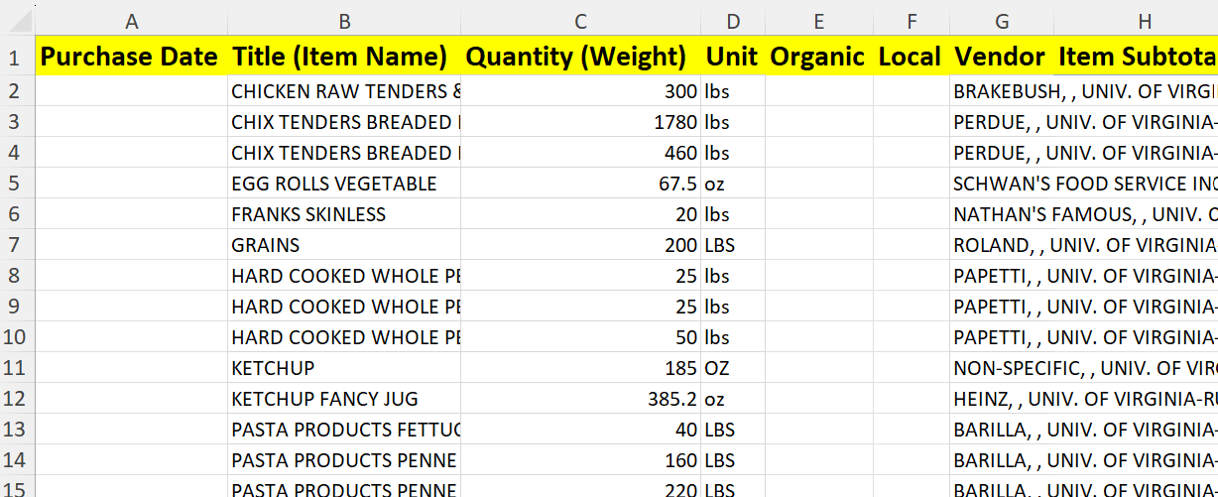
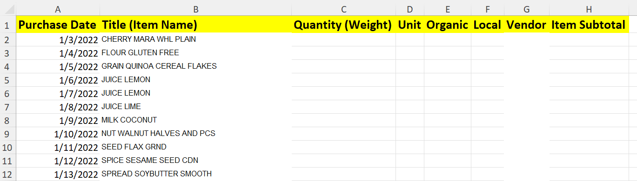
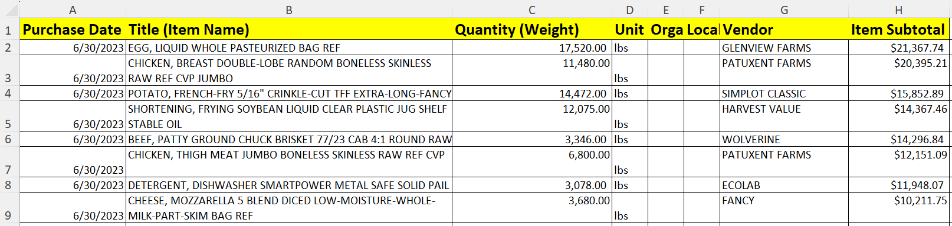
TASTE Food can process all of these
The more data you provide, the more TASTE Food can do for you

Slide 26
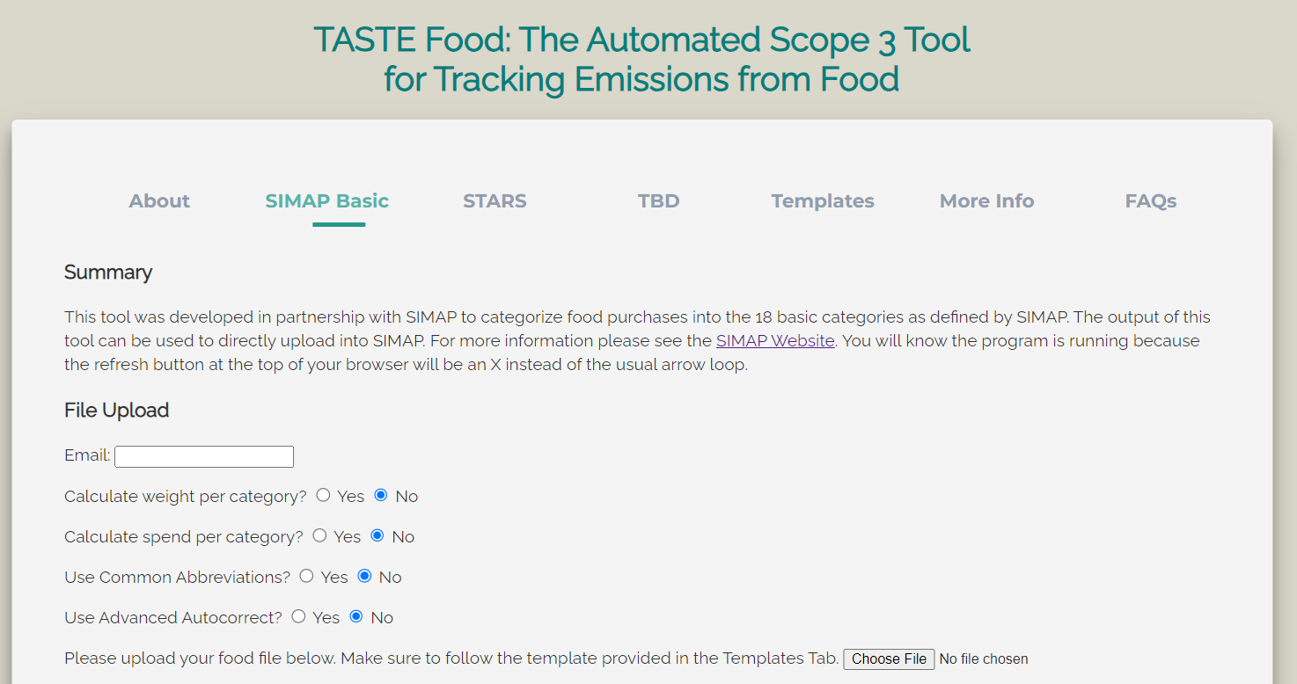
}
Select these based on the provided data and specifics of your data

Slide 27
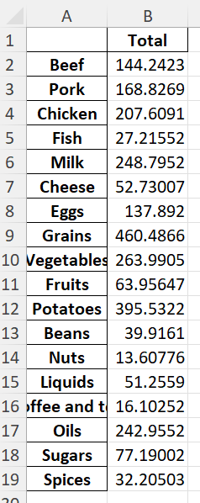

If select “Yes”, will include a tab in the output file with the total amount of weight in kilograms categorized to each category
Weight is split evenly among all categories for an item
Conversion from liquids to Kilogram is same as SIMAP assumes
 | Kilogram
1 US Gallon | 3.8
1 Liter | 1.0038536
1 Pound | 0.453592
Accepted Units: US gallon, liter, kilogram, pound
(Same as SIMAP Accepts)

Slide 28
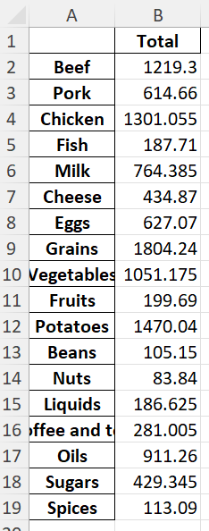

If select “Yes”, will include a tab in the output file with the total amount of spend categorized to each category
Spend is split evenly among all categories for an item

Slide 29
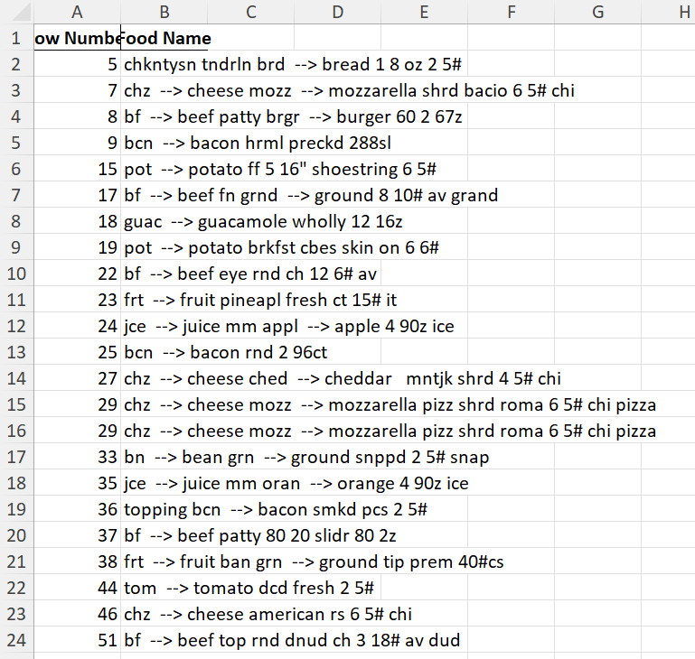

If you select “Yes”
Many food purchasing datasets have abbreviations
Converts the word before --> to the word after -->
These will show up in the Autocorrected Lines tab for ease of visual verification
Notes:
Important to check over these to make sure the abbreviations were correctly assigned
Will also attempt to find common abbreviations if the code was not able to assign a category to the food item on the first try
If you know your dataset has a lot of abbreviations, select yes to make the code run faster

Slide 30
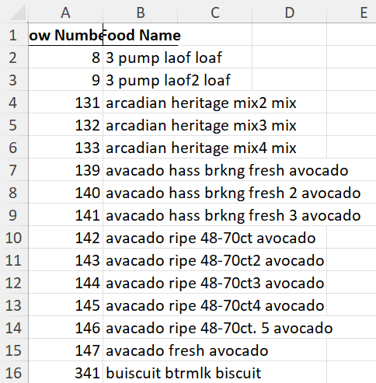
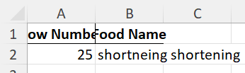
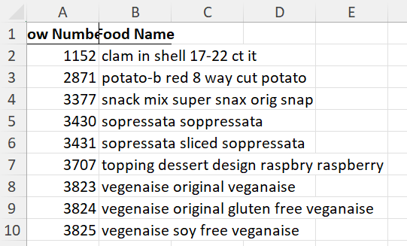
If you select “No”, will only consider the most likely autocorrection
Useful if words are only slightly misspelled

Slide 31
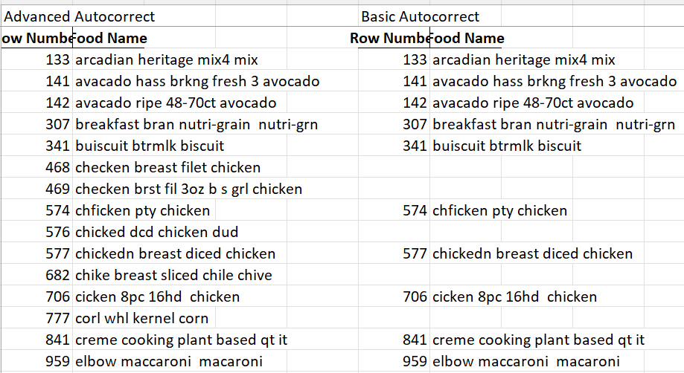
If missing on the right, was in deleted items because so misspelled that the basic autocorrect did not find an option for autocorrection

Slide 32
Here, it was so misspelled that the advanced autocorrect actually autocorrected it to the wrong thing

Slide 33
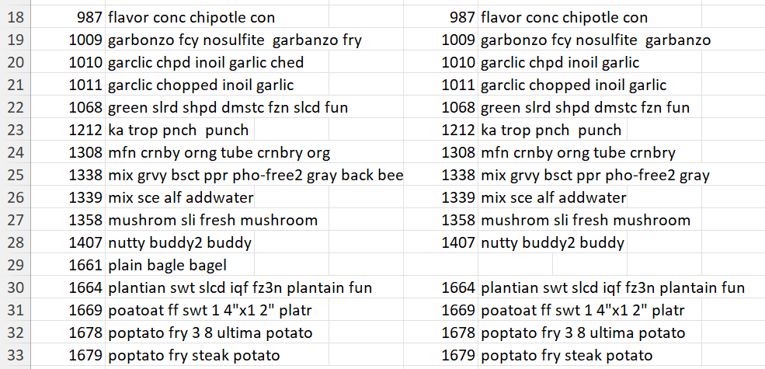
Advanced autocorrect here is actually wrong
Differences in how it autocorrected in this group are not actually useful
Notes:
Advanced autocorrect takes more time to run, it’s a tradeoff

Slide 34
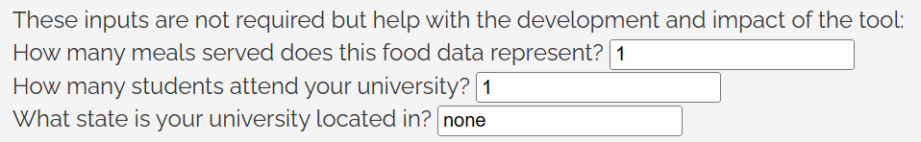
These are not required inputs but if you know and are willing to share this information alongside your data set, it helps me quantify the tool impacts

Slide 35
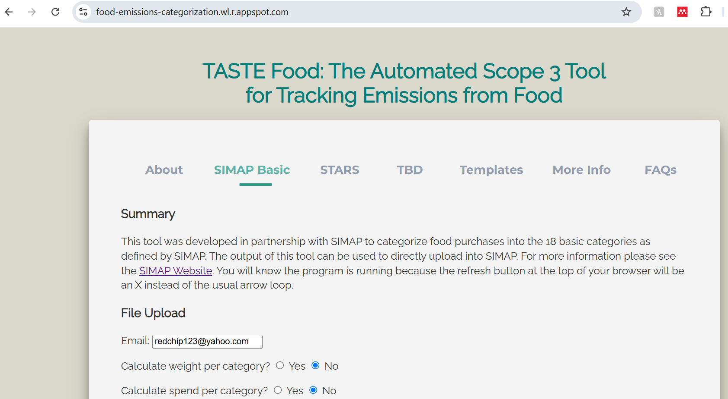

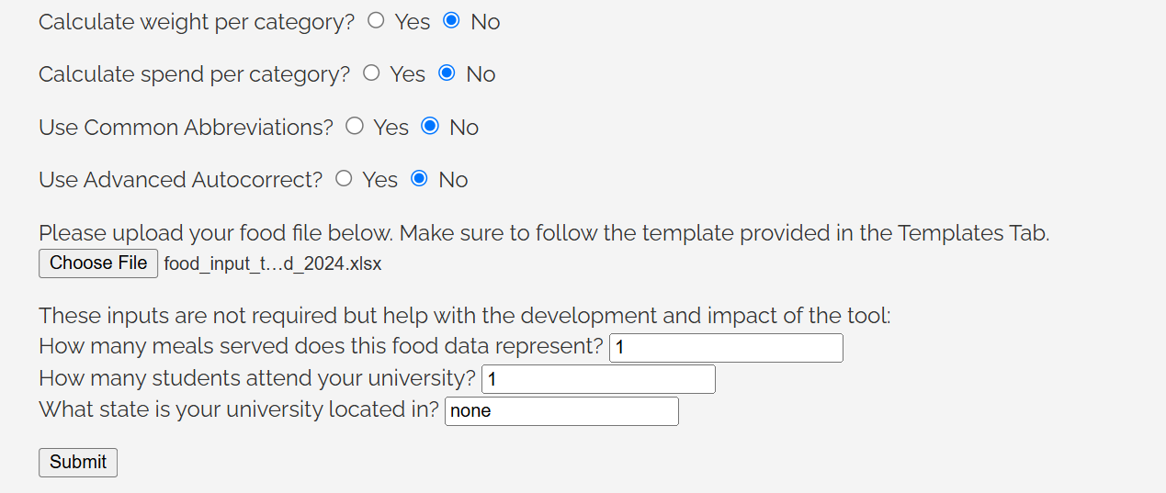

Slide 36



Outputs
Output tabs
Some of these will not appear if you did not select that option and some will be empty depending on your data set

Slide 37
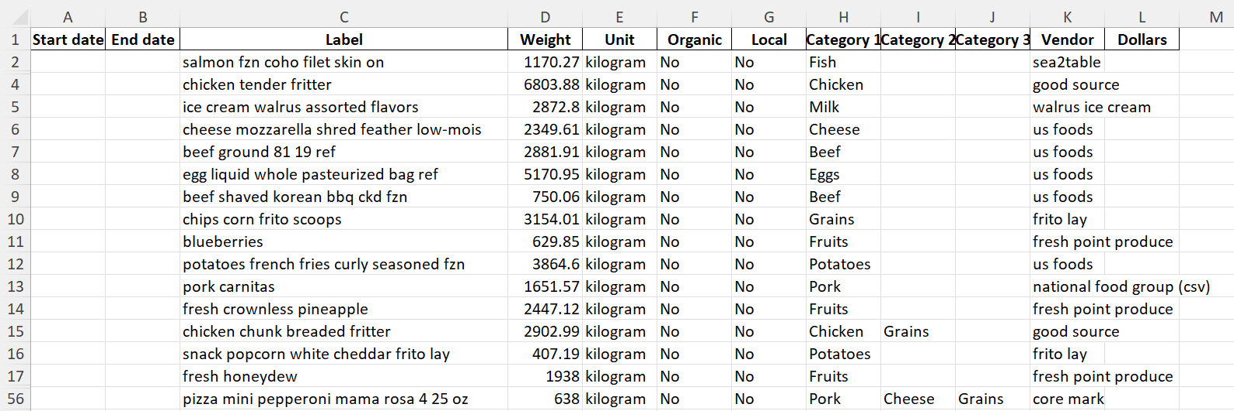
Categorized Data

Slide 38
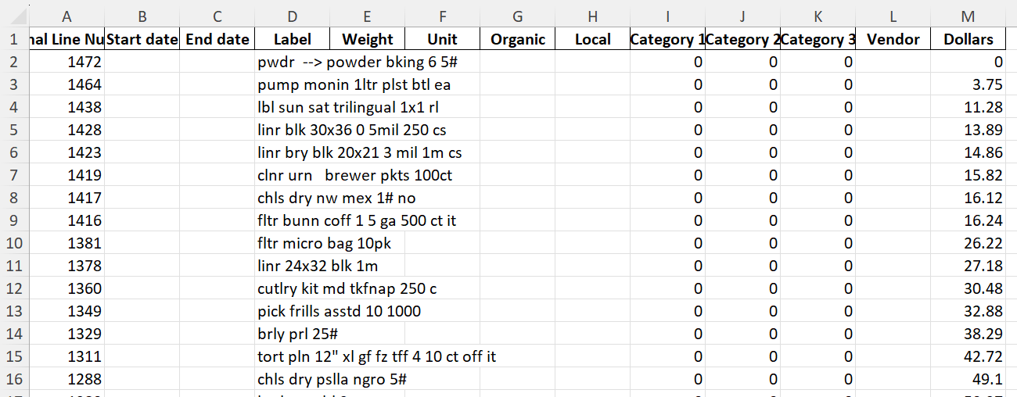
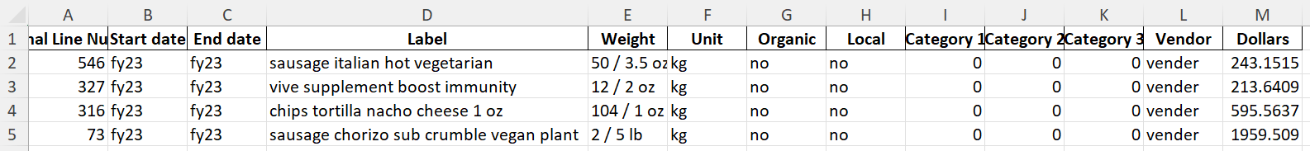
Deleted Items
Notes:
Will include non-food items, vegan meats/cheeses unless a brand is specified because they can be made with several different foods categories, things that are very misspelled, items it does not recognize which could include lines that just don’t have enough information

Slide 39
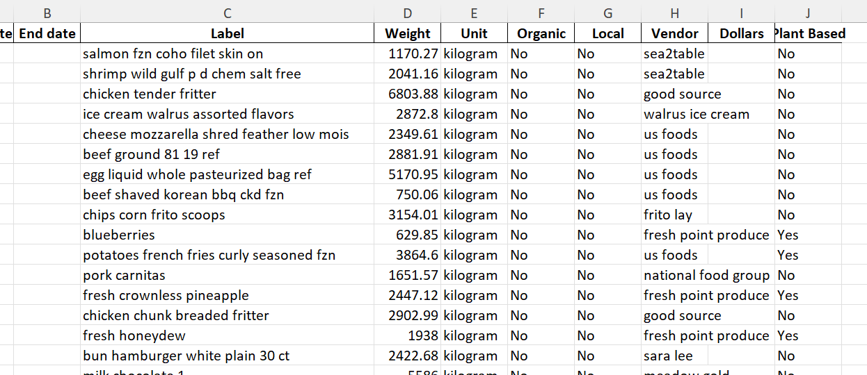
Plant Based

Slide 40
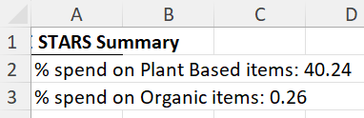
AASHE STARS Summary
These percentages can be input directly into AASHE STARS reporting
These are a lower bound, the tool errs on not tagging things as plant-based when they are than tagging things that aren’t plant-based, plant-based
Not required to upload underlying data to AASHE STARS but can and someone will help verify these

Slide 41

Your turn!
https://bit.ly/4fhTAWW

Slide 42
Questions?

Slide 43
“Live” Demonstration
https://youtu.be/M3ecAKzG8NY

Slide 44
FAQs

Slide 45
Q: I only have spend, or I only have weight data. Can I still use the tool? Which columns are required?
A: Yes! You can leave either column empty and just make sure to not ask the tool to calculate the spend or weight per category if you do not have that data.
Notes:
Only the title column is required for categorization.

Slide 46
Q: What should I do with the items in the deleted sheet in the output file?
A: There are a couple of options:
Simply disregard this data
You can hand categorize the items
You can go into your original file, find the line item and add an appropriate key word to the item name (for example, apple for red delicious, pretzel for snack mix) and rerun the file through the tool with the edited line item names
Notes:
If the total weight or spend of the deleted items in this sheet is small compared to your entire data set, you can simply not include the data in your analysis. You can hand categorize the items that are deleted and copy them from the deleted sheet to the main Categorized Data sheet. If you do this, you will also need to include the weight or spend information from those line items into the spend per category or weight per category tabs if you are using those. The leftmost column of the deleted sheet shows the row number of each data point in the original file fed into the tool. If an item was not tagged because it is misspelled or not enough information was able to be obtained from the original item name, If this is done instead of the hand categorization of deleted item, then the spend per category and weight per category will include the weights and spend from the lines that had previously been uncategorized.

Slide 47
Q: Why is one (or more) of the totals for my weight or spend per category blank?
A: This means that there are some values in the data set you fed into TASTE Food where either the weight or spend is missing.
Notes:
Please either delete this line item if you do not know the spend or weight for this item, try to find the appropriate weight or spend from your original data source, or put a zero in that space if the missing data is not particularly important to the analysis you are planning to do after.

Slide 48
Q: Why is, for example, Cereal or Donuts not being categorized to Sugars as well as to Grains? (Can replace any food with any other two categories)
A: The recommendation for categorization is that the weight or spend should be evenly split between the categories. Thus, if the categorization does not make up 50% of the weight for a two category item or 33.3% of the weight for a three category item, it should not be assigned to the additional categories.
Notes:
For example, often, people are confused why things such as cereal or donuts are not categorized as Sugars as well as Grains, and this is because both of those, although they are very sugary, are not 50% by weight sugar, therefore only Grains is assigned to this category.

Slide 49
Q: Why is Category 2 not in position 1?
A: There is no difference in assumptions made for the first or second or third category. Therefore, the order of the categories assigned does not matter.

Slide 50
Q: I believe an item should have been tagged as plant-based but it was not. Why?
A: AASHE defines food items that are predominantly composed of ingredients of neither plant/fungi nor animal origin that are not intended as alternatives to meat or dairy (e.g., packaged mineral water with fruit flavoring) as not qualifying as plant-based. Therefore, things such as wine or vinegar, even though they do not contain animal products are not considered plant-based by AASHE STARS. This means that not all items that are vegan are considered plant-based but all plant-based items are vegan.

Slide 51
Q: I am getting an internal server error page which says: "The server encountered an internal error and was unable to complete your request. Either the server is overloaded or there is an error in the application."
A: The tool is being hosted on an external server and because of cost constraints, the amount of time before the server times out is on the shorter side (on the order of a couple of minutes), which is what causes the error you are seeing. There are a couple of ways to circumvent this:
First, if you are not using a pivot table to consolidate all the items with the same name, you can do this in order to reduce the total number of items that the software has to look at (there is information on how to do this in the explanation document available on the website, but if you have any questions or difficulties with this I am also happy to help).
Second, you may have a large number of non-food items included in your data set. These can include gloves, utensils, hair nets, and other commonly purchased items for dining halls that are not food. Please remove these and the probability of seeing the error should decrease.
Third, you can split up the file into a couple of files and run each one through the tool. It should be able to handle ~1000 lines without running into this time out issue as long as there aren’t a significant number of items the tool cannot categorize
Fourth, you are welcome to send me the file, and I can run it locally on my laptop and then there is no time out issue since everything is happening on my laptop so you don't have to do any of the things above

Slide 52
Backup Slides

Slide 53
Background and Relevant Information:
$${CO_{2}}_{item purchased}=kg_{item purchased} ∗emissions factor \left[\frac{kg CO_{2}}{kg_{item purchased}}\right]$$
$${CO_{2}}_{item purchased}={ \$}_{item purchased} ∗emissions factor \left[\frac{kg CO_{2}}{\$_{item purchased}}\right]$$
LCA is a process that analyzes emissions associated with a product or process by determining emissions associated with each stage of that product or process during its entire lifetime
Most EFs are spend-based or weight-based and are available for aggregate food categories such as vegetables, fruits, beef, etc.
Public institutions tend to use weight-based EFs and private institutions tend to use spend-based EFs
Notes:
Boundaries and assumptions determine which of these stages are included, i.e. end of life food waste in this example is not considered, miles transported, etc.

Slide 54
Categorization Methodology
Food line items
Local vendors
User Inputs – Excel Sheets
Provided Inputs – Excel Sheets
Keywords
Edge Cases
Categorize purchases
Do edge cases
Categorize spices
Fix spelling
Tag organic
Tag local
Functions – Python Tool
Output – Excel Sheet
Categorized and Tagged Food items
Food Data Flows
Other Data Flows
Notes:
User formats food purchasing data using template and uploads to TASTE Food website
TASTE Food categorizes data remotely and emails user the results (in format ready for SIMAP [3] upload)
Approximately 50 items categorized per second
1,200+ Keywords and 800+ Edge Cases
By standardizing categorizations, emissions from different institutions can be compared

Slide 55
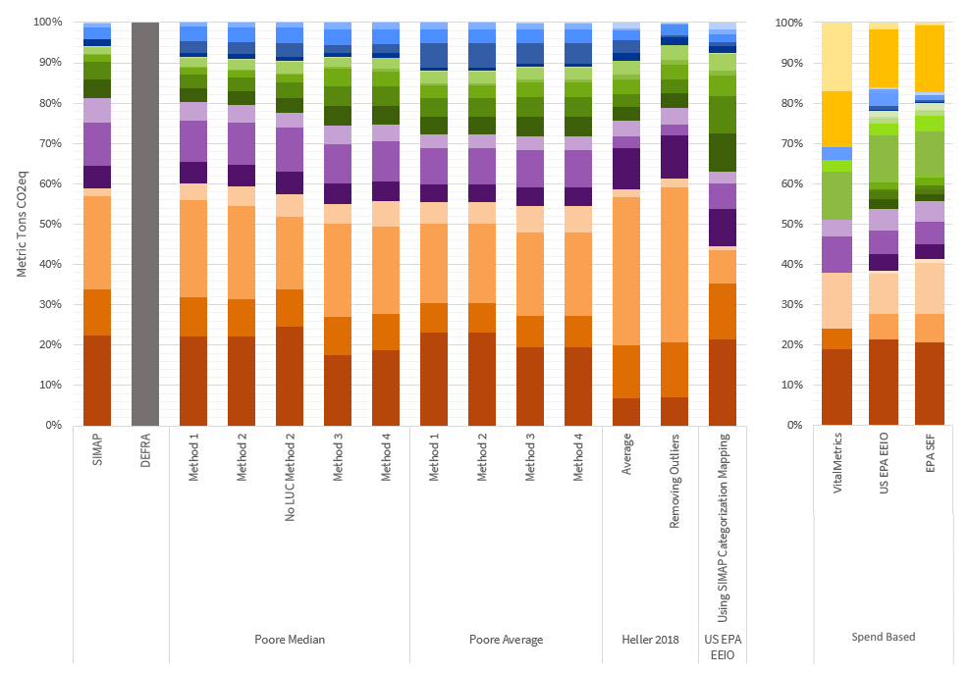
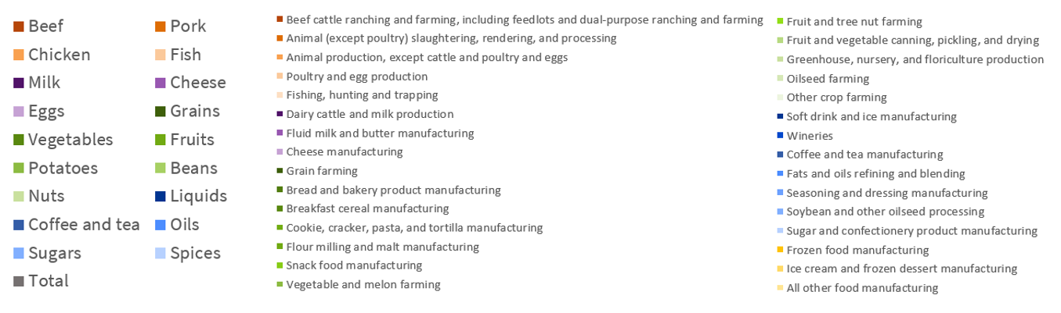

Slide 56
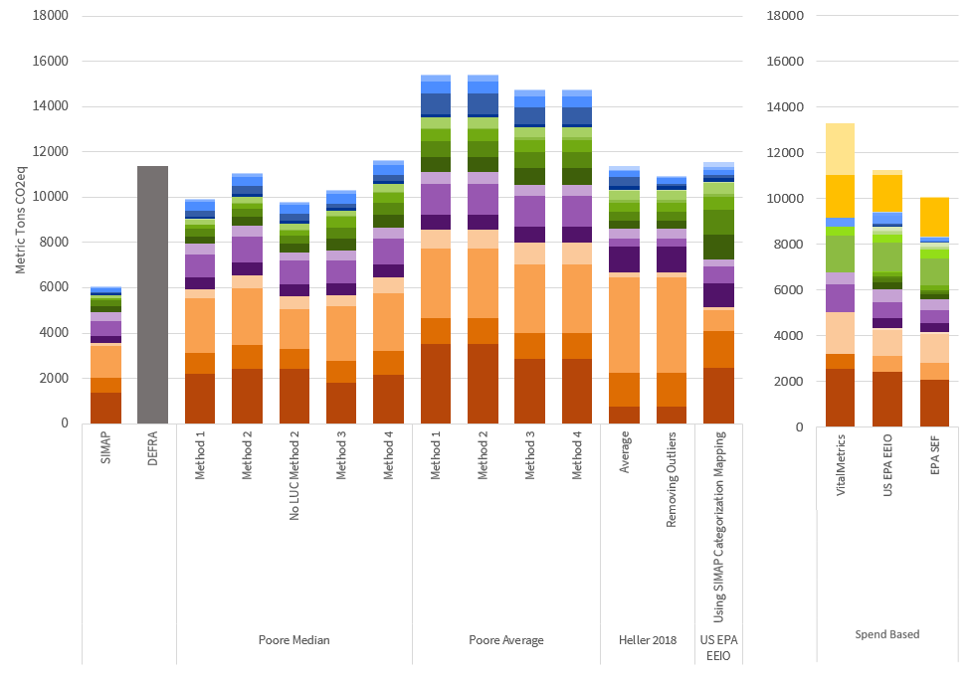

Slide 57
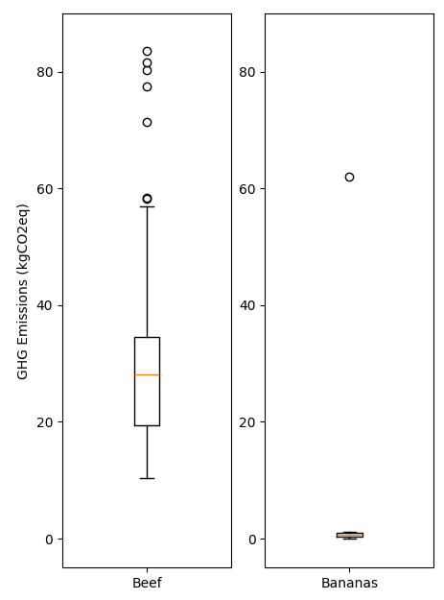
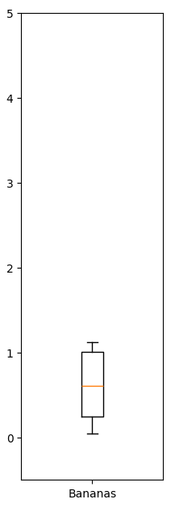
Estimated emissions within a food category can vary significantly which is why using a category average or median is important
Outlier
Minimum
Maximum
Average
Notes:
Here on the left we have a box and whisker plot for the carbon emissions per kg of beef and bananas as two examples. The circles are outliers, the bottom and top lines are the min and max and the orange bar is the average. Each of these values is based on a life cycle analysis that was conducted for a specific farming technique in a specific part of the world and has different assumptions associated with end of life, how it accounts for land use change emissions and many other things. Depending on which of these values you choose, you can get a very different answer, which is why supplier specific emissions factors can be so valuable. And although with this data set there is a different category which is bananas, it doesn’t for example have a category for kumquats. So how can you determine the emissions associated with your kumquat purchases? Well you can use an average fruit emissions factor which takes into account many different types of fruit and assume that the kumquat won’t be that different from the average fruit.

Slide 58
This is the information I submitted for the session – do these slides match this?
Field reports provide a great way to spotlight innovative and high-impact approaches for advancing sustainability based on the real-world experiences of higher education sustainability leaders.
45 minutes
Currently, estimating purchased food emissions requires time intensive methods and cost prohibitive software which are limited to estimating emissions based on spend. To improve this process, The Automated Scope 3 tool for Tracking Emissions from Food (TASTE Food) was developed. This free tool uses a python-based script to categorize food purchases into 18 categories frequently used to analyze food emissions and is available to use online. In this session, we will discuss an overview of the tool and how it works, what scenarios it can be used in, including both spend-based and weight-based analyses, discuss frequently asked questions, and do a live demonstration of the tool. By using TASTE Food, institutions can quickly categorize food purchases, facilitating the process, and guaranteeing that the calculated emissions are determined consistently and can be compared from one institution to another. In this way, many of the barriers to quantifying, and subsequently mitigating, emissions from purchased foods can be eliminated. Previously, institutions that analyzed purchased food emissions underwent the slow and error-prone process of hand categorization. Due to the large amount of effort required by hand categorization, many institutions have been unable to prioritize quantifying and mitigating these emissions. Even for those institutions that have conducted hand categorizations, differences in how institutions categorize the same type of item, as well as high rates of human error, make it difficult to compare results between institutions. TASTE Food was validated using hand categorized data sets from 8 universities, and it was found that the tool-categorized data estimated no more than 5% difference in emissions as compared to the hand categorized emissions and the data analysis at maximum took 10 minutes. TASTE Food has now officially been recommended for use by SIMAP, the University of New Hampshire tool often used by universities to disclose Scope 1, 2, and some components of Scope 3 emissions. TASTE Food has also been used by several universities associated with the Menus of Change University Research Collaborative and in total has now been used by more than 40 universities worldwide.
Many universities who are part of the AASHE community can directly benefit from the knowledge and use of this tool to quantify the emissions from purchased foods quickly and effectively. I plan to conduct a live demo and go over frequently asked questions such that attendees will be able to walk away ready to use the tool. The output of the tool is in the same format as SIMAP requires, which is particularly helpful because many AASHE community institutions use SIMAP to disclose or calculate their emissions. If possible, it would be wonderful to ask attendees to come to the session with a data set they want to analyze, and I can be ready to help after the session or use one of these as the live demo

Slide 59
I can add info about the validation and more about how it works – should I?
This work describes the development and validation of an automated Python-based categorization tool, called TASTE Food, for food purchases which has allowed for a new data set which represents 107,000+ unique items, 18,000+ metric tons of food purchasing data, and $124.7+ million in spending. Validation of the tool was conducted by comparing the tool-categorized data to samples of hand-categorized data provided through a partnership with SIMAP. TASTE Food is available online for free use by anyone. Analyses and work presented here were conducted as part of a Stanford University Master’s thesis in the Energy Science and Engineering Department published in 2022.

Slide 60
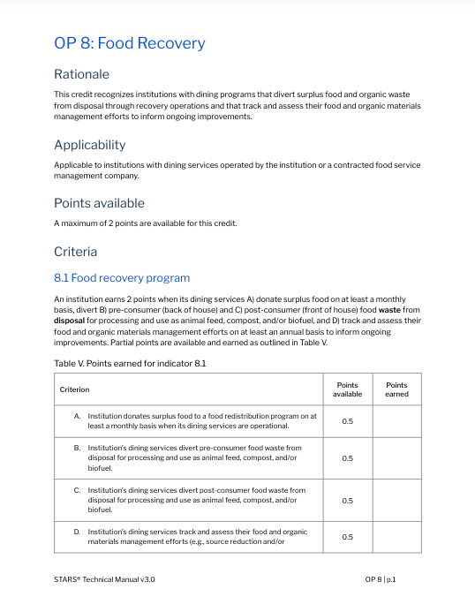
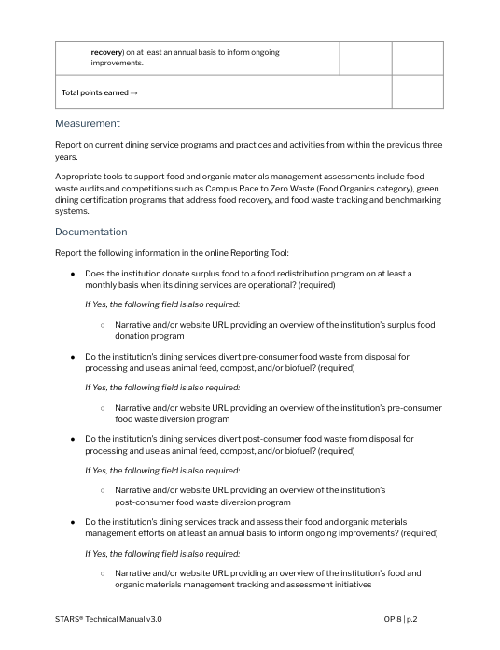

Credits and Indicators

Slide 61
Food & Dining Credits
OP 7: Dining Service Procurement 8 points
7.1 Percentage of food and beverage spend that meets sustainability criteria
7.2 Percentage of dining service spend with social impact suppliers
OP 8: Food Recovery 2 points
8.1 Food recovery program

Slide 62
OP 7: Dining Service Procurement
7.1 Percentage of food and beverage spend that meets sustainability criteria
A. % of spend on products that are sustainably or ethically produced | + | B. % of spend on plant-based foods

Slide 63
OP 7: Dining Service Procurement
7.1 Percentage of food and beverage spend that meets sustainability criteria
Products that are sustainably or ethically produced
Certified products (e.g. Organic, Fairtrade, Rainforest Alliance); aligned with Anchors in Action (HCWH, GFPP, Real Food)
Seafood Watch recommendations
Products from small-scale farms that use sustainable methods

Slide 64
OP 7: Dining Service Procurement
7.1 Percentage of food and beverage spend that meets sustainability criteria
Plant-based foods
Produce, nuts/seeds, herbs/spices, whole grains, coffee and tea
Processed foods that are predominantly derived from plants and/or fungi and contain no ingredients derived from animals
Dairy alternatives

Slide 65
Innovation & Leadership
Bonus Credits
IL 34: Coolfood Pledge
IL 35: Nitrogen Footprint
IL 36: Red Listed Foods
IL 37: Sustainable Dining Recognition

Slide 66
Resources on stars.aashe.org
Credit language
Qualifying food/beverage certifications (spreadsheet)
Food and beverage spend template (spreadsheet)
Help Center

Slide 67
