Slide 1

Rural Resiliency Assessments and Unnatural Disasters
Benjamin Newton
Environmental Sustainability Director

Slide 2

Central Community College
BOONE
VALLEY
GREELEY
PLATTE
COLFAX
NANCE
SHERMAN
HOWARD
POLK
BUTLER
MERRICK
DAWSON
BUFFALO
HALL
HAMILTON
GOSPER
PHELPS
ADAMS
CLAY
KEARNEY
FURNAS
HARLAN
FRANKLIN
WEBSTER
NUCKOLLS

Slide 3
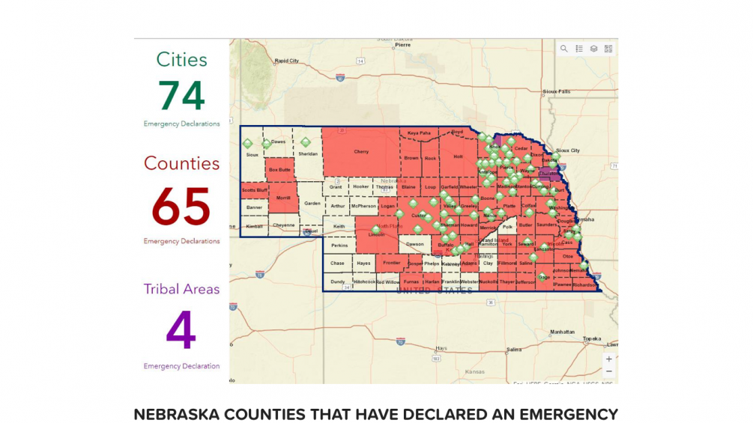
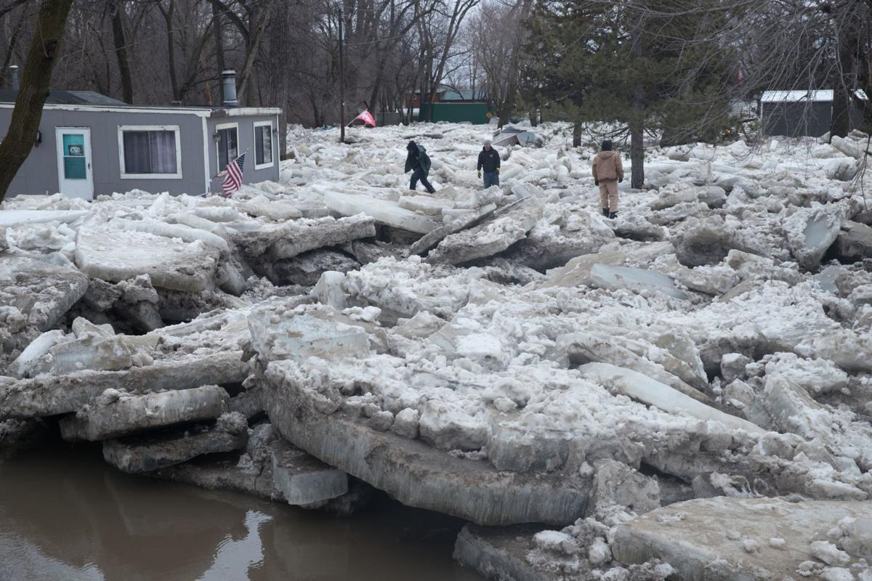
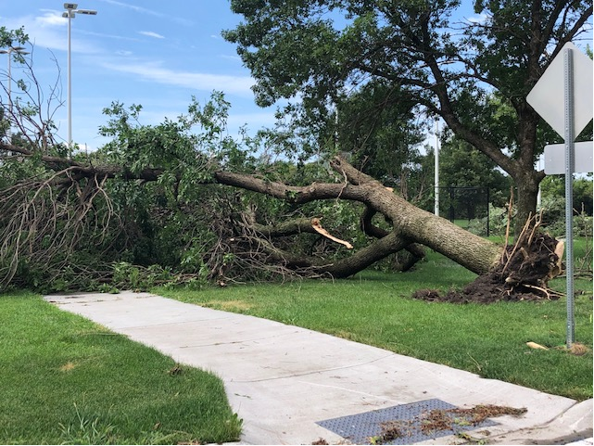
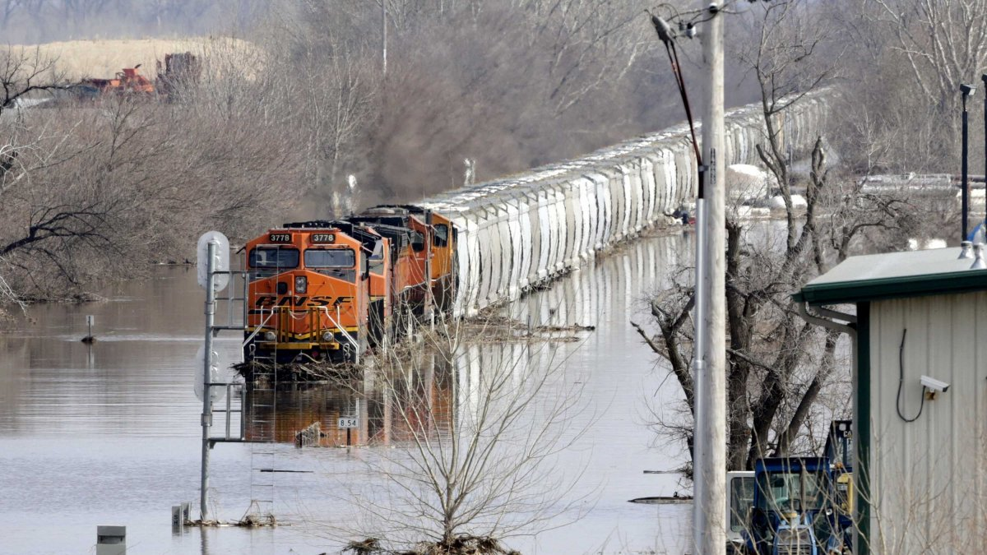

Slide 4

How We Got Started
College president signed ACUPCC in 2011 with Second Nature
Sustainability office created in 2012
Climate Commitment signed 2014 with Second Nature
Combination of carbon and resilience commitment
Sustainability & Climate Action Plan created in 2015, revised in 2019

Slide 5
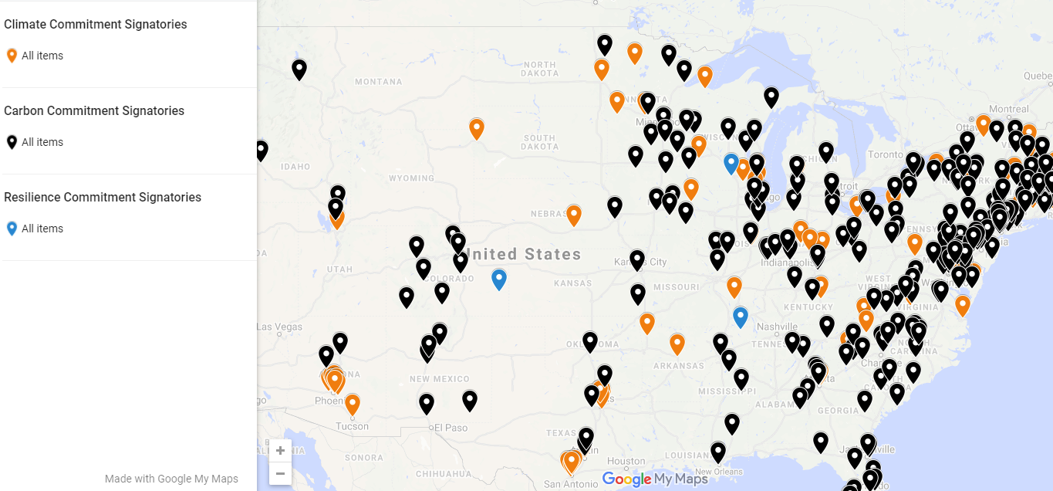
Climate Commitment- Carbon and Resiliency

Slide 6
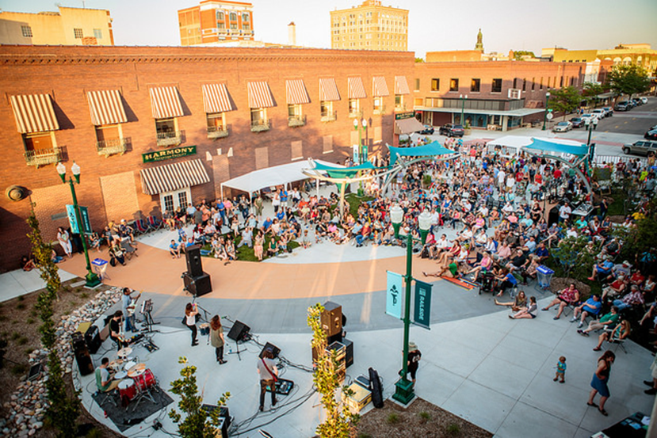
Resiliency Committee Invite
December 2017 invites to 3 campus communities and Kearney Center:
Emergency Management office
City Planners
Health Department
UNL Extension office
Parks and Recreation Director
Renewable Energy Company
Economic Development office
Utilities office
Involved with previous city-wide committees- transportation planning
Personnel invite in advance
ClimateNexus.org affects in Nebraska
Proactive in protecting resources and reduce risk in our communities
Photo by Lauren Farris

Slide 7
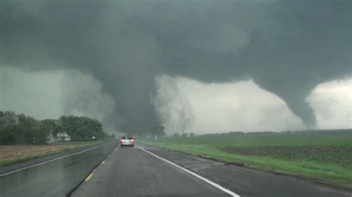
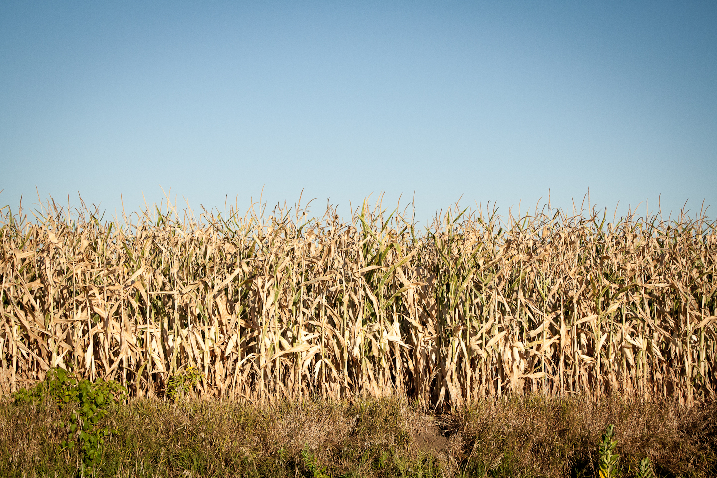
Campus/Community Resiliency Assessment
Sent out assessment in advance
Nature Conservancy
Community Resilience Building tool
Top strengths (total of 10)
Agricultural aquifers/food
Low Unemployment
Infrastructure (roads, electrical grid)
Educational opportunities
Hazard mitigation warning systems
Climate change vulnerabilities
Severe storms
Extreme temperatures
Drought
Water Insecurity
Invasive Species

Slide 8

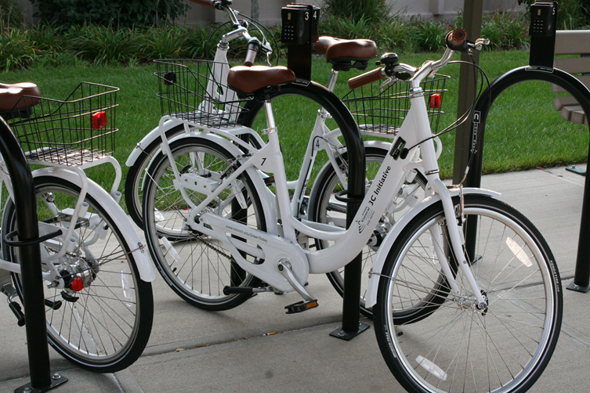
Initial Resilience Indicators
1. Social equity and governance
Vulnerable populations
Income Disparity
Climate Change Education
2. Health and Wellness
Nutritional Education
Access to Affordable Health Care
Mental Health
3. Ecosystem Services
Access to outdoor recreation
Biodiversity loss/conservation
Water quality/pesticides
4. Infrastructure
Access to Multi-modal transportation
Communication/emergency planning
Energy efficiency
5. Economic
Tax incentives
Renewable energy
Financial self-sufficiency

Slide 9
Rural Campus/Community Resilience Assessment
Existing committees and partnerships
Climate and severe weather connected to agriculture and tourism
Low numbers of staff in Planning and Emergency Management
Make majority of the decisions
Strong sense of community
Open space for large scale renewable energy projects
Lack of public transportation
Focus on education and awareness of health/social justice
Strong Partnerships
Resiliency is unique to your community and partnerships

Slide 10
Central Community College Resiliency Committee
Grand Island/Hastings
Benjamin Newton, Environmental Sustainability Director
Jon Rosenlund, Hall County Emergency Management Director
Jaime Parr, Nebraska State Fair Facility Director
Jeff Berggren, GenPro Energy Nebraska Program Manager
Allen Zafft, Metropolitan Planning Organization Program Manager
Jennifer Hubl, Central District Health Department Accreditation Coordinator
Teresa West, CCC Health and Wellness Committee
Todd McCoy, Grand Island Parks and Recreation Director
Liang O’Brien, Environmental Sustainability Admin. Assistant
Kearney
Olivia Whittaker, Environmental Sustainability Manager
Ashley Weets, Director of Student Services and Enrollment
Laura Steele, Assistant Director, Two Rivers Health Department
Katherine Mulligan, Health Educator, Two Rivers Health Department
Nathan Eidem, Geography Lecturer, University of Nebraska at Kearney
Lee McQueen, Director of Facilities Management and Planning, UNK

Slide 11
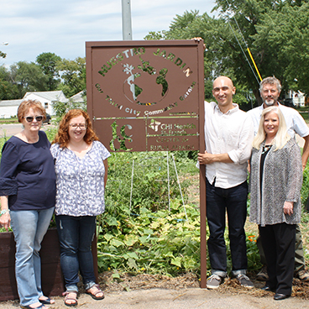
Initial Opportunities and Key Outcomes
Emergency Preparedness and Storm spotter training workshop
Promoting, improving, and expanding access to trail systems
Intracity Bus Route
Community gardens
Communication to diverse populations
Networking

Slide 13
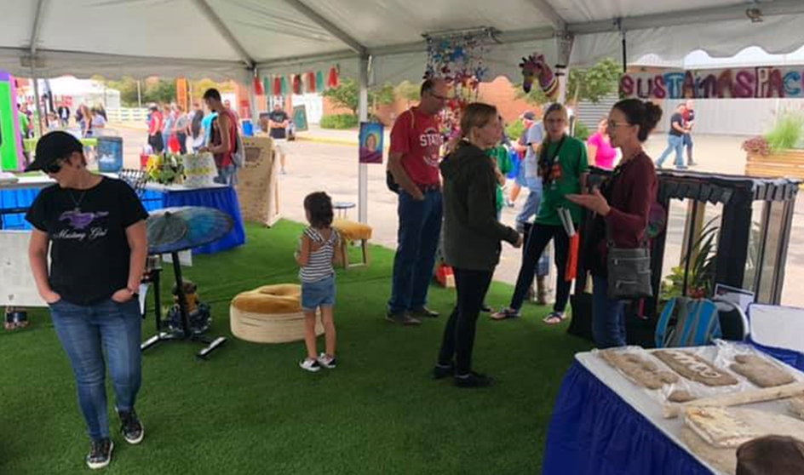
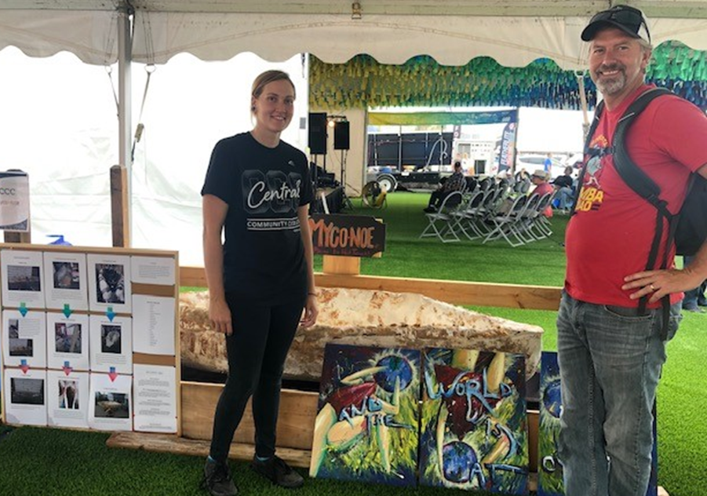
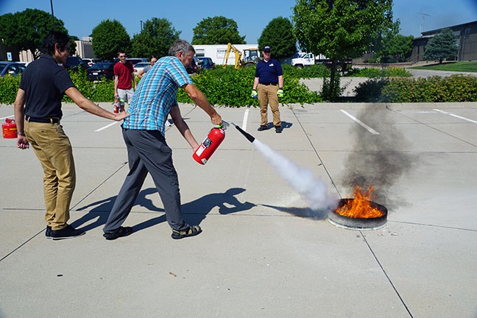
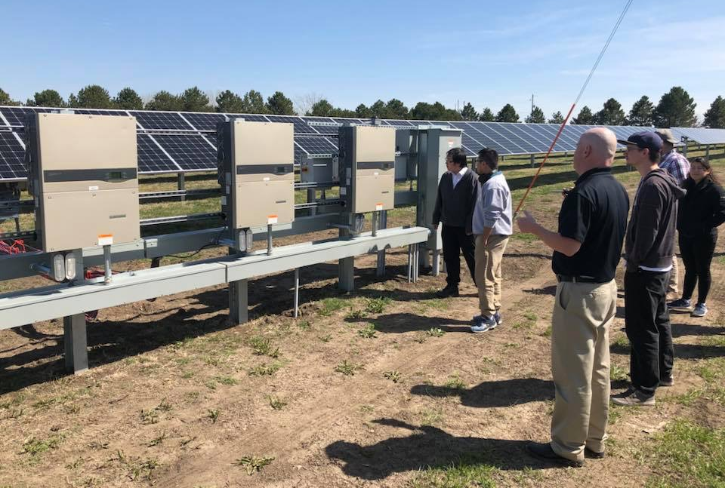

Slide 14
Questions?
Ben Newton
Environmental Sustainability Director
benjaminnewton@cccneb.edu

