Slide 1
Second Nature’s Resilience Commitment
Tim Carter, President
tcarter@secondnature.org

Slide 2
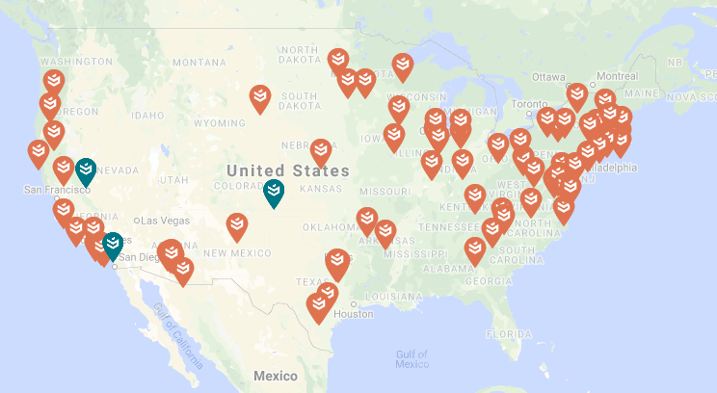
Climate Resilience
“Resilience is the ability of a system or community to survive disruption and to anticipate, adapt, and flourish in the face of change.”
https://secondnature.org/climate-action-guidance/resilience-landing-page/

Slide 3
Commitment Implementation
Campus / Community Task Force
Resilience Assessment
Future Scenarios
Climate Impacts & Vulnerability Assessment
Climate Action Plan
Solutions & Prioritization

Slide 4
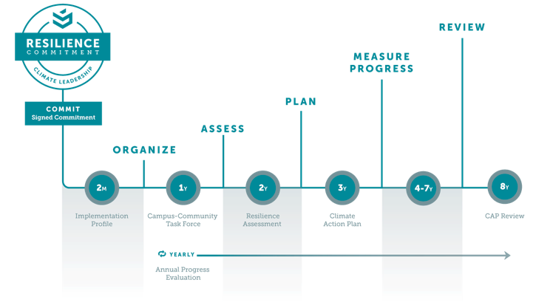
Commitment Implementation

Slide 5
Campus CRB Example: Eastern Connecticut State University
Partnered with Town of Windham, CT
Participants included town Fire Department, town Energy Commission, campus Office of the President, campus Facilities, students & faculty representatives
https://secondnature.org/climate-action-guidance/resilience-landing-page/

Slide 6
Campus Workshop Example: CalState Long Beach
Facilitators attended a “Train the Facilitators” workshop
Emerging priority areas: 1) Increase community activism and organization, 2) Upgrade and retrofit the electrical grid, 3) Increase tree cover and green space, 4) Active and electrified transportation
https://secondnature.org/climate-action-guidance/resilience-landing-page/

Slide 7
Campus Workshop Example: American University
Hired a consultant to facilitate workshop
Attended a ”Train the Facilitators” workshop in partnership with other DC area campuses & city
Identified indicators and metrics for resilience to inform Resilience Assessment, Actions to build Resilience
https://reporting.secondnature.org/home/

