Slide 1

Partners in Social & Economic Community Resilience
An Adaptation Primer
Beth Gibbons, Executive Director
www.adaptationprofessionals.org

Slide 2
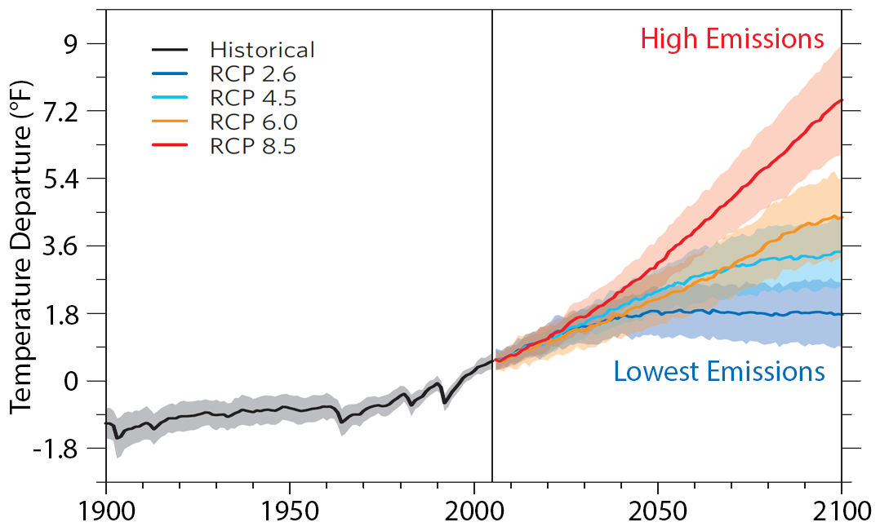
What is Climate Change Adaptation & Resilience?
Community Resilience
Adaptation
Mitigation
Social Equity
www.adaptationprofessionals.org

Slide 3
Who is involved?
Severe weather events increasing
  14, Billion Dollar Events in 2019
  Hurricanes, Wildfire there, Historic Lake Levels
Improved Cost / Benefit Analysis for resilient investments
  High estimates of 11 to 1, conservative estimates at 5 to 1
  CBA tools to apply for every planning context
New & Newly Energized Risk Standards
  CDP
  Global Reporting Initiative (GRI)
  Task Force on Climate-related Financial Disclosures (TCFD)
Strong statements from the private market on risk
  Larry Fink’s January Statement
  McKinsey Climate risk and response: Physical hazards and socioeconomic impacts

Slide 4
What is ASAP’s Role?
Open Access
Freely share information and knowledge
Member Driven
Members lead by voting with their feet
ASAP Mission
Trust
Members share successes and failures
Something for Everyone
Not everything for everyone
Connect and support climate change adaptation professionals to advance innovation and excellence in the field of climate change adaptation.
Reciprocating
You give, you get, everyone benefits

Slide 5
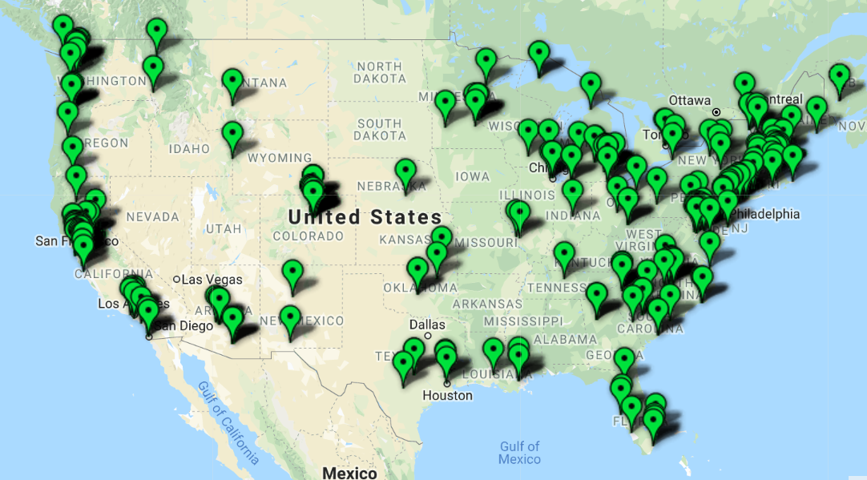
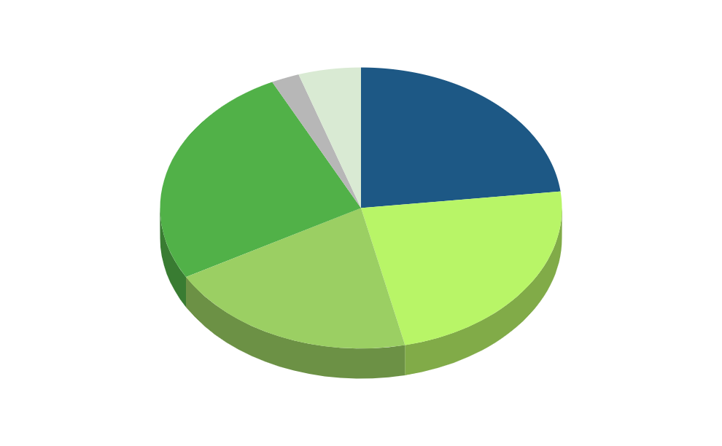
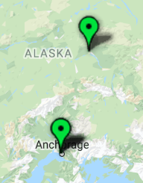





Academia
23%
Private
26%
Government
23%
Non-Profit
20%

Slide 6
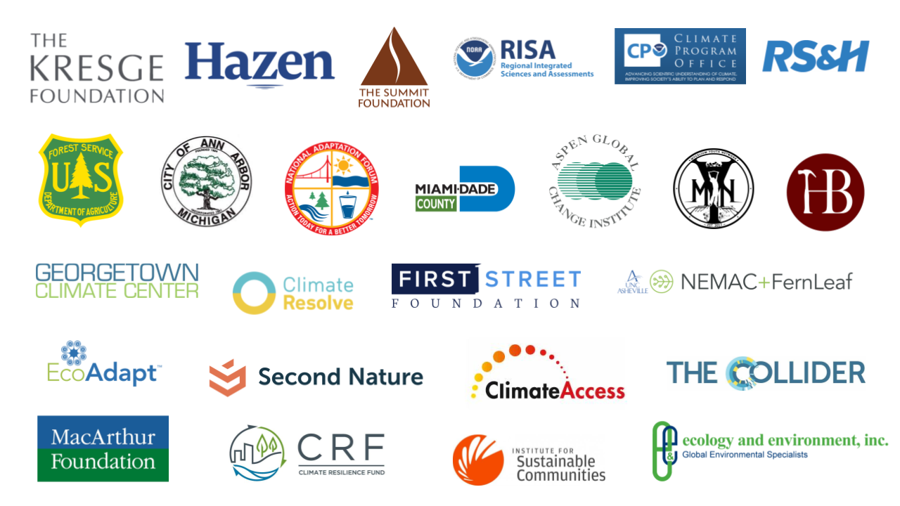



Slide 7
ASAP Programs & Services
ASAP Connects
Member Groups & Regional Hubs
Adaptation Careers
Mentorship, Professional Training, Jobs & Opportunities
Adaptation Voices
Digital Magazine, Network News, Resource Library
ASAP Applied Research Program
In-Migration & Climate Opportunities
https://adaptationprofessionals.org/what-we-do

Slide 8

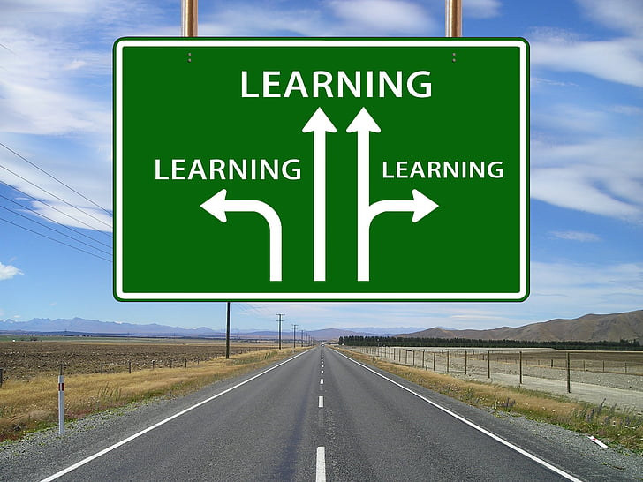
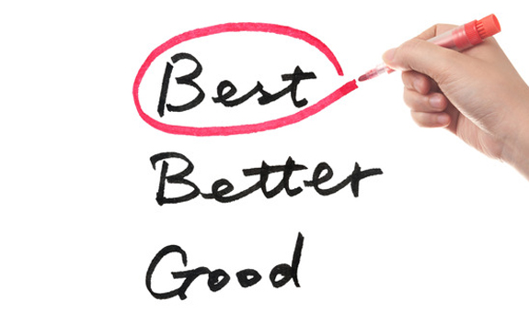
Professional Development & Education Resources
Knowledge and Competencies Framework
Code of Ethics
Living Guide
On the Principles of Climate Adaptation
https://adaptationprofessionals.org/asap-careers-2

Slide 9
Larry Fink,
Blackrock
The need is particularly urgent for cities, because the many components of municipal infrastructure - from roads to sewers to transit - have been built for tolerances and weather conditions that do not align with the new climate reality. In the short term, some of the work to mitigate climate risk could create more economic activity. Yet we are facing the ultimate long-term problem... Every government. company, and shareholder must confront climate change.
May
2020
…We will see changes in capital allocation more quickly than we see changes to the climate itself. In the near future – and sooner than most anticipate – there will be a significant reallocation of capital.

Slide 10
What Communities Need from Higher Education Institutions
Integrate facility management plans with community activities.
Set standards with future climate information built into capital improvement projects and share this information with the community.
Align the institution with resilience and climate action standards and plans coming from the community.
Work with community-based resilience and emergency management teams to understand the role your institution can play to assist the community.
Model holistic, systems thinking:
  Integrate facilities and operations and academic programs, host interdisciplinary applied research teams on campus projects, engage students on the academic pursuit and on/in the ground meaning of resilience.

Slide 11
Individual Memberships begin at $150
Customized Sponsorships & Organizational Packages beginning at $1,500
Join Us
When you become a member of ASAP, you get access to our resources as well as our network of professionals who are tackling climate change challenges every day, just like you.
www.adaptationprofessionals.org/join-us
www.adaptationprofessionals.org/join-us

