Slide 1
Welcome to AASHE webinar:
Doing Good While Doing Your Job – Moving Toward a Circular Economy (during this time of Coronavirus)

Slide 2
About AASHE
Mission: To inspire and catalyze higher education to lead the global sustainability transformation
An international association of colleges & universities working to create a sustainable future. About 1000 members.
Professional home for campus sustainability staff.
  But we offer resources for everyone in higher education: faculty, students, staff, administrators, and businesses and nonprofits that collaborate with campuses

Slide 3
AASHE Resources
STARS (Sustainability Tracking, Assessment & Rating System): https://stars.aashe.org/
AASHE newsletters: http://www.aashe.org/connect/
Campus Sustainability Hub: http://hub.aashe.org
Professional Development opportunities: http://www.aashe.org/events-education/
Virtual Conference: http://www.aashe.org/conference
October 20-22, 2020

Slide 4
Housekeeping
All attendees are in listen only mode
Type your questions or comments into the GoToWebinar questions pane
Please fill-out post-webinar survey
The webinar slides & recording will be available in the Campus Sustainability Hub

Slide 5













HEASC

Slide 6
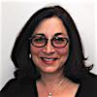


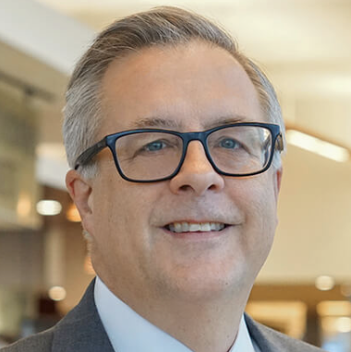

Today’s Presenters
Debra Rowe, Co-Founder, Higher Education Associations Sustainability Consortium (HEASC)
Reniera O’Donnell, Higher Education Lead, Ellen MacArthur Foundation
Ilma Stankeviciute, Learning Designer, Ellen MacArthur Foundation
Van Sullivan, Executive Director, Stony Brook University
Johanna Anderson, Member Success Manager, Sustainable Purchasing Leadership Council

Slide 7
HEASC
A network of higher education associations with a commitment to advancing sustainability both within their constituencies and the system of higher education.
Each member association has sustainability resources:
American Association of State Colleges & Universities (AASCU)
Association of Higher Education Facilities Officers (APPA)
Association for the Advancement of Sustainability in Higher Education (AASHE)
Association of College and University Housing Officers – International (ACUHO-I)
Campus Safety, Health, and Environmental Management Association (CSHEMA)
ACPA – College Student Educators International
International Institute for Sustainable Laboratories (I²SL)
National Association of College Auxiliary Services (NACAS)
National Association of College & University Business Officers (NACUBO)
National Association of Educational Procurement (NAEP)
National Council for Workforce Education (NCWE)
NIRSA: Leaders in Collegiate Recreation
Society for College and University Planning (SCUP)

Slide 8
HEASC resources
https://www.aashe.org/partners/heasc/
Sustainability Primer for Presidents, Trustees, and Staff
Beyond Doom and Gloom: Climate Solutions’ Policy Partner Network
Sustainability in Job Descriptions and Performance Appraisals
Setting the bar and providing resources for you and your presidents/provosts, facility directors, business officers, recreation, EH&S, planners, housing, student life, procurement, workforce education
Be a Fellow!

Slide 9
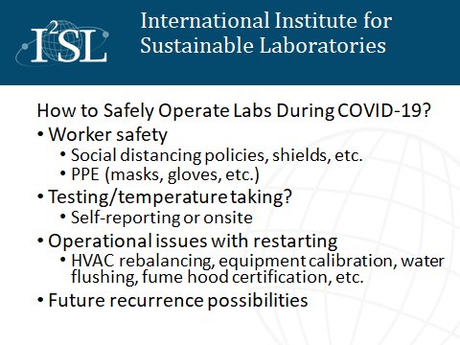

Slide 10
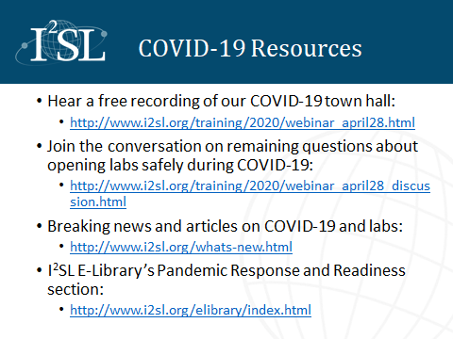

Slide 11
Questions?
Debra Rowe, Co-Founder,
Higher Education Associations Sustainability Consortium (HEASC)
Reniera O’Donnell, Higher Education Lead,
Ellen MacArthur Foundation
Ilma Stankeviciute, Learning Designer,
Ellen MacArthur Foundation
Van Sullivan, Executive Director,
Stony Brook University
Johanna Anderson, Member Success Manager,
Sustainable Purchasing Leadership Council
education@aashe.org

Slide 12
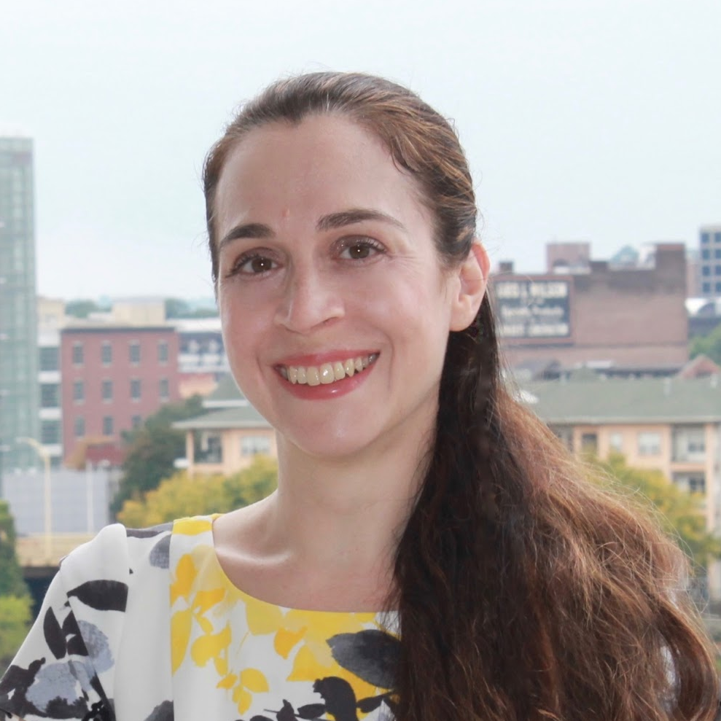
Thank You!
Daita Serghi
Education Programs Manager
education@aashe.org
daita.serghi@aashe.org

