Slide 1


Miranda Gorman, PhD
Senior Fellow, Industry
Climate Friendly Cooling Pledge and New Regulations Affecting Universities: Opportunities and Implications

Slide 2
Notes:
Want to tell you about Drawdown – based on the concept of Drawdown, which is the point in time in which we actually start to remove CO2 from the atmosphere -
The major problem we’re facing is that GHG concentrations are growing exponentially due to anthropogenic activities, so what we try to do is identify solutions that can contribute to not only preventing further growth, but also actually drawing down carbon, ultimately tied to "de-carbonization"

Slide 3
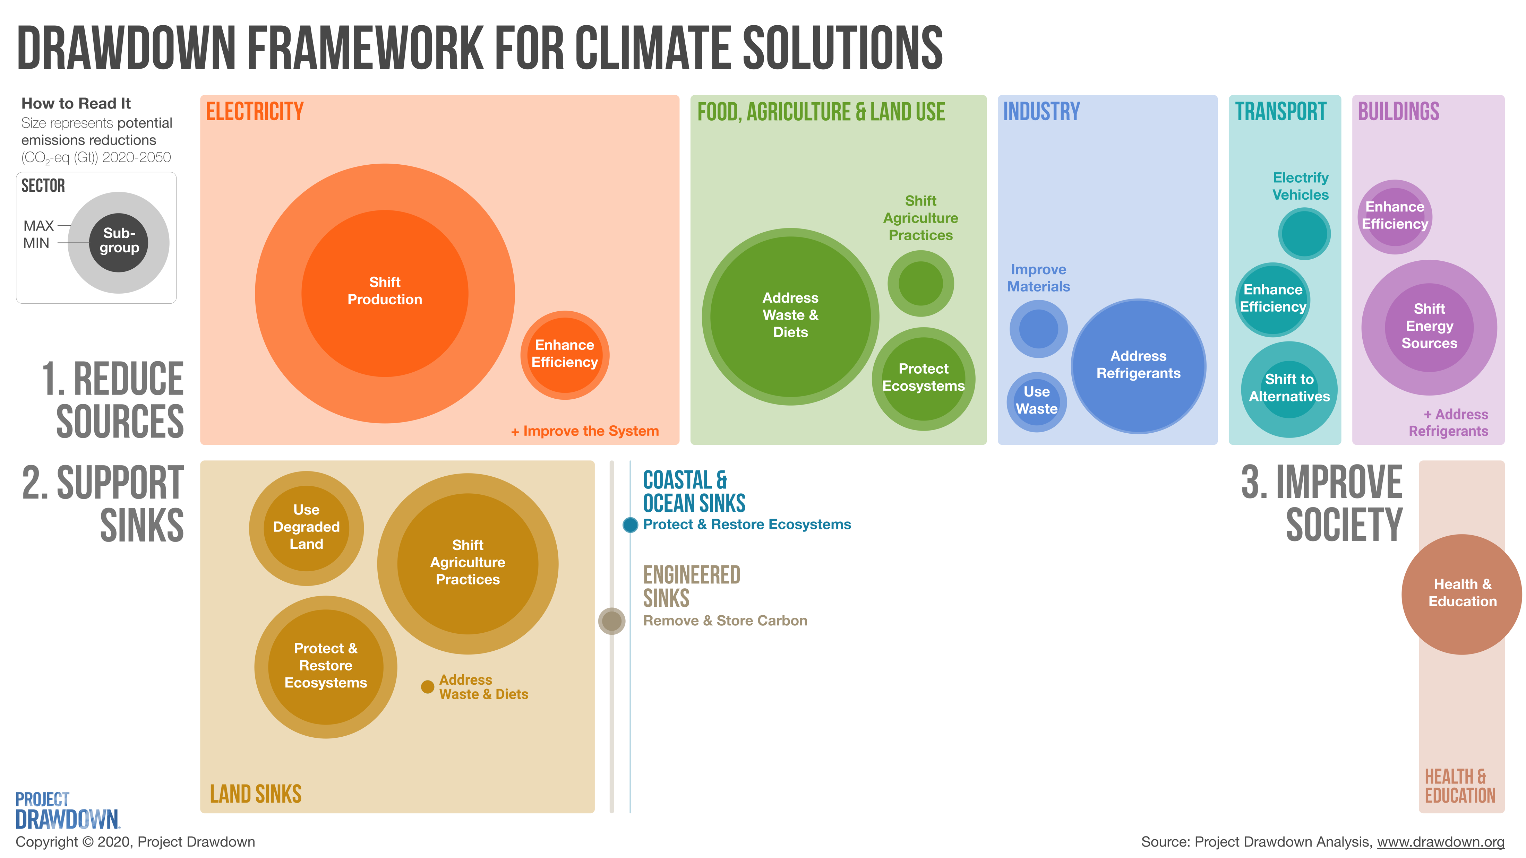
Notes:
We think about three aspects of GHGs- sources, sinks, and society, and their impact on global warming.
Most industrial activities fall into ”sources”: buildings, industry, impacts reaching to transport and even FALU due to the “address waste” goals.
What you’ll see throughout this presentation are the potential impacts of global adoption at 2 levels of aggression of solutions that Trane is already starting to adopt – imagine the potential given the path that is being paved

Slide 4
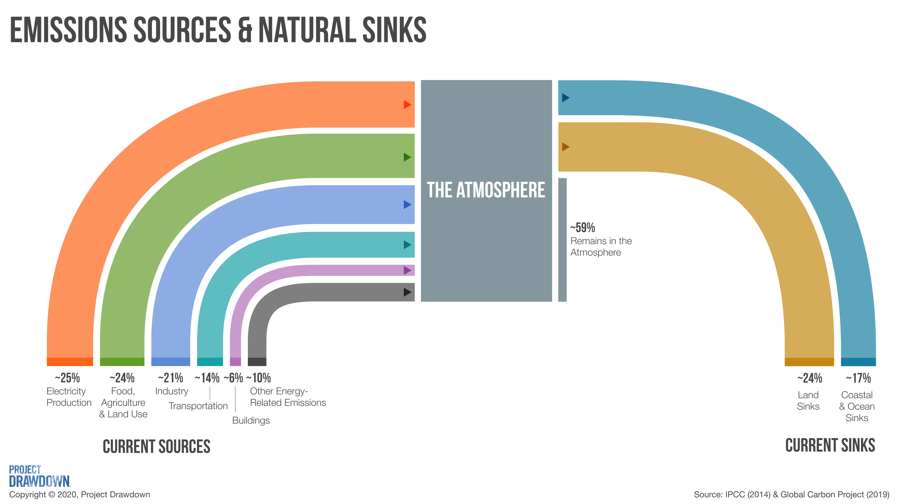
Notes:
We think about systems broadly – this is an overview of how all the identified sources and sinks interact with our atmosphere globally
We try not to demonize carbon, but identify solutions that contribute to the reduction of atmospheric GHGs by reducing sources and supporting sinks .

Slide 5
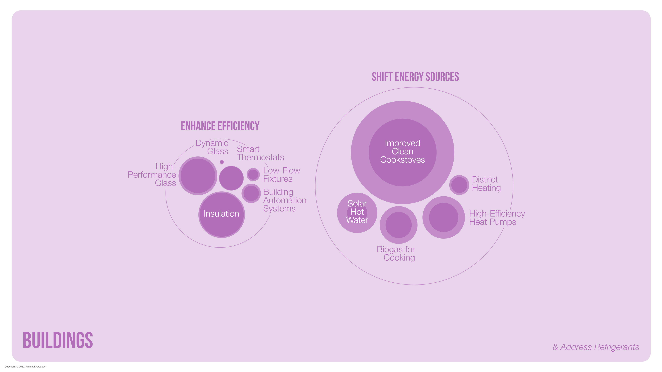
Notes:
In the building sector, we’ve identified 10 solutions that fall into to broader categories – enhancing efficiency and shifting energy sources
Where enhancing efficiency directly contributes to reducing climate change solutions, the shift in energy sources integrate with our electricity production solutions –
these are solutions in which we can see higher electrification or a transition to greener fuels
What youre seeing here are scaled representations of potential GHG emission reduction potential of various solutions a “plausible” solution and a “drawdown” solutions – we identify varying levels of adoption of these solutions from current year to base year to develop ranges.
We can take a closer look at the way to shift energy sources

Slide 6
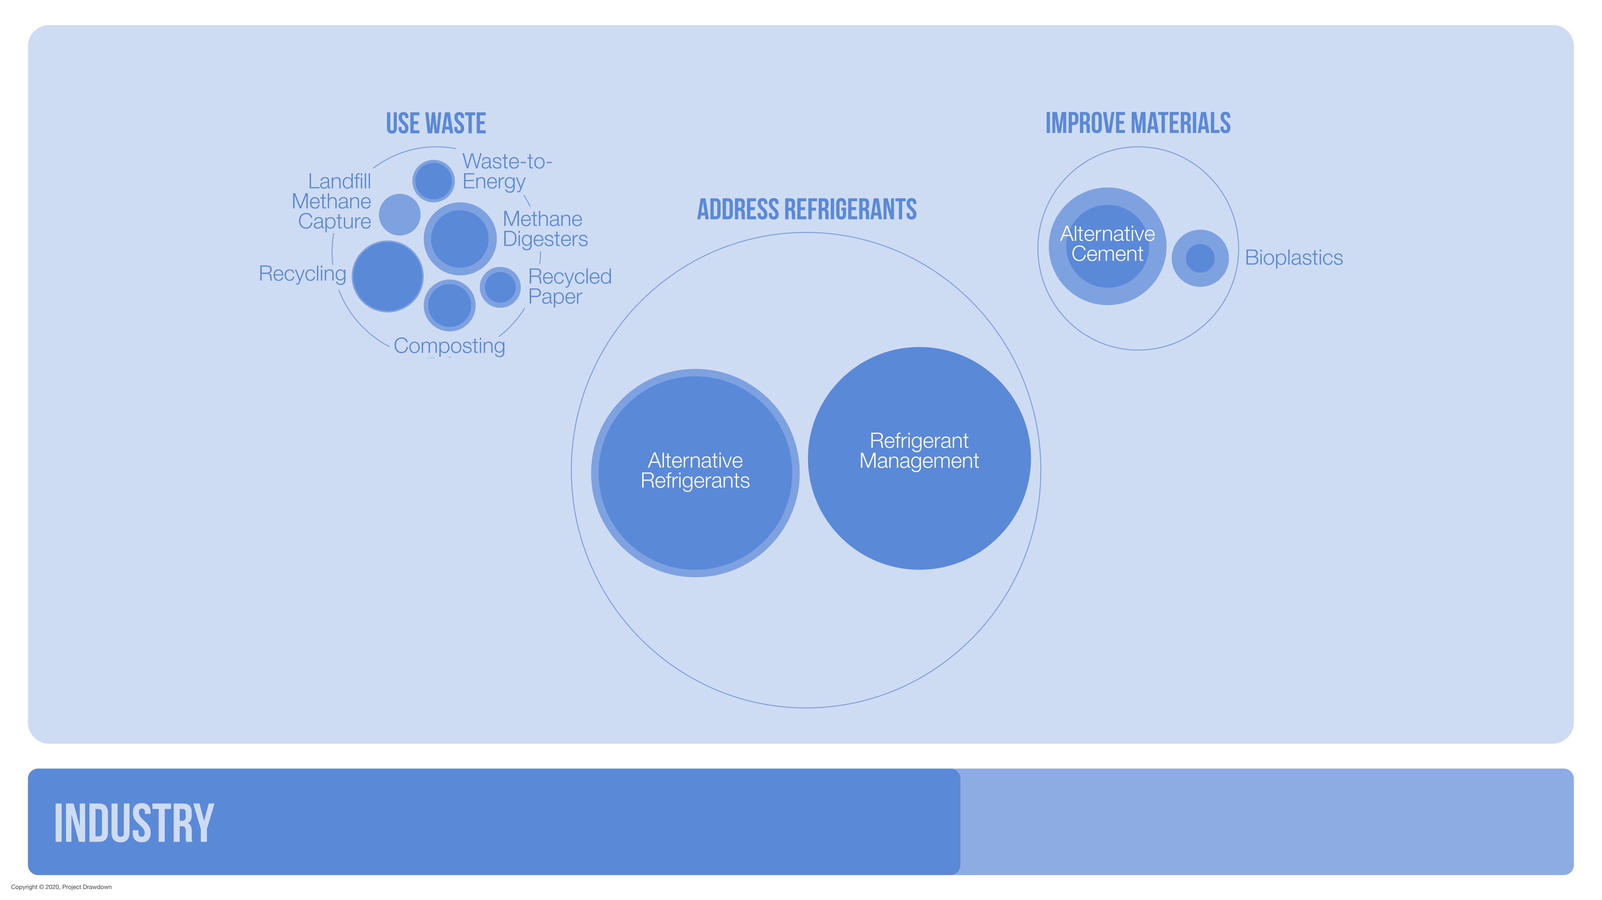
Notes:
Talk about industry – three major activities, lets focus on refrigerants

Slide 7
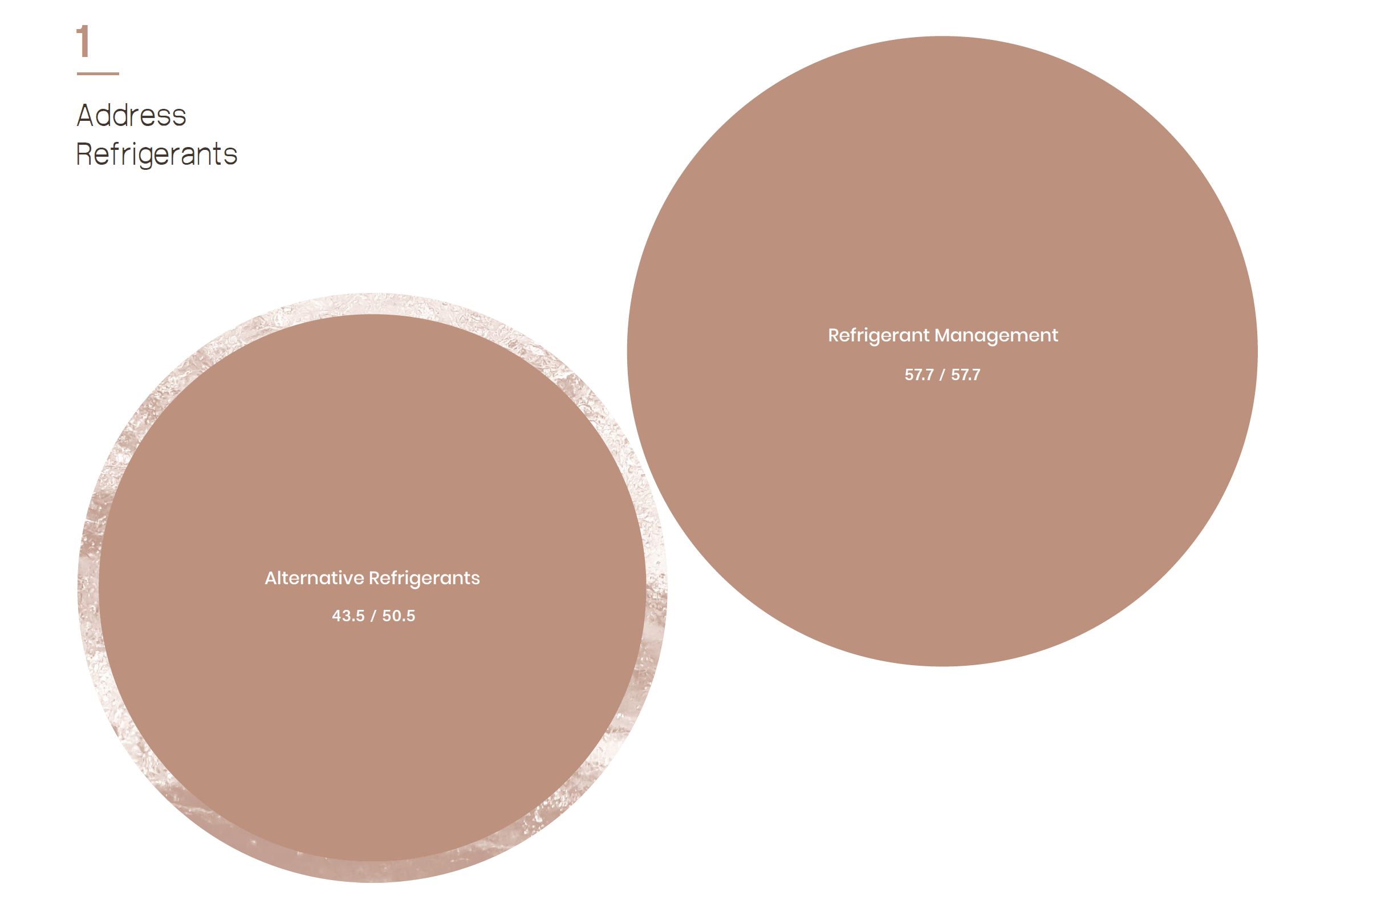
Notes:
We have 2 refrigerant solutions (used to just be 1) which includes switching to lower GWP refrigerants as well as responsible management of refrigerants
These combined are our largest solution, but even individually, Ref. Managmenet is a major player ~58 Gt, because of the huge GWP of refrigerants.
Refrigerants are a major player, also, in the supply chain for food and agriculture, so again, there’s an integration with another sector. – Food and Land use

Slide 8
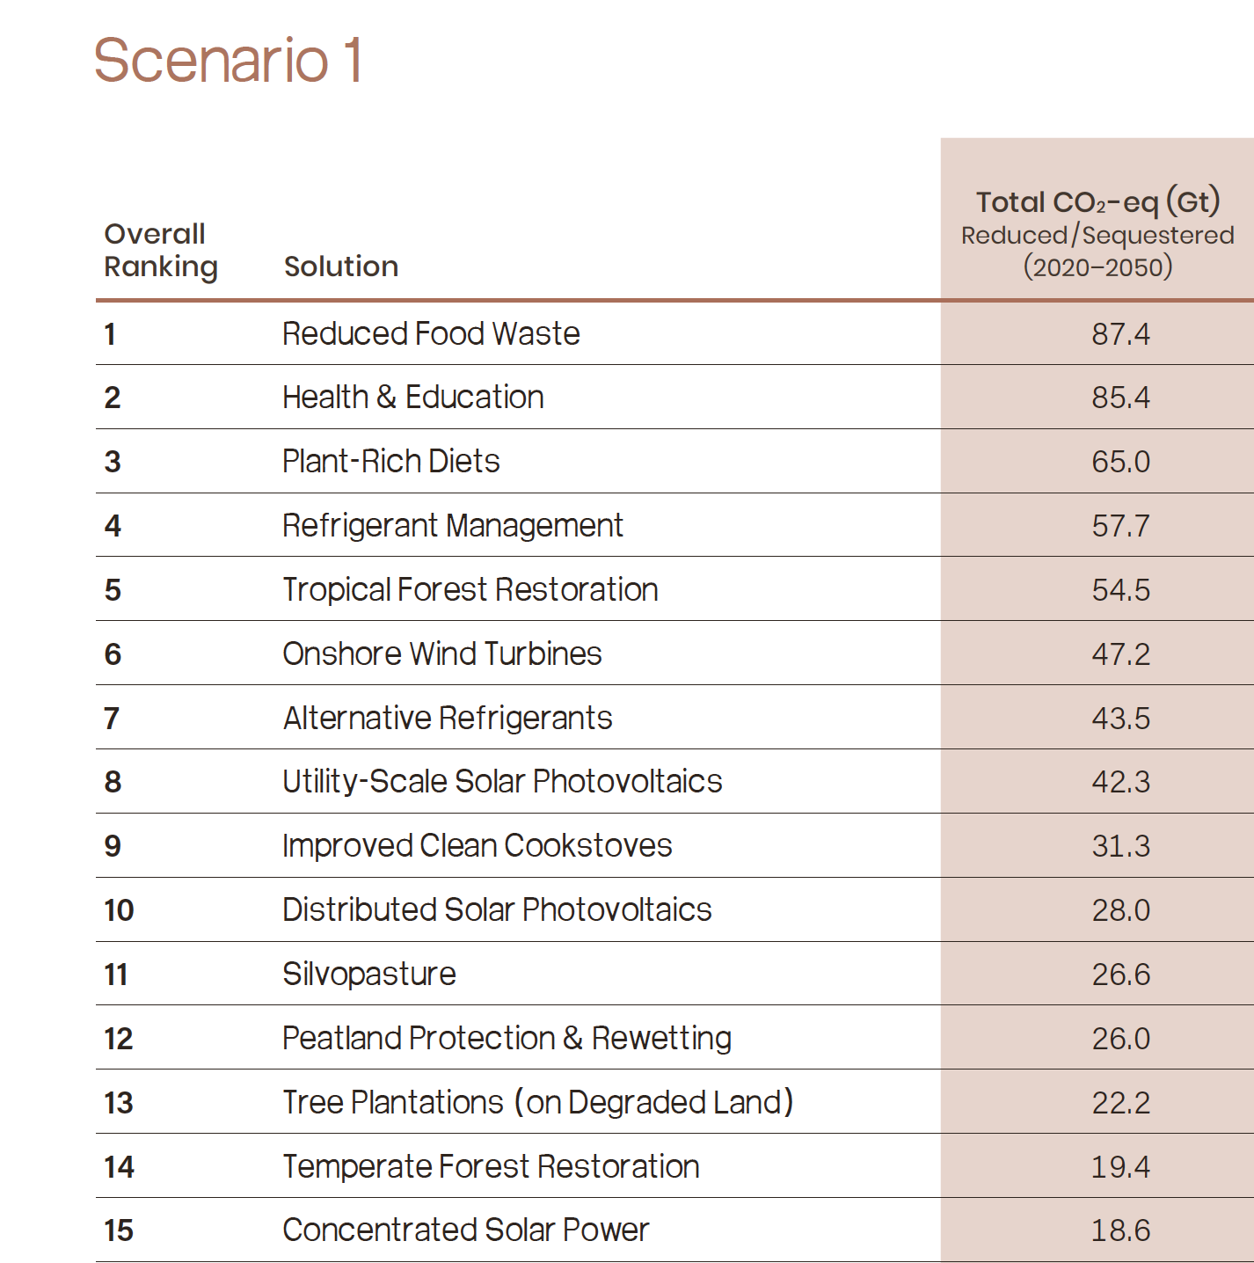

Slide 9
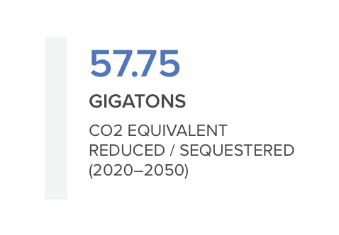
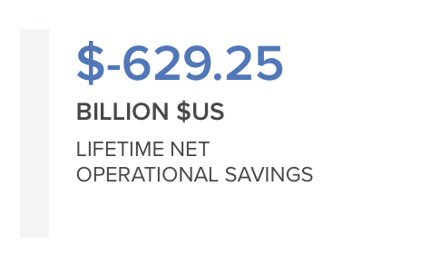
Refrigerant Management
Managing leaks and disposal can avoid emissions in buildings and landfills
HFCs have GWP >1000x CO2
End of life destruction
79% of releases can be contained
Revenue from resale of recovered gasses
  Refrigerants can be transformed into other chemicals
Net cost for recovery, destruction, leak avoidance

Slide 10
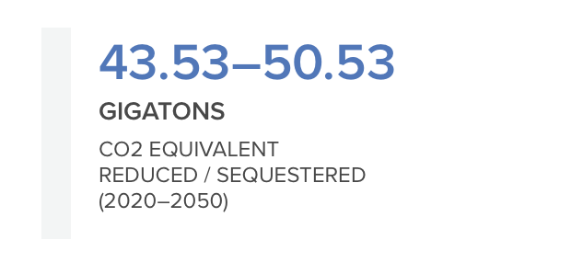
Alternative Refrigerants
Alternatives: ammonia, captured CO2, propane can replace HFCs and fluorinated gasses
Kigali accord (2016): replacement of HFCs with a mix of alternatives
  Still need refrigerant management because 90% of emissions happen at end of life
Replacement of between 67-82% of HFCs by 2050

Slide 11
Thank you!
miranda.gorman@drawdown.org
Notes:
Jon foley available on the website

