Slide 1



The Intersection of Safety and Sustainability
Star Scott, June 24th, 2020

Slide 2
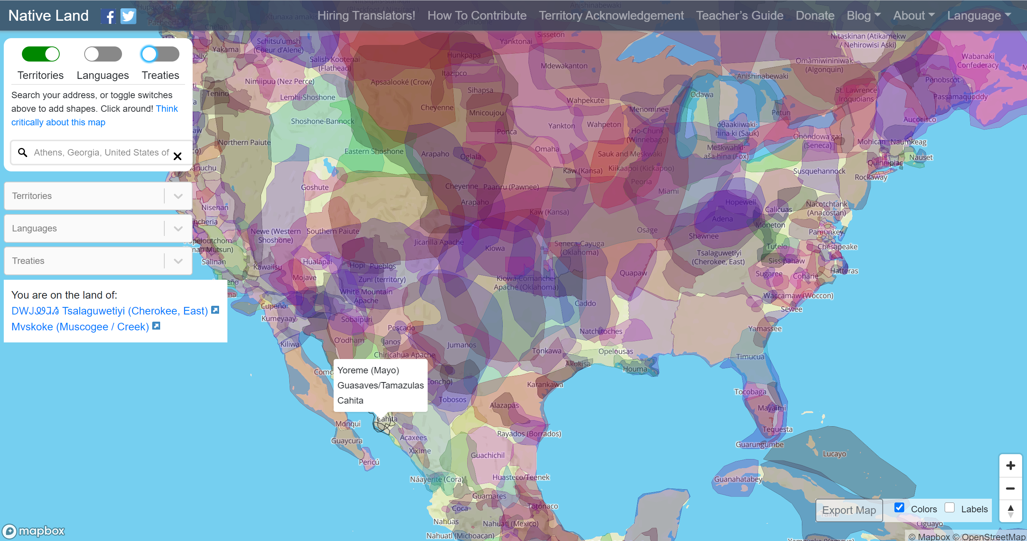
Land Acknowledgement
https://native-land.ca/

Slide 3
Learning Objectives
Gain a deeper understanding of the psychologies, semantics and accompanying narratives of safety and sustainability, and how these ideas drive perceptions and attitudes
Gain a better understanding of the relationship *between* safety and sustainability and how they fit together
Learn how to use gained insight to their advantage in communicating with their customers and stakeholders to strengthen both safety and sustainability initiatives
Be able to describe functional and dysfunctional interactions between EH&S and Sustainability groups with the purpose of developing better relationships with one another
Gain a deeper understanding of how Social Justice falls within the purview of both safety and sustainability

Slide 4
Question 1—New webinar, who dis?

Slide 5
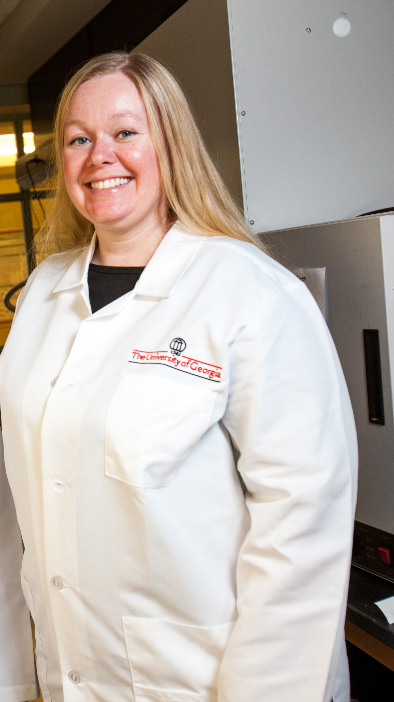
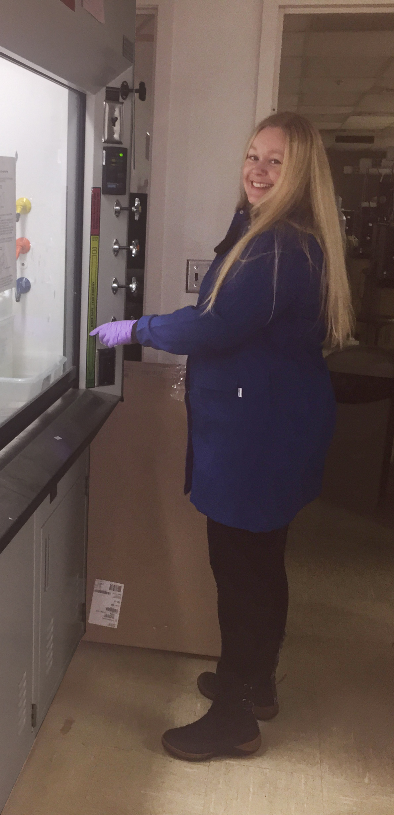



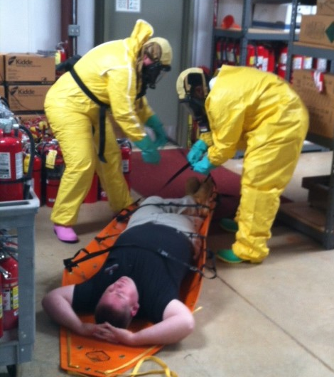

Slide 6
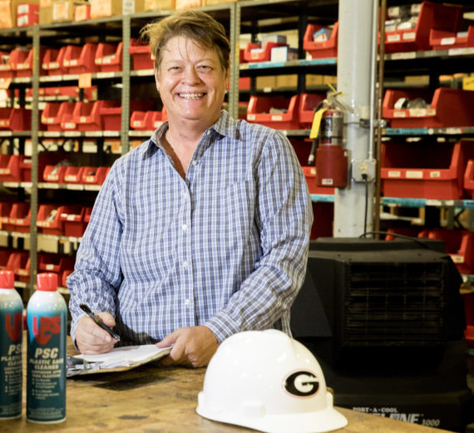
Psychology of Safety
Prevention-Focused
Compliance-based Framework

Slide 7

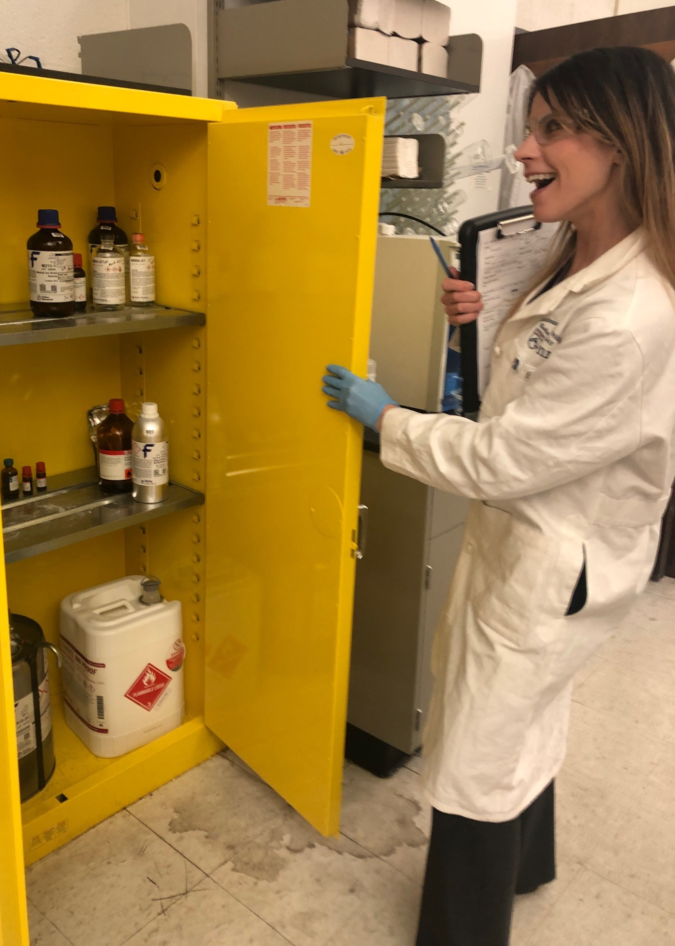
Language---Regulatory
Perceived as: “The Whip”
Involves a tremendous amount of unseen effort

Slide 8

Psychology of Sustainability
Promotion-Focused
Opportunistic Framework

Slide 9


Language--Opportunistic
Perception: “The Carrot”
Small efforts are recognized

Slide 10
Motivational Focus
Promotion Focused
Prevention Focused
See their goals as creating a path to advancement
Play to win
Comfortable Taking Chances
Think Creatively
Work Quickly
Worst case scenario: A failure to Advance
See their goals as responsibilities
Play not to lose
Risk-averse
More thorough/accurate
Work slowly/meticulously
Excellent Problem-solving skills
Worst case scenario: Sliding backwards
Heidi Grant Halvorson and Tori Higgins

Slide 11
Question 2—What drives you?

Slide 12




Slide 13
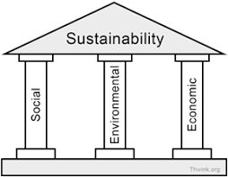
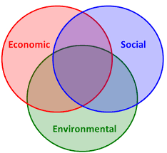
What is the relationship between sustainability and safety?
First, let’s define sustainability
People, planet, profits
Meeting the needs of the present without compromising the ability of future generations to meet their own needs

Slide 14



What is the relationship between sustainability and safety?
Let’s define safety-
EHS stands for Environment, Health, and Safety. It's a general term used to refer to laws, rules, regulations, professions, programs, and workplace efforts to protect the health and safety of employees and the public, as well as the environment, from hazards associated with the workplace.
Taking care of your employees sustains your business and protects your profits.

Slide 15

So, safety is actually a part of sustainability?!!!!!!!

Slide 16

Often pushing same outcome, but using different semantics and narratives to do so
Not about changing your goals or your focus
About working smarter, not harder (can incentivize)
Builds bridges with other stakeholders

Slide 17

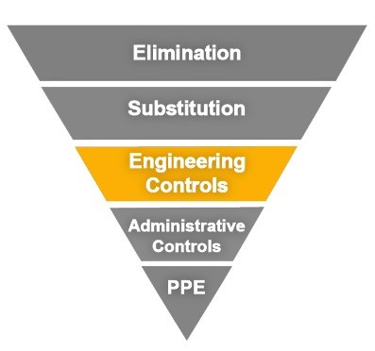


Fume Hoods
=
=

Slide 18

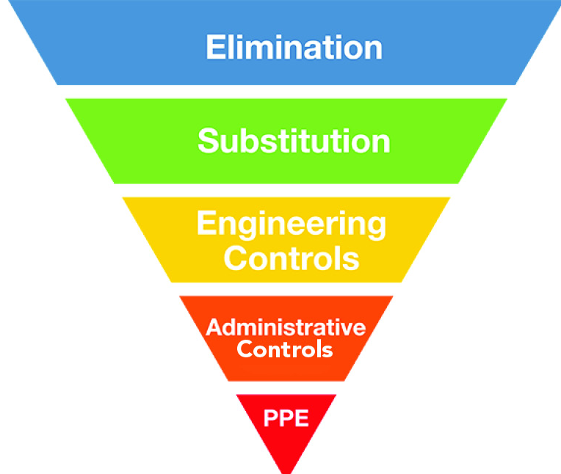


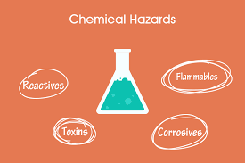
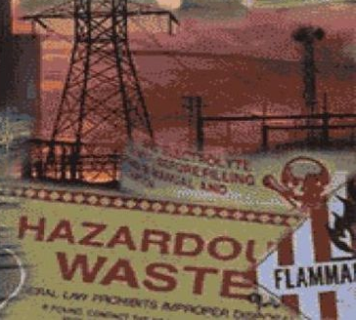
Green Chemistry
=
=

Slide 19
Much of what I see in EHS professionals is learned behavior from trying to survive the culture they’re in.
-Tom BRIGGS, Former president of CSHEMA
Other considerations
Culture of the profession
Culture of the institution
Culture of the program

Slide 20

Types of Programs
EH&S Programs
Dysfunctional
Proscriptive
Progressive
Sustainability Programs
Technical
Outreach
Progressive

Slide 21
Question 3—It’s a twofer

Slide 22
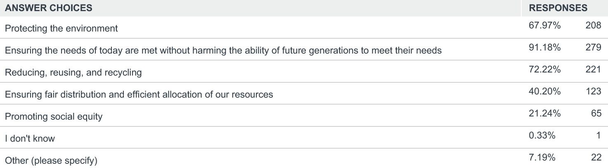
2018 CSHEMA Sustainability Survey
Purpose: to better understand CSHEMA members’ attitudes regarding sustainability.
How do you define sustainability? Check all that apply

Slide 23
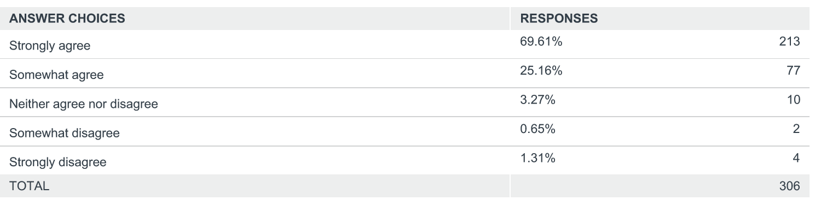
The following question is intended to gauge your PERSONAL values regarding sustainability. Please respond to the following statement: “I believe it is important to support sustainability initiatives.”

Slide 24
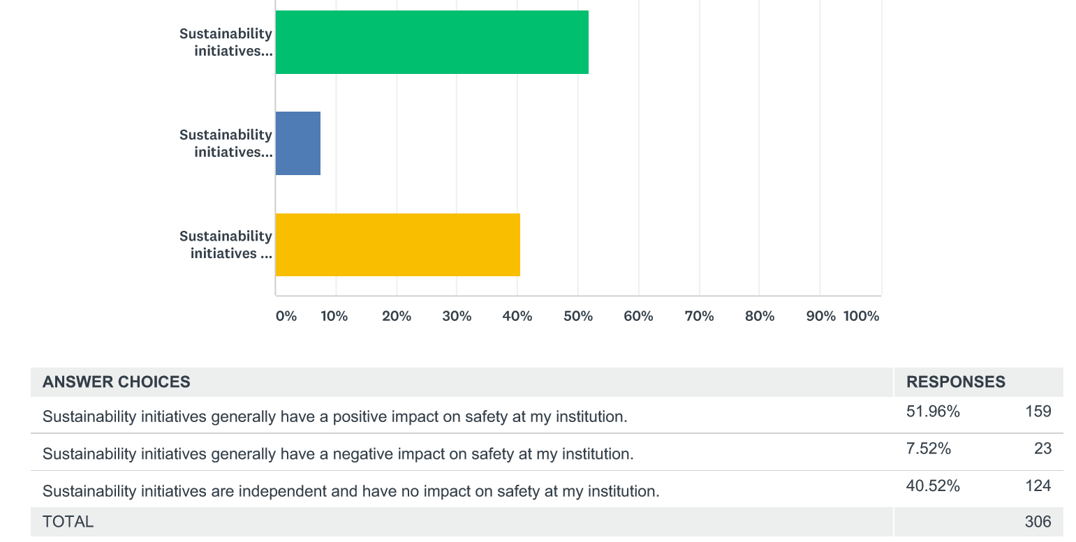
Which statement best reflects your PROFESSIONAL values regarding sustainability and safety?

Slide 25
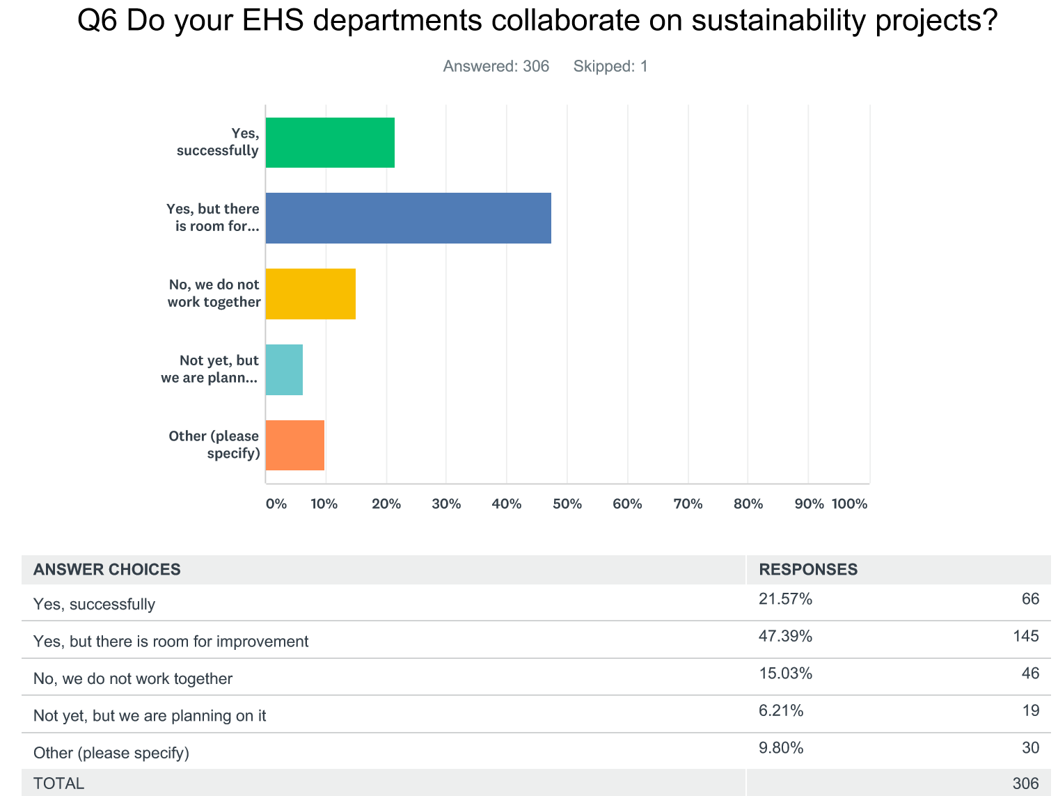

Slide 26
Additional Comments
“EH&S professionals at my institution have a perception of sustainability professionals as dilettantes—getting paid the same amount running the bike program or community garden as a biosafety specialist does. The university might value those two positions the same, but we do not.”
“EHS and Sustainability collaborate frequently at my institution. That being said, the last thing we need is yet another organization talking about sustainability.”
“There is an existing attitude among EHS professionals that sustainability gets in the way of safety.”
“There is so much benefit that can result from safety and sustainability working together. We have seen that on our campus. In fact, in the world of social psychology and behavior change, Community Based Social Marketing (CBSM) is quite useful for both safety and sustainability.”

Slide 27
Case studies
RCRA recycling concerns
LED traffic lights
United Rentals 2011 lighting retrofit
UGA Green Lab program—able to promote program as a means by which to improve upon lab safety

Slide 28

What now?
More communication
More case studies
Be more conscientious
Be more helpful
Work against false narratives
More collaboration

Slide 29
Social Justice and Higher Education
We have a responsibility to review the impacts of higher ed in all capacities, including impacts on social justice, both positive and negative
Continue to use the framework of “who benefits and who bears the burden?”
We can’t mitigate our impact without first acknowledging we have one

Slide 30
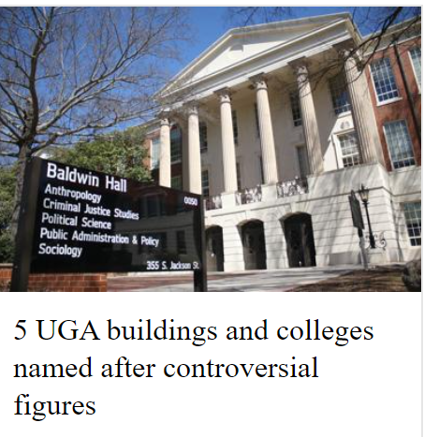
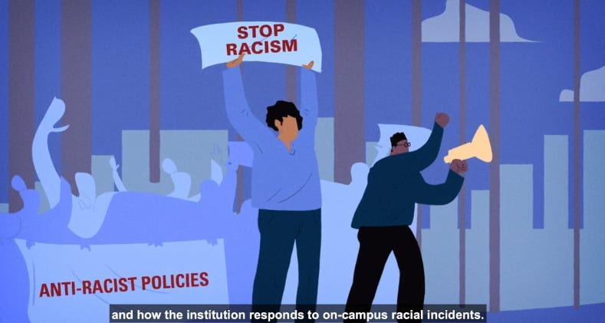


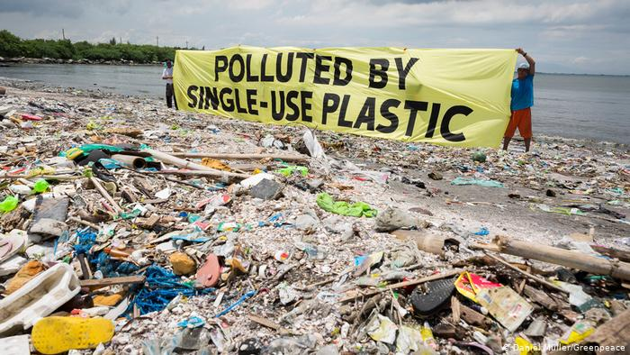


Slide 31

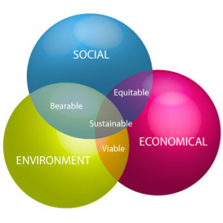
Social Justice is a Clear Component of Sustainability

Slide 32
Does Social Justice Fall Within the Purview of EH&S?
EHS stands for Environment, Health, and Safety. It's a general term used to refer to laws, rules, regulations, professions, programs, and workplace efforts to protect the health and safety of employees and the public, as well as the environment, from hazards associated with the workplace.
Taking care of your employees sustains your business and protects your profits.

Slide 33

Social Justice & Environmental Health
Need to examine the relationship between social justice and environmental health
Water
Indoor Air Pollution
Outdoor Air Pollution
Substandard Housing
Soil and Water Contamination
Food
Lead
Persistent Organic Pollutants
Climate Change
Superfund/Haz Waste sites
Levy & Sidel

Slide 34


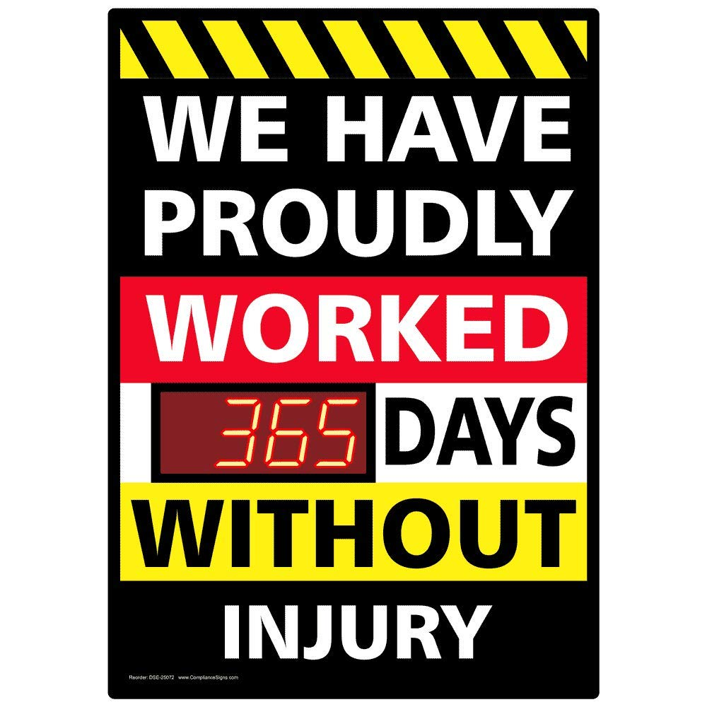


Social Justice and Workplace Safety
Work profoundly defines the well-being of individuals and populations
Workplace Democracy—Supporting an environment where ALL employees have a voice, as well as job security which would allow workers to be more insistent in demanding safer working conditions
“Stop Work Authority”

Slide 35

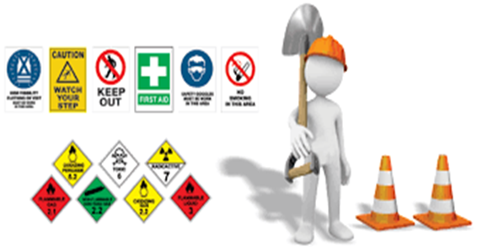


Does Social Justice fall within the purview of EH&S?

Slide 36

Star Scott
Questions?
Resources
Land Acknowledgement (https://native-land.ca/)
Halvorson/Higgins, Motivational Focus
The International Institute for Sustainable Laboratories (I2SL.org)
The Campus, Safety, Health and Environmental Management Association (CSHEMA.org)
The Higher Education Associations Sustainability Consortium(aashe.org/partners/heasc/)
The Association for the Advancement of Sustainability in Higher Education (aashe.org)
Greever, Scott, Gabrieloff-Parish, Presentation: How to Make the Research Enterprise More Sustainable and More Equitable
https://ejscreen.epa.gov
starscot@uga.edu
greenlab@uga.edu

