Slide 1
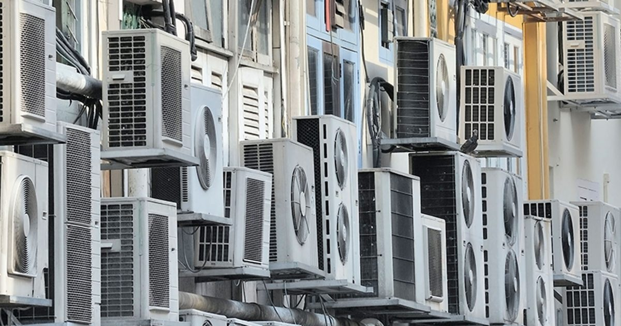
REFRIGERANT INVENTORY:
WHY AND HOW
DAN SMITH, LAURIE HUSTED: BARD COLLEGE
TILDEN CHAO: YALE REFRIGERANTS INITIATIVE
Notes:
Key process not only for colleges and universities, but for buildings and facilities in general.

Slide 2


1. WHY INVENTORY?
What: list of refrigeration and air conditioning equipment, its identifying information, and refrigerant is used
Broad benefits: procurement and maintenance strategies; identify emissions reduction reports; simplifying compliance and reporting
Notes:
A refrigerant inventory is similar to a typical greenhouse gas inventory, but focuses on air conditioning and refrigeration equipment and the refrigerant gases inside. Along with refrigerant information, facilities managers can collect model and serial numbers that are useful for organization and procurement.
Inventories yield broad and powerful benefits and streamline procurement and maintenance strategy and environmental leadership and compliance.

Slide 3
INVENTORIES ANSWER KEY QUESTIONS:
What proportion of HVAC equipment in my building uses HFCs (and HCFCs and CFCs) ?
Where are the largest sources of refrigerant emissions on campus?
Where is aging/inefficient equipment located?
What is estimated climate impact from refrigerant leakage annually?
Which high-impact zones can be most easily mitigated?
Notes:
Inventories also answer important questions—both for facilities administration and climate mindfulness. This list isn’t exhaustive, but covers some questions that you all may have been thinking about during this talk.

Slide 4
2. READING NAMEPLATES
Location: sticker on the rear panel or interior of an HVAC unit
Nameplates provide key information: manufacturer, model and serial number, refrigerant type, and refrigerant charge

Slide 5

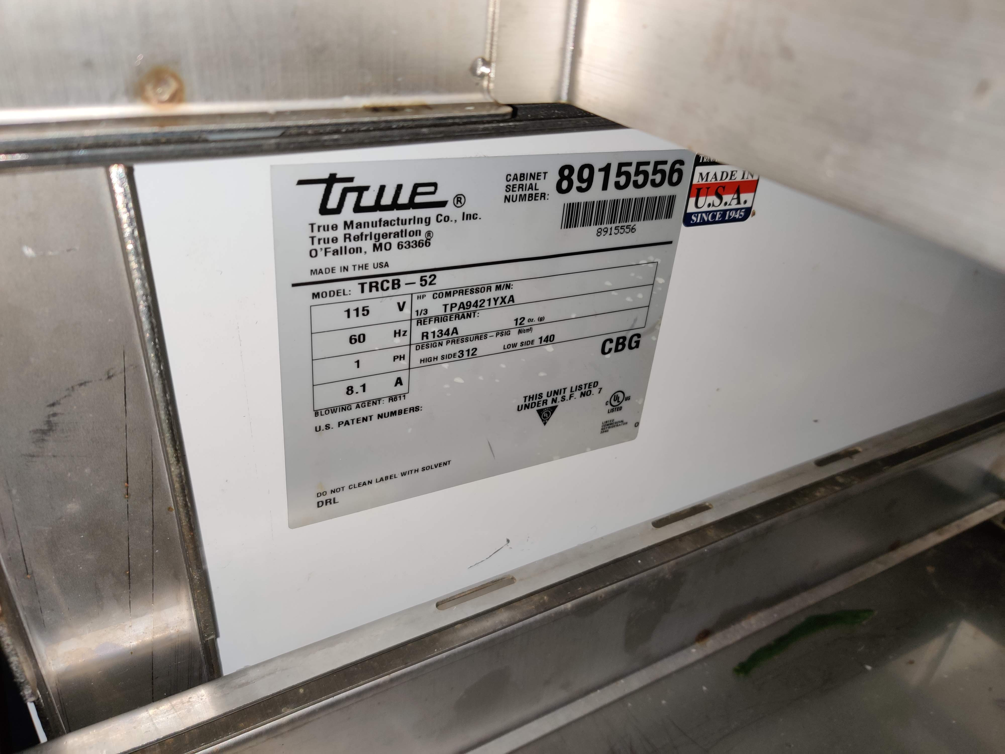
SERIAL NUMBER
MODEL NUMBER
Nameplates usually display information clearly, but in a very small text size. It can be helpful to take pictures of nametags and zoom in when entering the data into the spreadsheet.
REFRIGERANT TYPE
REFRIGERANT CHARGE

Slide 6
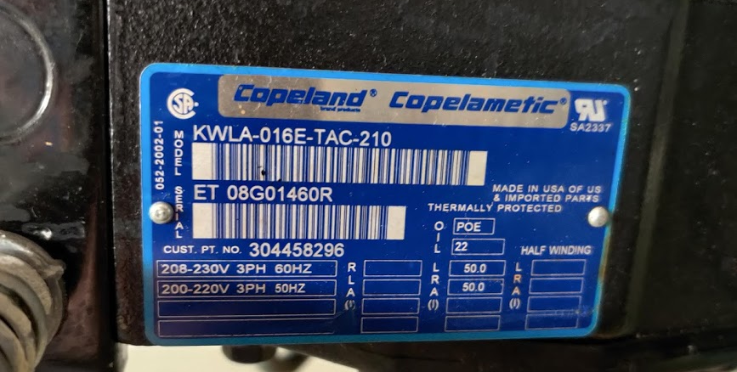
On compressor racks, often seen in university dining halls, refrigerant information might not be displayed on the nameplate. Refer to your refrigerant technician for this information.
This Copeland Copelametic compressor doesn’t display what type of refrigerant is used nor how much refrigerant there is (charge size). The technician who services this equipment should have this information on hand.

Slide 7

3. REFRIG. ASSET INVENTORY
HELPFUL TIPS to conduct your audit of refrigeration equipment…
Daniel Smith
Energy Manager

Slide 8
HELPFUL TIPS
So you’ve decided to conduct a refrigeration asset inventory?
Daunting?
Many buildings…
Locating equipment…
Collecting & tabulating data…
Talk to the HVAC team; managers & technicians:
May have documentation (e.g. building lists, equipment logs, etc.)
Advice, or assist with audit!
TEAM UP! Divide & conquer (split up buildings, determine roles, etc.)

Slide 9
HELPFUL TIPS
Scope & Prioritize:
Determine the scope “boundary” and “priority”.
Which assets?
      Large/med/small capital equipment (ex. process cooling, chillers, heat pumps, split systems, etc.)
      Window units? Refrigerators? Mini-fridges?
      Vehicles?
      Vending machines (who owns?)
Type of refrigerant?
GWP?

Slide 10
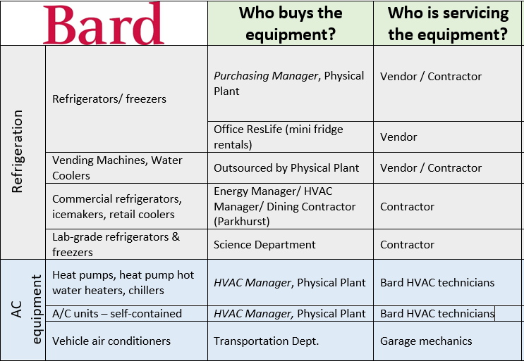
HELPFUL TIPS
Scope & Prioritize:
Talk with:
HVAC team
Mechanics
Building staff
Purchasing dept.
ANYONE!!!
Existing info & docs can save time & effort

Slide 11
HELPFUL TIPS
Scope & Prioritize:
    Gathering documents:
    Building lists
    Campus maps
    Building floorplans, drawings, etc.
        Make a plan & chart a path!!!

Slide 12

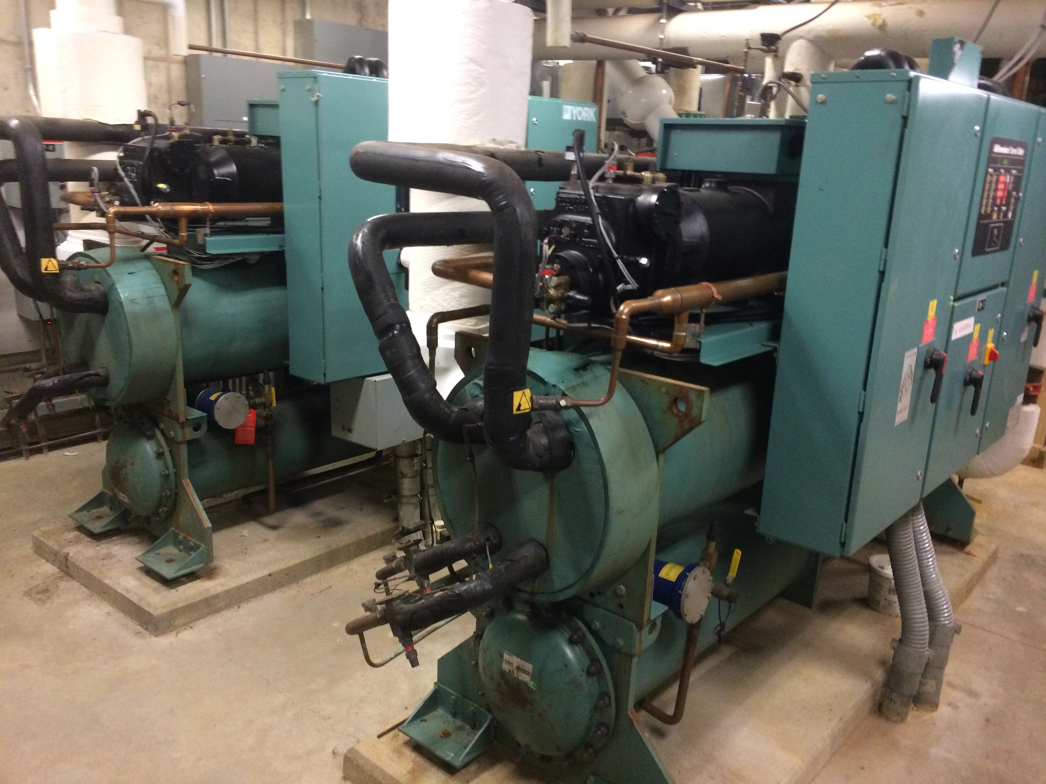
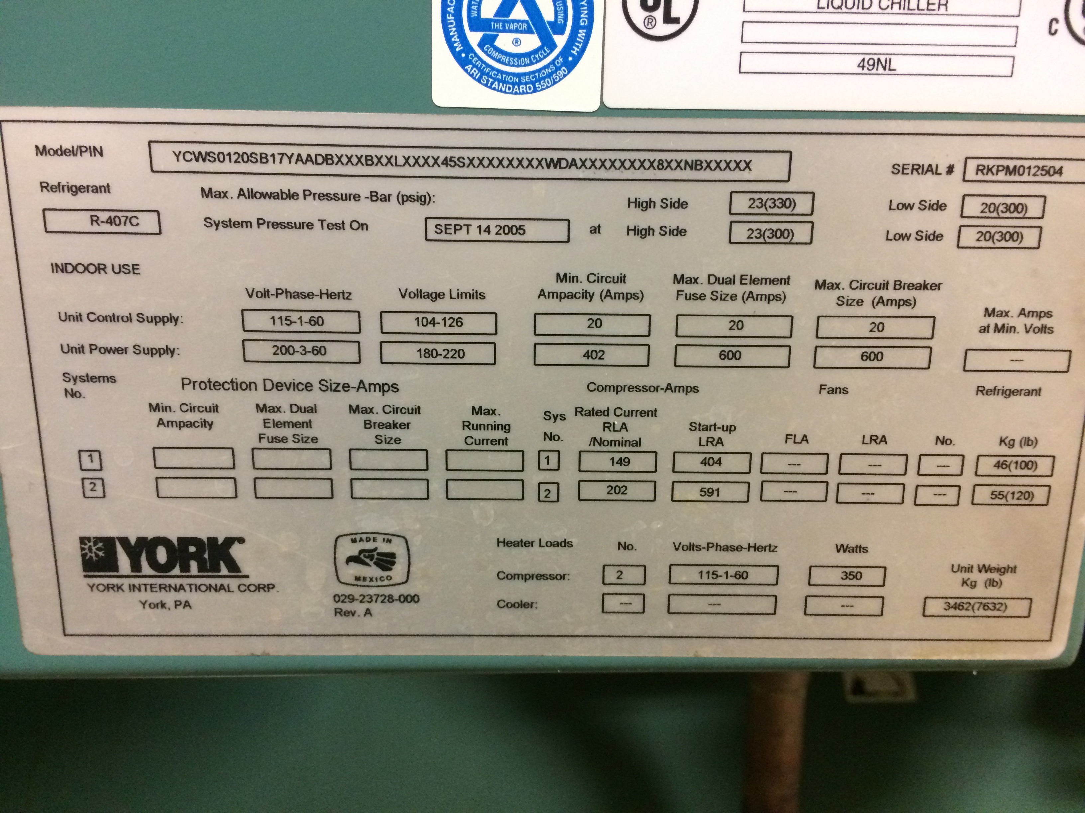
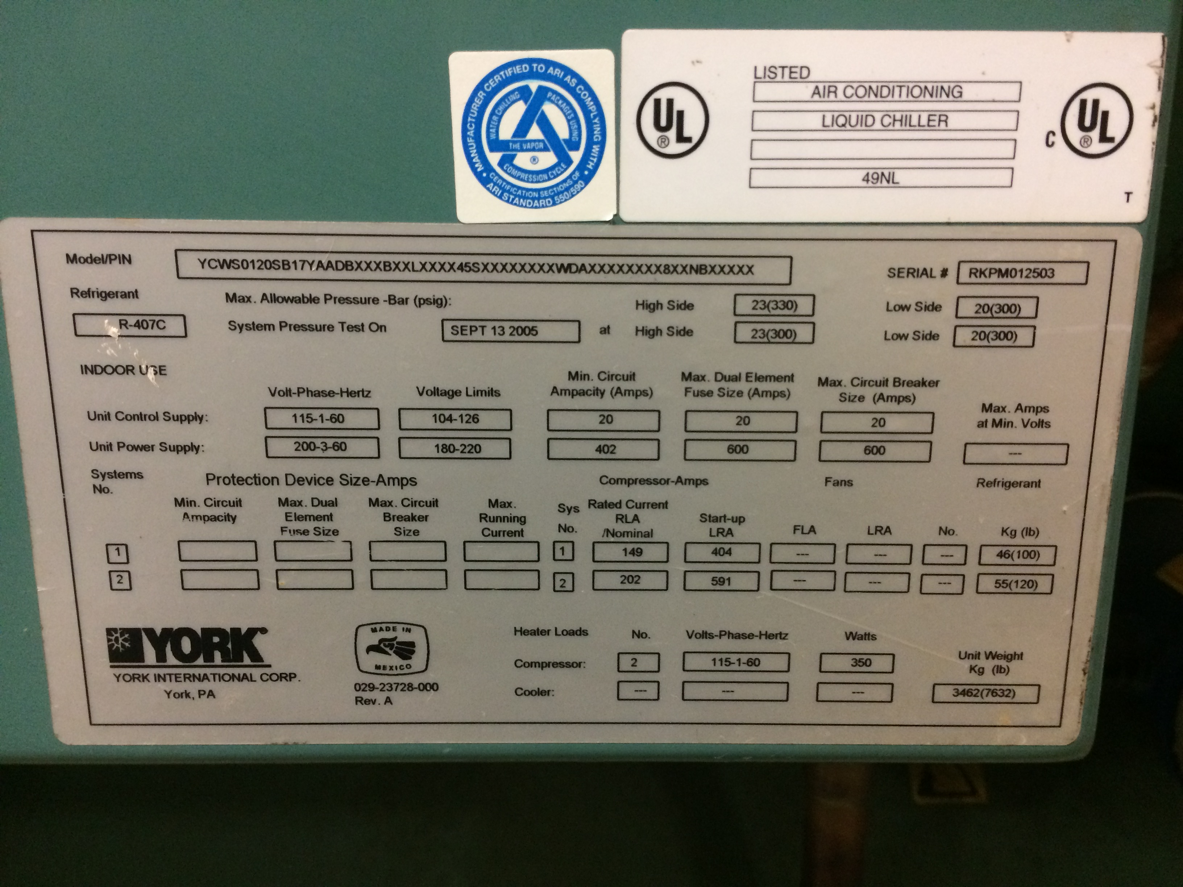
HELPFUL TIPS
Take lots of photos as you go…
(you’ll thank yourself later)
Establishing shot: building
Establishing shot: equipment/room
Nameplate zoom
Label photos: ex. 1, 1A, 1A-1, 1A-2
Clipboard to track your path & building order
Data entry back at the office (photos saved; now a resource)

Slide 13
HELPFUL TIPS
Construction drawings & equipment schedules
Save time on searching an entire building
Quickly identify:
different equipment types (and ID/name schemes)
quantities
basic model info
***Take a photo of nameplate for each type***
(refrigerant type & volume are usually not on these docs).

Slide 14
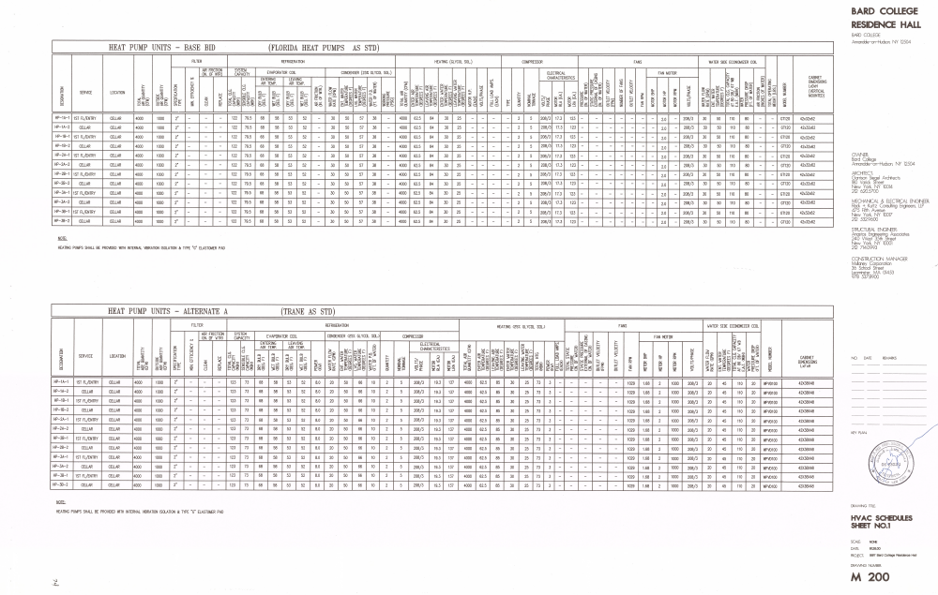
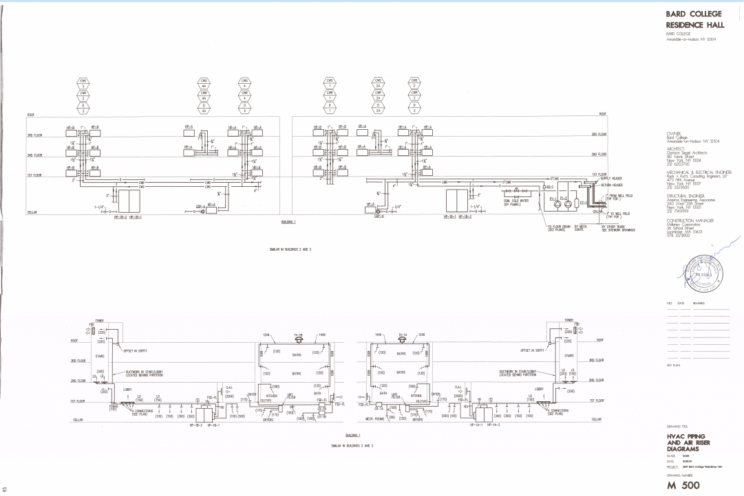
HELPFUL TIPS
Construction drawings & equipment schedules

Slide 15
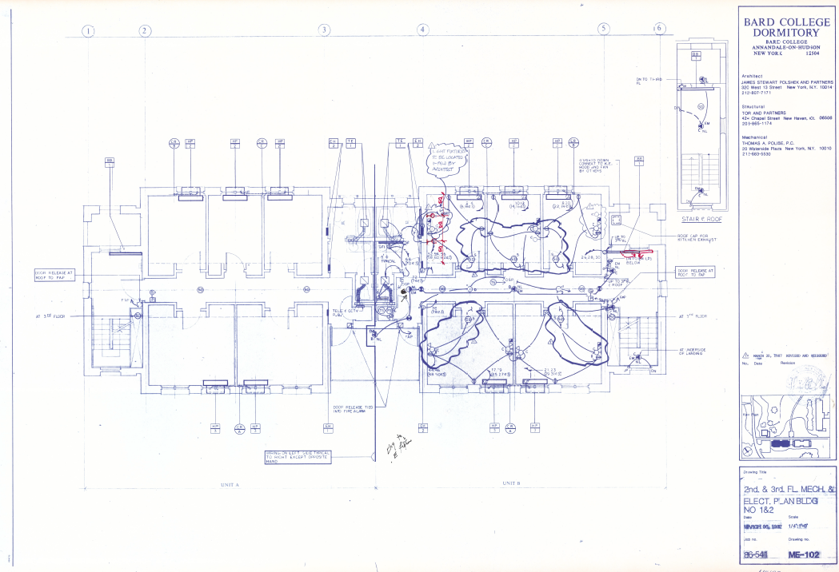
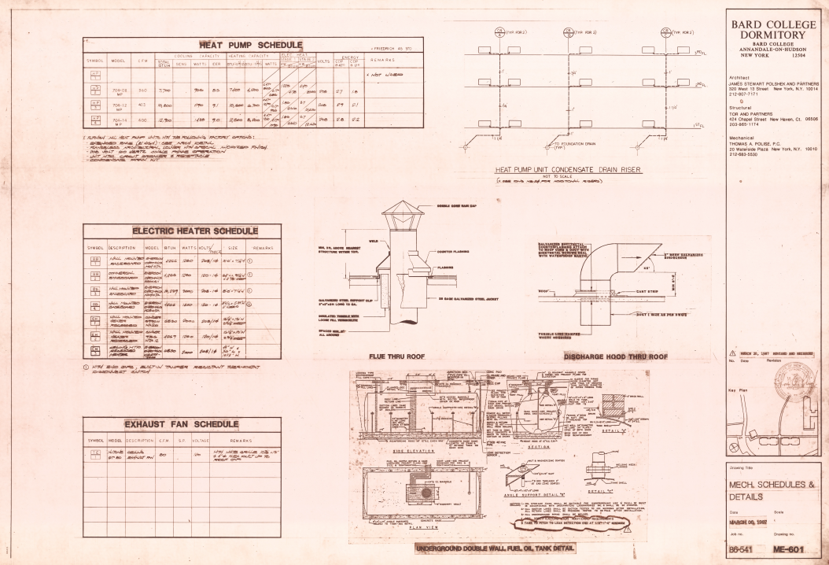
HELPFUL TIPS
Construction drawings & equipment schedules
Tradeoff: time searching for drawings (find balance of both options)

Slide 16
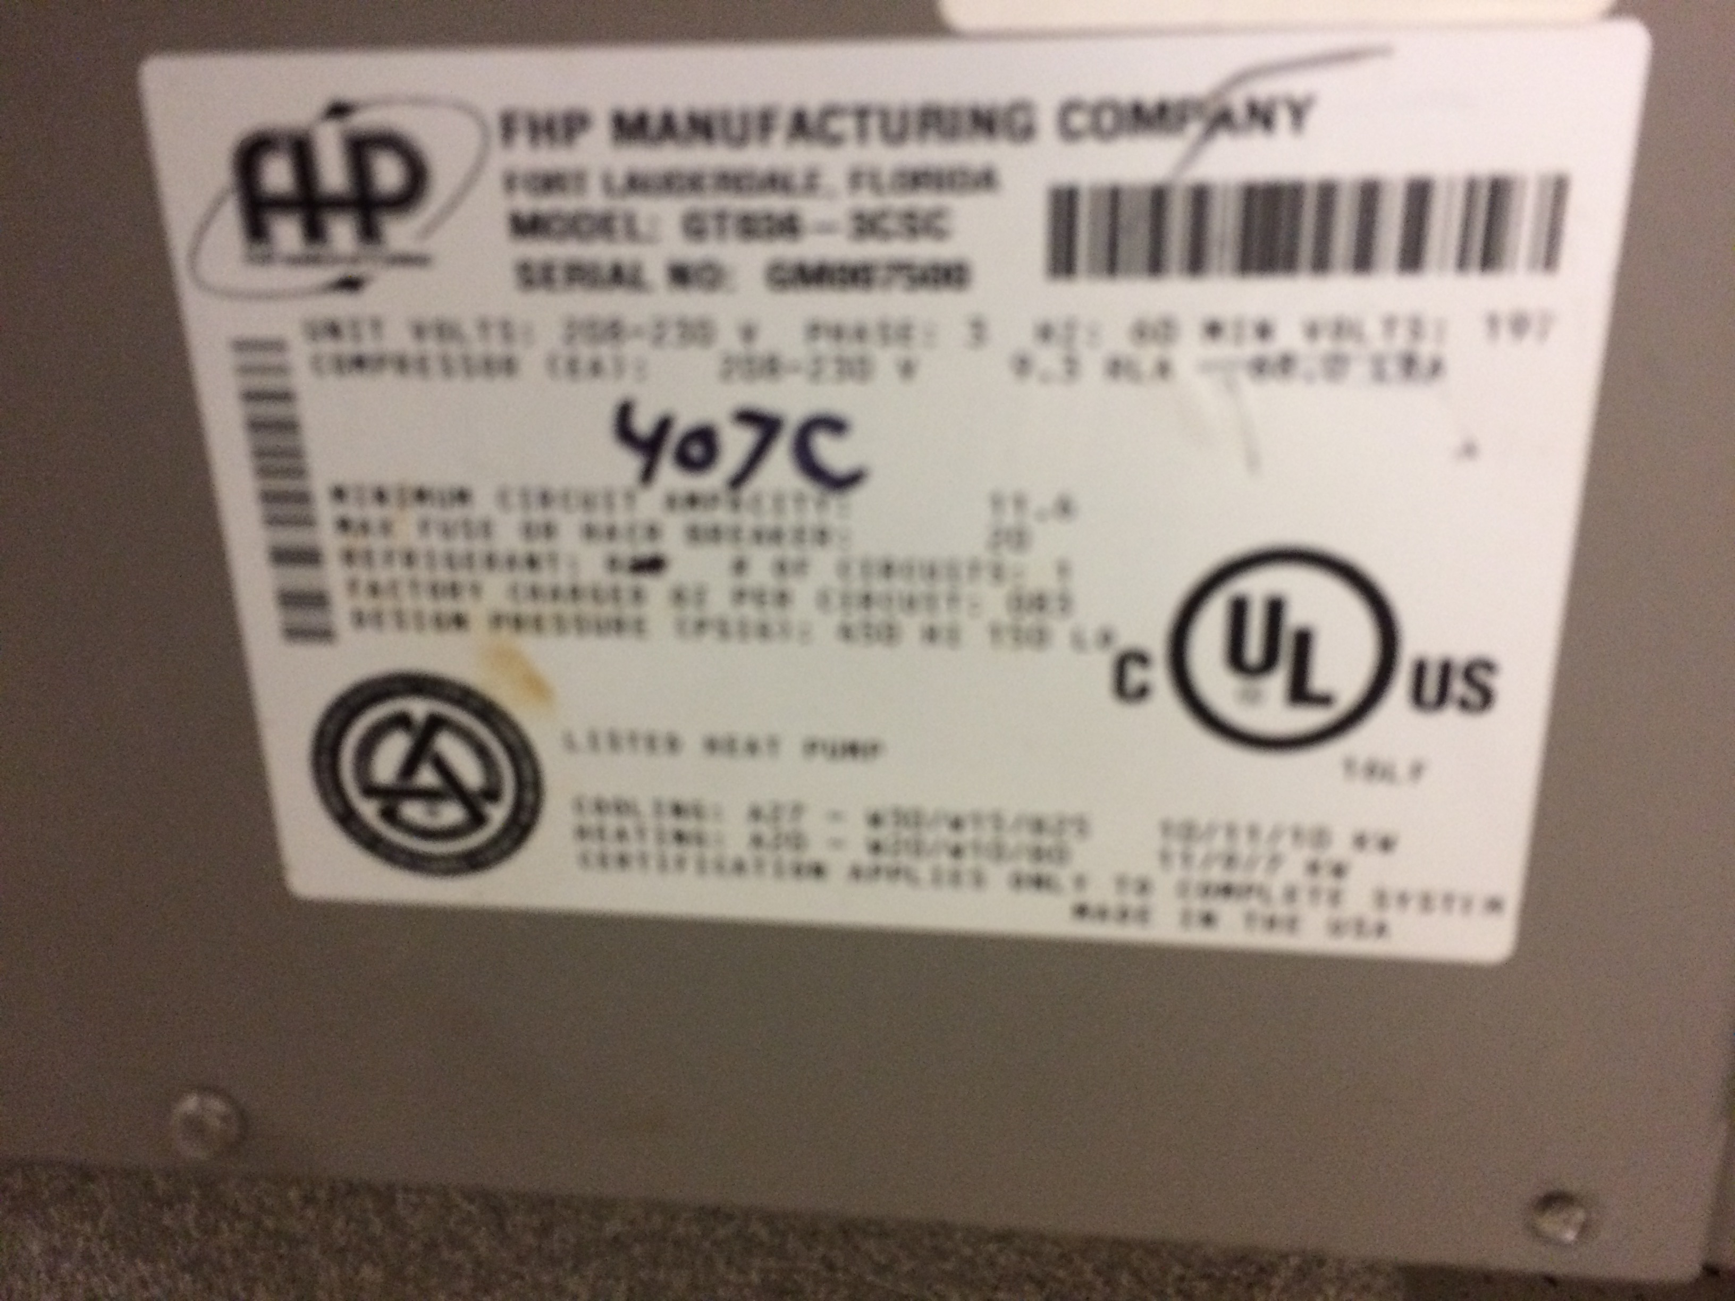

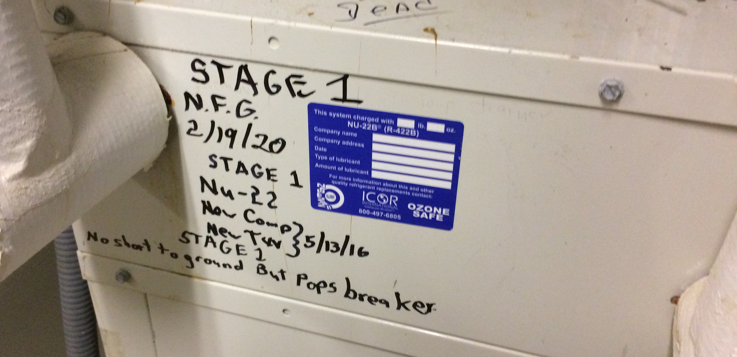
HELPFUL TIPS
Missing data & filling gaps
Nameplate missing or illegible
Be a Detective; look for clues…
notes from technician
model #s to search online
Online search for technical data (manuals, brochures, cutsheets)
Filling gaps = use data from similar models, vintages, tonnage size, etc.

Slide 17
HELPFUL TIPS
Entering asset data:
Spreadsheet? Custom…
  minimum info (equipment type, ID, refrigerant type & volume)
  detailed asset (+ model, serial, manufacture date, electric data, etc)
Refrigerant tracking software/app? (free/trails vs. paywall)
Existing company asset management system (i.e. modify to add data refrigerant categories)

Slide 18
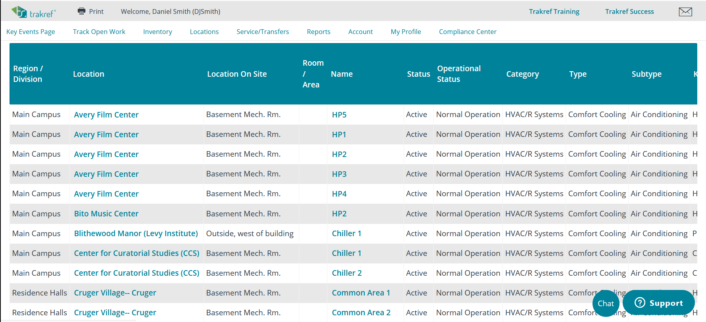
HELPFUL TIPS

Slide 19
4. WHAT TO DO WITH DATA
After collecting and inputting data, you can:
Develop new strategies to replace or maintain HVAC equipment
Calculate estimated environmental impact
Notes:
Now that an inventory is underway, you can use your data to develop new and better HVAC management strategies and to calculate environmental impact. We’ll focus on the latter now.

Slide 20
CALCULATING ENVIRONMENTAL IMPACT
Use Microsoft Excel or similar
GWP-20 numbers are available on the internet; based on climate science
From technician estimates, EPA guidelines, or historical data (how much refrigerant is being added each year)
GWP * (Annual leaks, kg) / 1000
Note the high environmental impact of these leaks!
Notes:
Using Excel, you can run simple calculations that give an estimate of the carbon dioxide equivalent emissions of refrigerant leaks in your facility. These metrics can help facilities managers prioritize the replacement of equipment with particularly high environmental impact.

Slide 21
STRATEGIC NEXT STEPS
Prioritize replacement of leaky HVAC units that use high-GWP refrigerants with large charge sizes
When units are replaced, assure that your maintenance team purchases energy efficient options that use climate-friendly refrigerants
Keep inventory documents updated and organized
Notes:
There are a few more things to keep in mind.

Slide 22
5. FURTHER DISCUSSION
Contacts:
          Kristen Taddonio, IGSD: Ktaddonio@igsd.org
          Dan Smith, Bard College: djsmith@bard.edu
          Laurie Husted, Bard College: husted@bard.edu
          Tilden Chao, Yale Refrigerants Initiative: tilden.chao@yale.edu
          Summary: www.yalerefrigerantsinitiative.org/inventory
Notes:
We can field questions about inventories in the cumulative Q&A session in just one minute. But lastly, for extended discussion of refrigerant inventories, please see the contacts listed above. For a written summary of this presentation, please visit yalerefrigerantsinitiative.org/inventory.

