Slide 1

Solve Climate By 2030 - 4.7.21
Catalyzing a Green Recovery in _____
Eban Goodstein/David Blockstein: Bard Center for Environmental Policy
SolveclimateBy2030.org

Slide 2
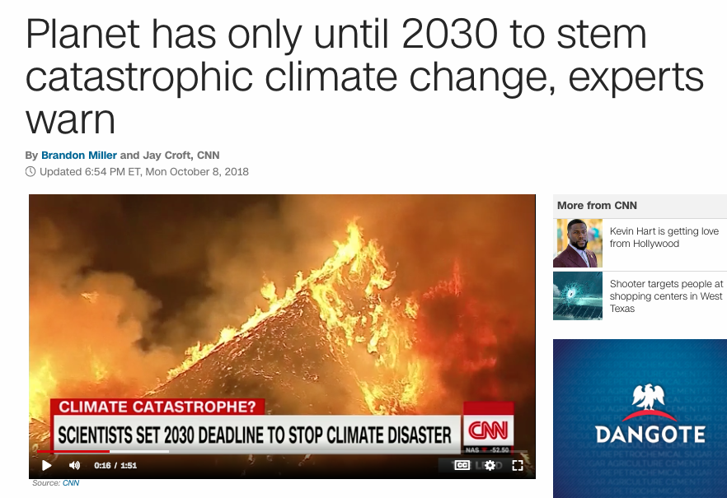

Slide 3






University and
Business Sponsors

Slide 4
100,000 students focused on climate solutions on April 7
(100 webinars * 1000 synchronous and recorded views)

Slide 5

Solve Climate Univ. Leads
April 2021: All 50 States, PR/DC
50 International Sites
www.solveclimateby2030.org

Slide 6
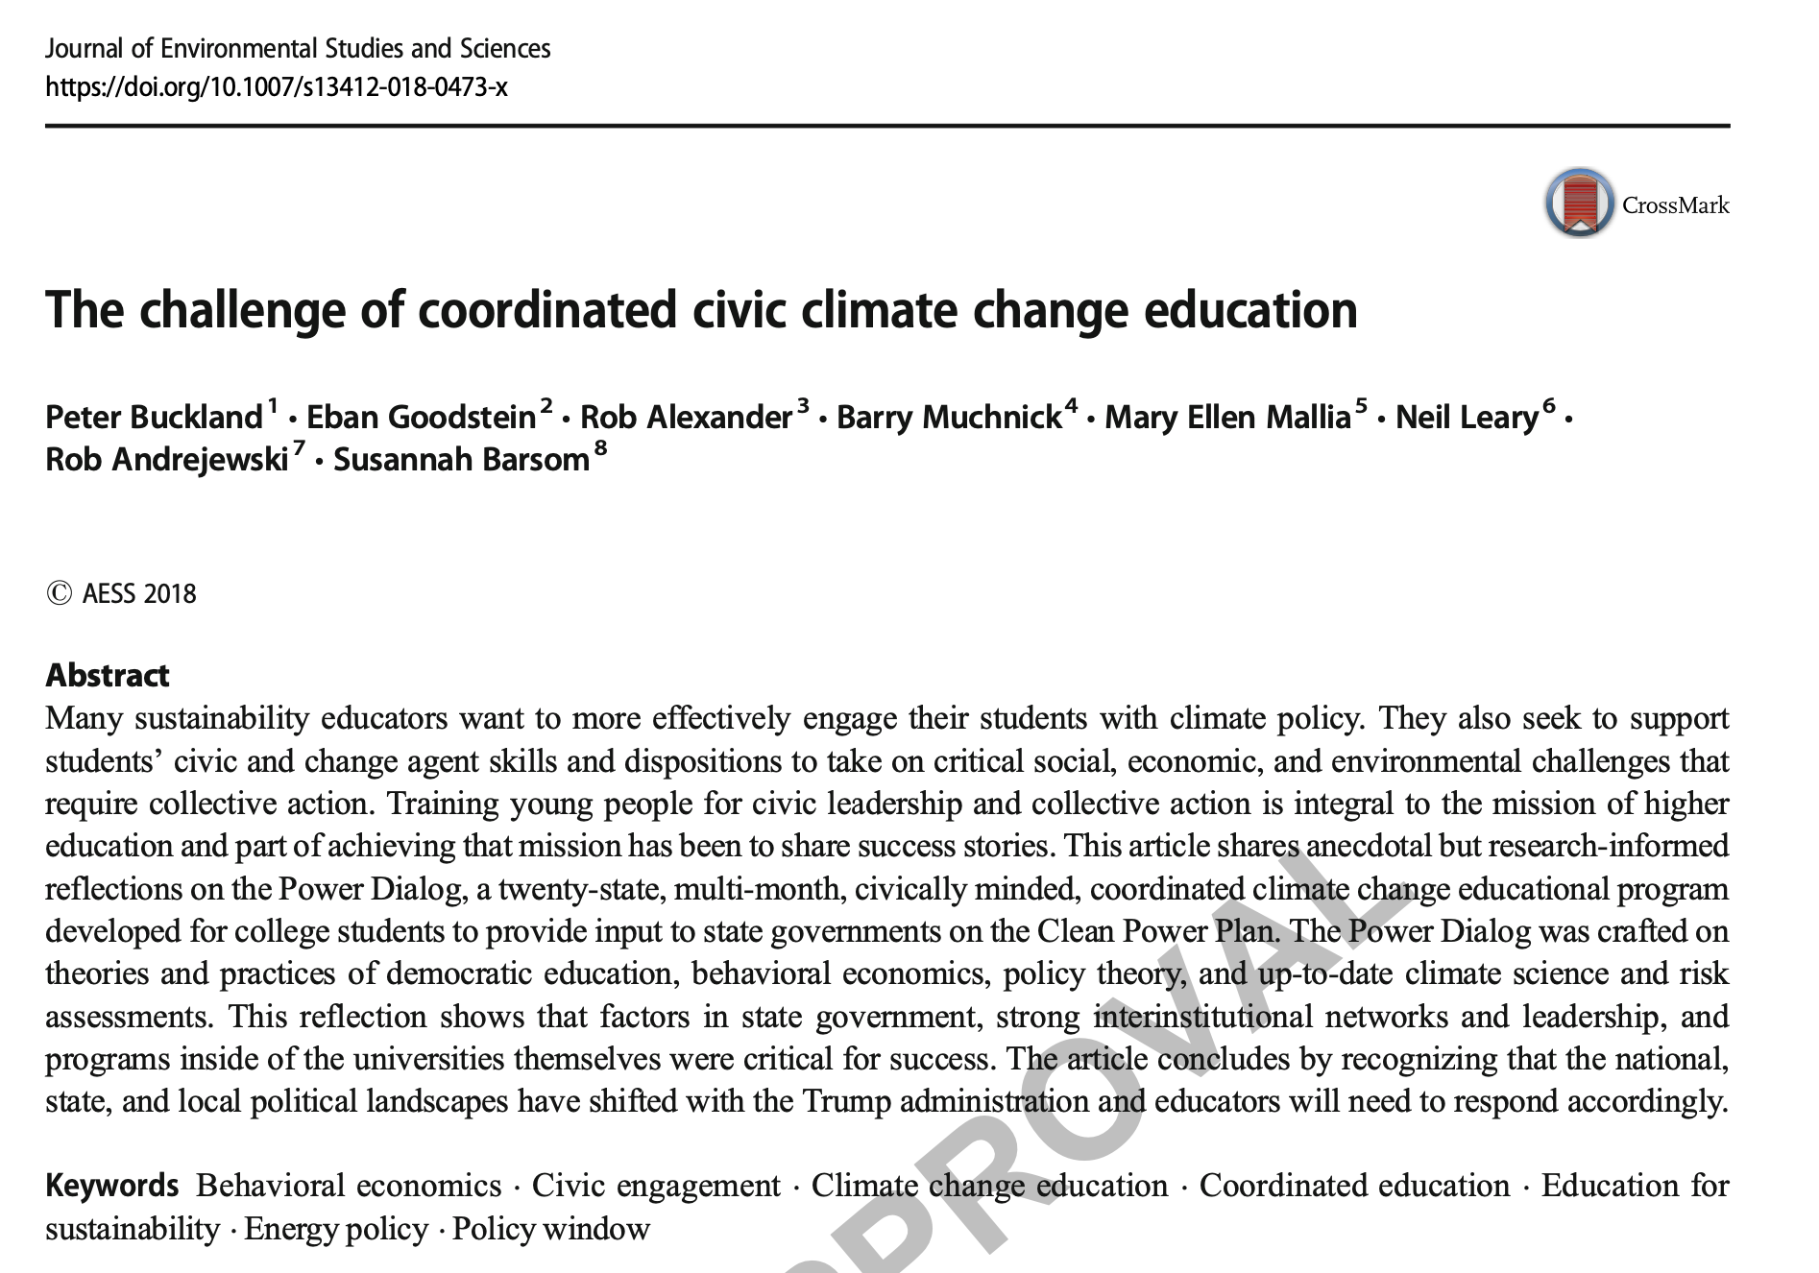

Coordinated Climate Education
Mobilizing Volunteers
Effective
Easy
Exciting (Fun)

Slide 7
Responses
From Nebraska One word – OUTSTANDING – everyone did a great job yesterday and your efforts are greatly appreciated…We had about 136 registrations, 84 participated in the webinar… It is great to have 2 undergraduate students play such a big role in this event – A BIG HIGH FIVE to you ALL!!!
From Tennessee. It went really well! The content was outstanding and my phone and email blew up with enthusiastic feedback last night and this morning.
From Kyrgyzstan. We feel good about how it all went. Our three panelists did a very nice job of presenting hard data on what is happening in Kyrgyzstan in climate, adaptation, and mitigation. Many questions were submitted by chat and we were able to respond to several of them immediately. We received a number of nice messages from participants at the end. We are particularly interested in following up on the Make Climate a Class concept.

Slide 8

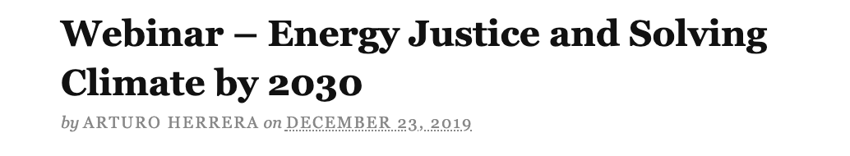
Rapid Global Energy Transition
Equitable access to affordable clean power and affordable clean mobility?
Clean energy jobs for all?
Jobs for workers in declining industries?
Critical for the Climate-- Big Justice Questions

Slide 9
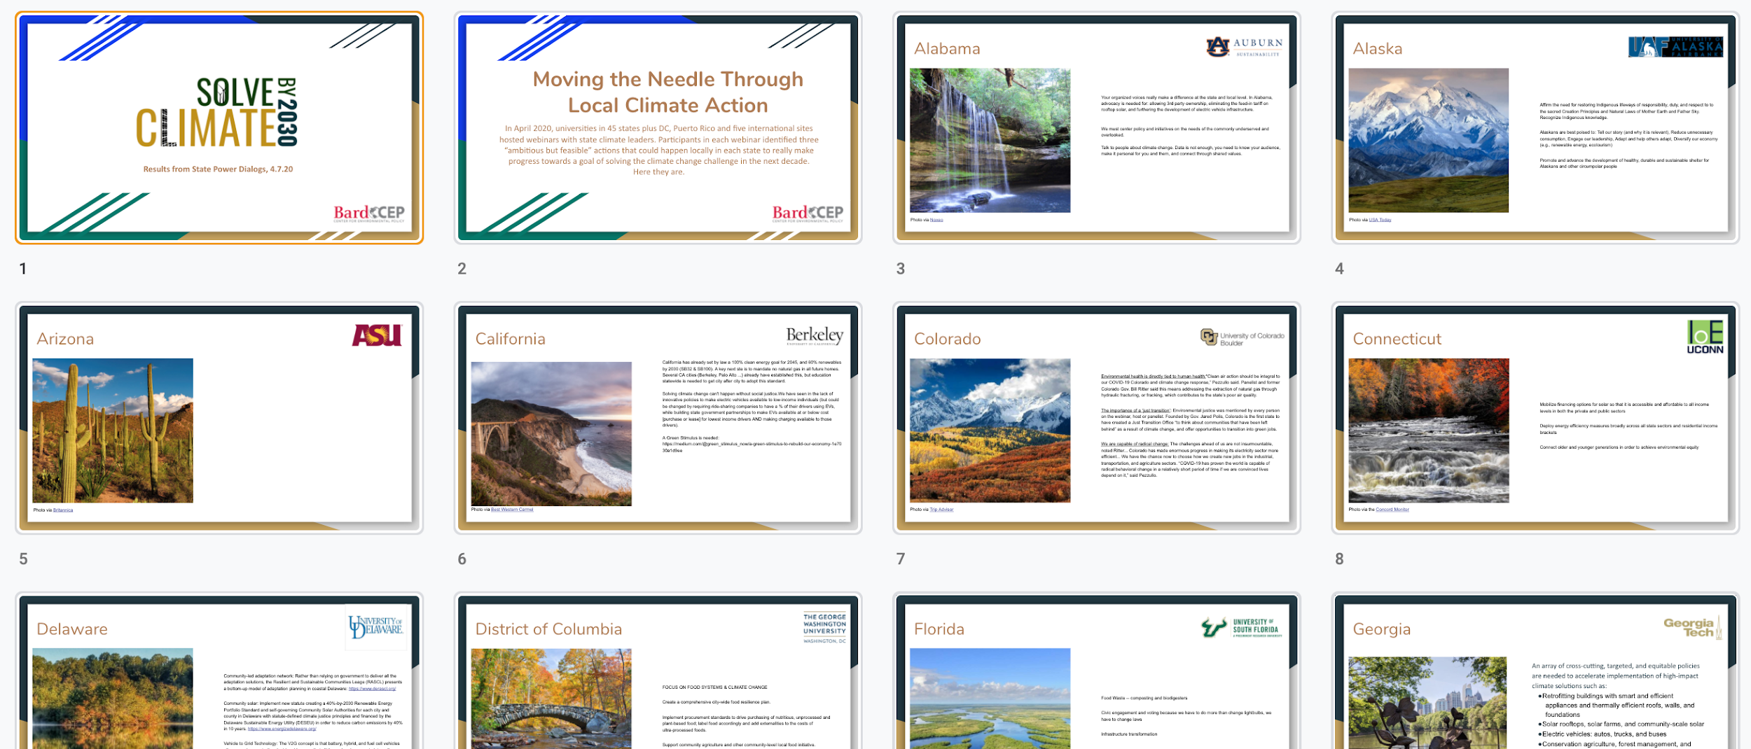
Ambitious But Feasible Solutions In AL, AK, AZ ….

Slide 10

This Fall

Slide 11
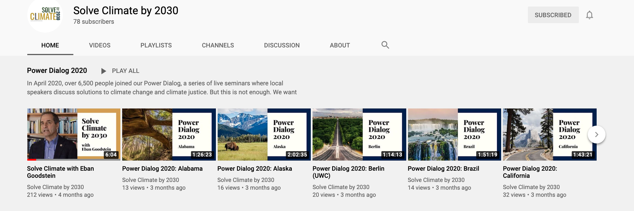

Resources

Slide 12

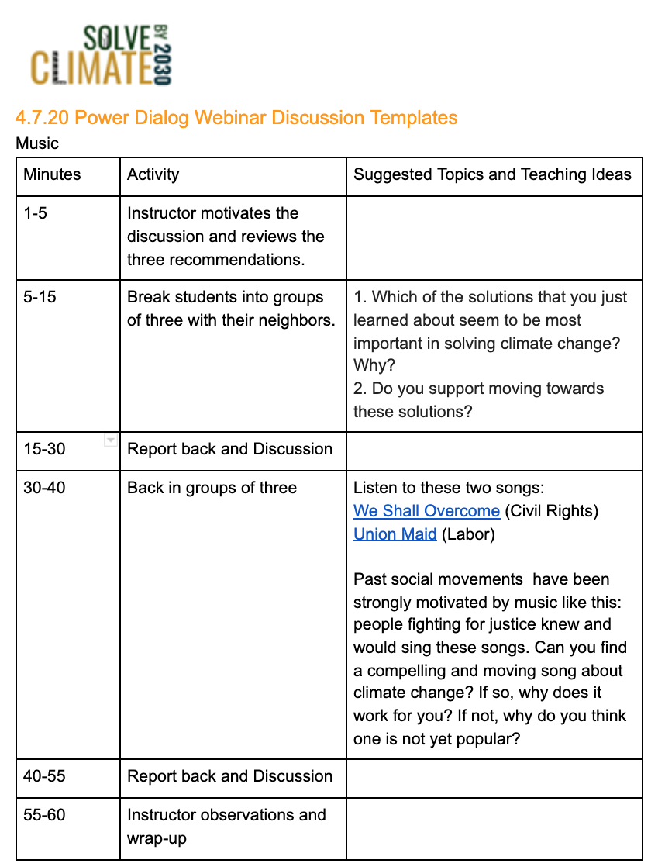
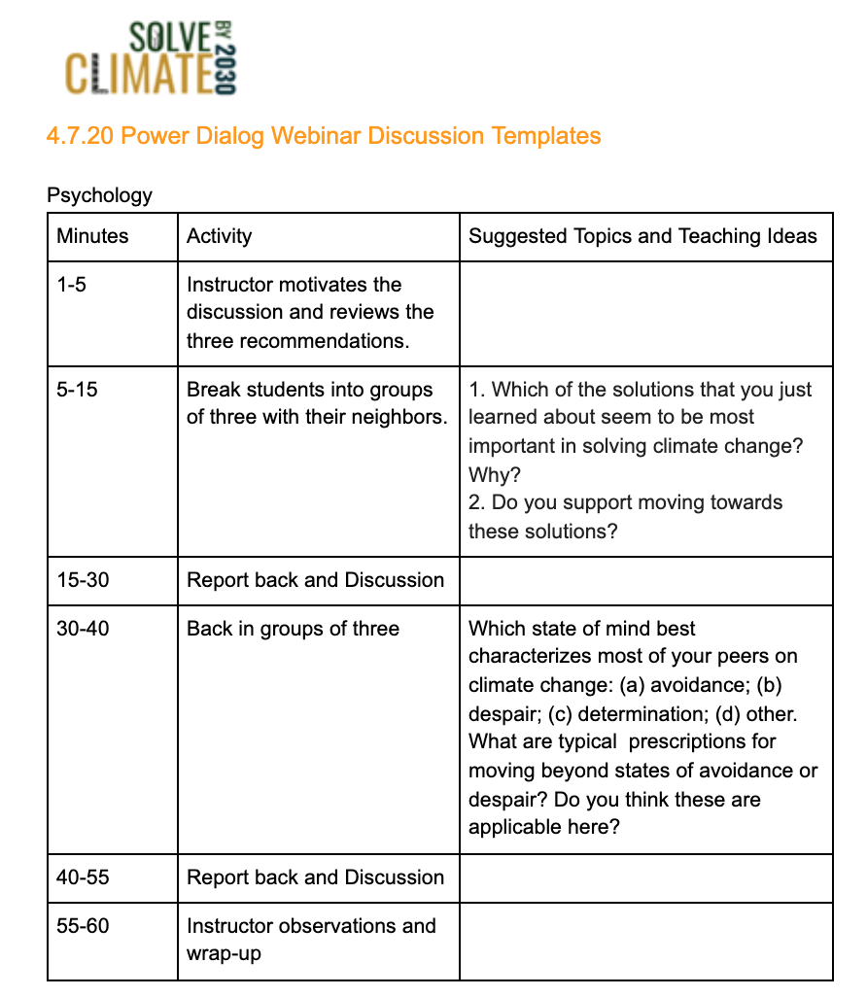
Every teacher you know

Slide 13
“Solve Climate” Means….
By 2030, be well on the way towards a 100% renewable economy
Electric power from solar, wind, hydro, geothermal, + “storage” (batteries)
Transportation transitioning rapidly toward Electric Vehicles (EV’s)
This solves the energy half of climate change.

Slide 14
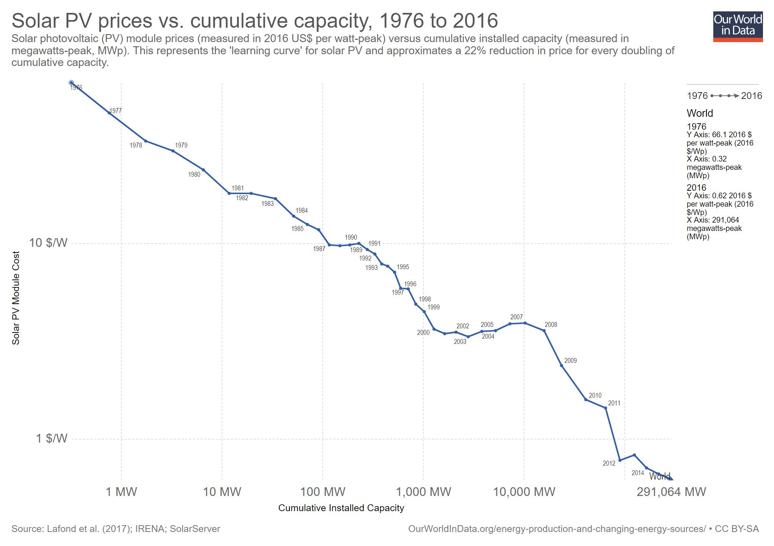
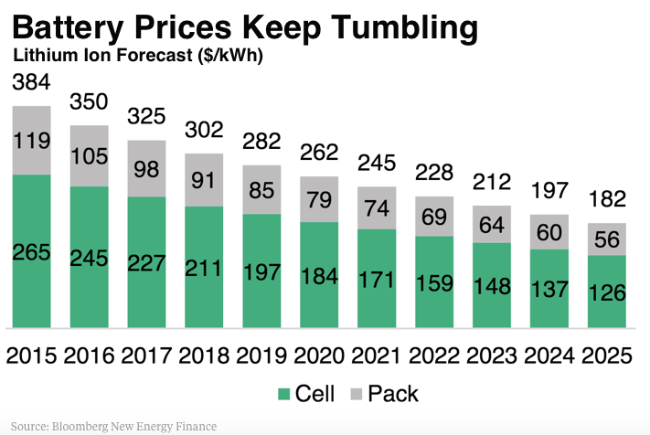
Imagine
The 2020’s as a decade of disruptive energy transformation driven by cheap, distributed solar + storage

Slide 15
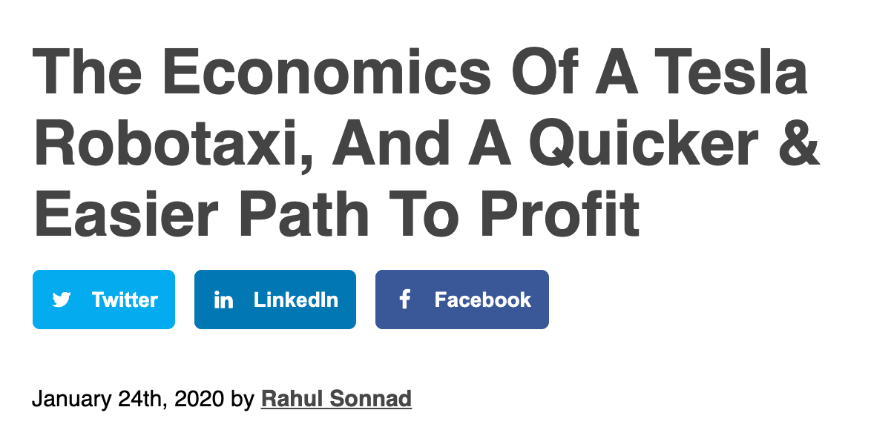
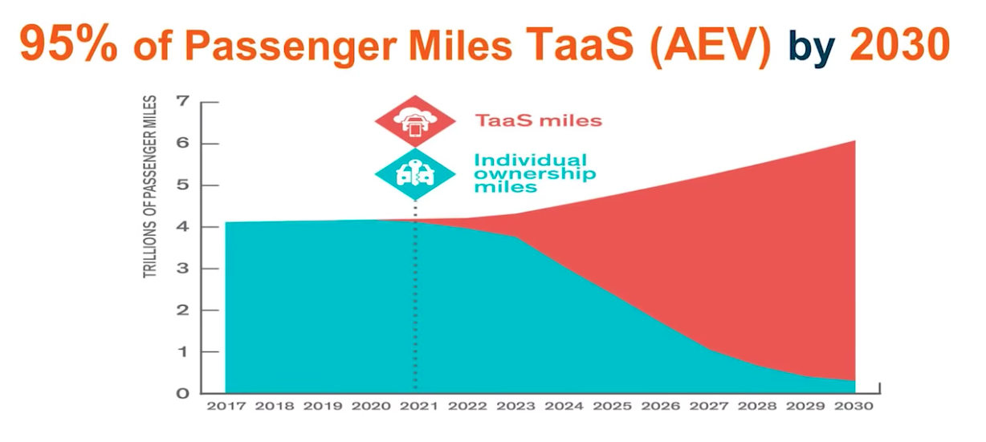






Imagine further
Cheap transport from driverless electric taxis and fleet

Slide 16
A “Technology Tipping Point”
Local and State Action is now much more important in solving climate.
Removing local and regional barriers to rapid deployment is key.

Slide 17
Join Us!
Organize your state or national webinar
#MakeClimateaClass this fall
Tell Every Teacher to #MakeClimateaClass
Tell Students to Join Spring 2021 Virtual Internship:
Social Media for Climate Activism

Slide 18
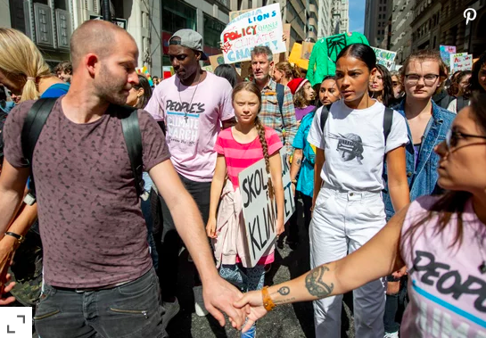
Solve Climate By 2030
ebangood@bard.edu
www.solveclimateby2030.org

