Slide 1


UB as a partner in
Community Resilience:
Examples and Major Takeaways
Presented by Susan Clark
Assistant Professor, Department of Environment & Sustainability, University at Buffalo

Slide 2
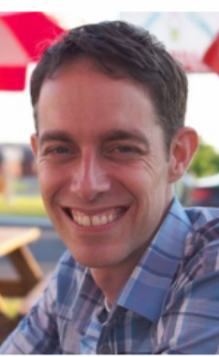
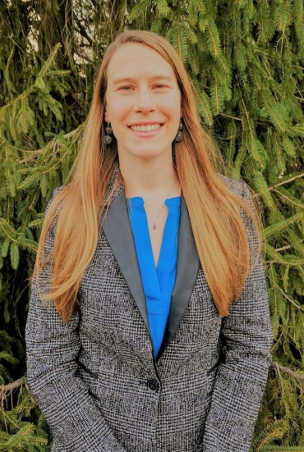
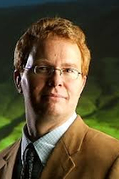
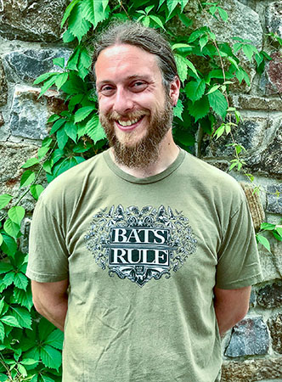
Example 1:
Climate Vulnerability Assessment for Erie County
P. Josh Wilson
Department of Environment & Planning,
Erie County
Dr. Susan Clark
Department of Environment & Sustainability,
University at Buffalo
Dr. Chris Renschler
Department of Geography,
University at Buffalo
Jonathan Townsend
Graduate Research Assistant,
Department of Geography,
University at Buffalo

Slide 3
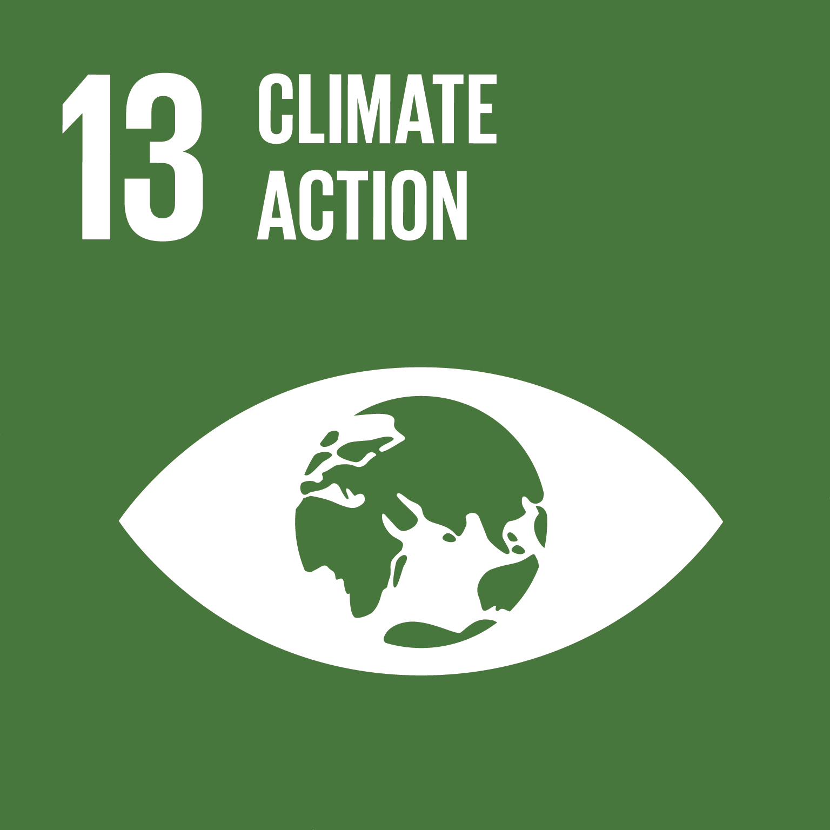
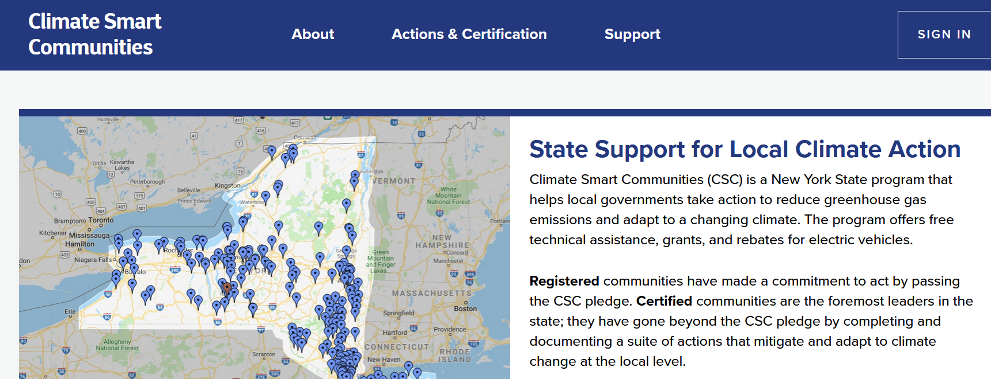
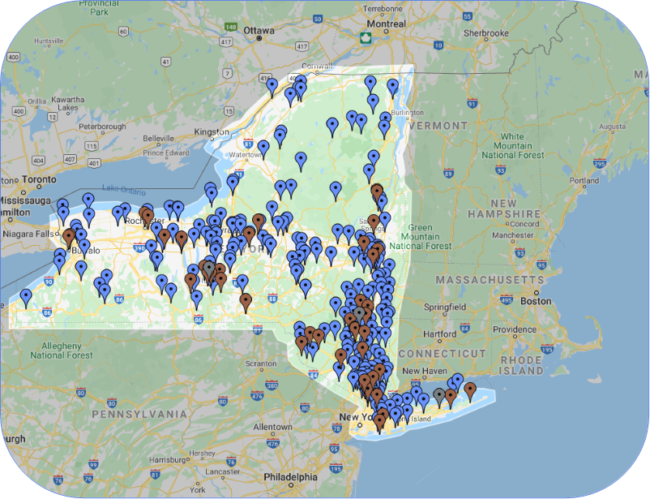
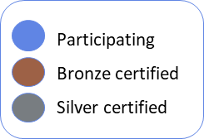

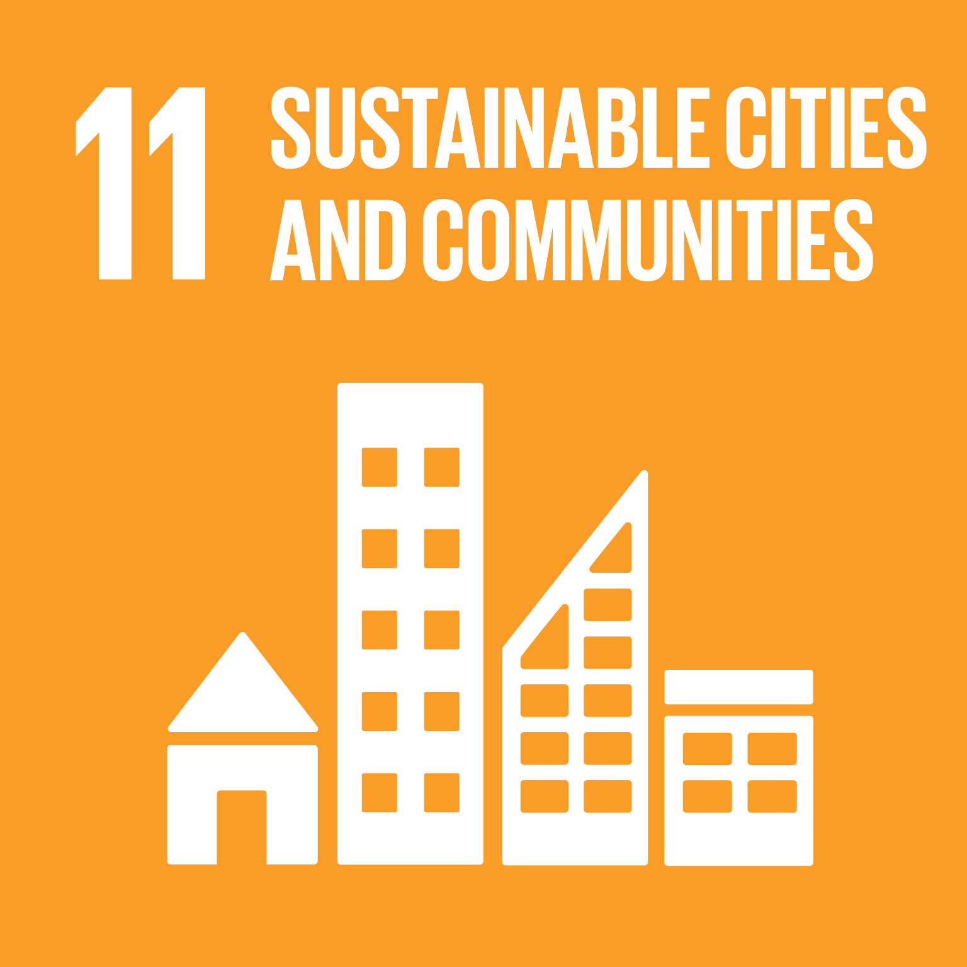
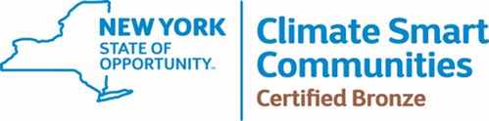
Erie County Climate Vulnerability Assessment
Notes:
This particular example is a climate vulnerability assessment of Erie County, which is the western most county in upstate New York, in which the City of Buffalo sits in between Lake Erie to our west and Lake Ontario to our North.
The funding for this project is the NYS DEC, who spearheads a program call Climate Smart Communities, which funds projects for local climate action across the state, which includes aspects of mitigation and adaptation to climate impacts.
A few years ago, I worked closely with our partners at Erie County Department of E & P to put together a proposal that would assess particular climate vulnerabilities for Erie County, which would help the County better plan for and mitigate the consequences of some of the potential changes headed their way.
IN Western NY, the climate impacts we are facing seem to be relatively less severe than other areas in the nation, however we definitely are expecting significant change. For example depending on the emission scenario you use, the climate we might expect to experience in NYS by the end of my lifetime could be more like that of South Carolina and Northern Georgia experience today.
This means significant shifts in our average temperatures and annual precipitations, but it also likely means we will experience more heat waves and more intense precipitation events in our region. These are the types of changes that Erie County is interested in understanding so that they may better prepare for the future.

Slide 4
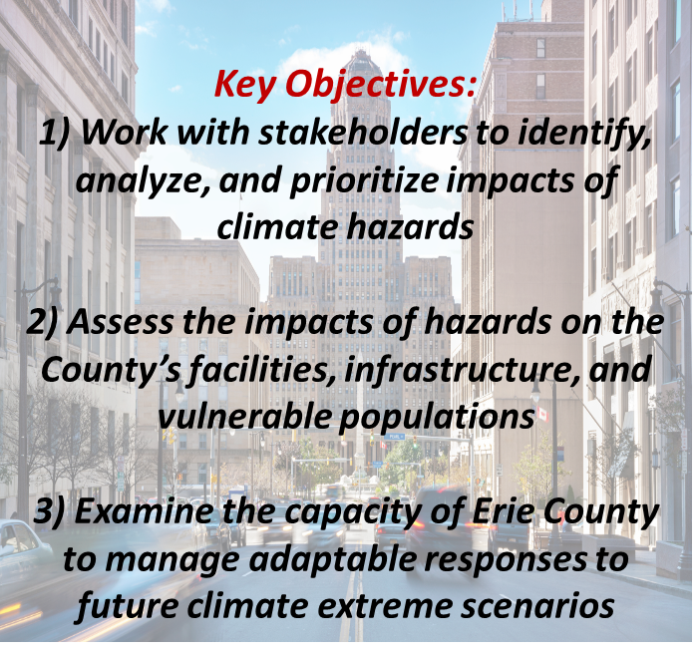

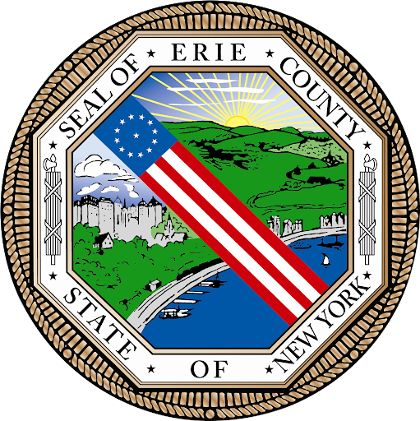
Project Organization:
External Stakeholder Committee:
Erie County Community Climate Change Task Force (C3TF)
Internal Stakeholder Committee:
Interdepartmental Committee or ‘Green Team’
Notes:
So getting to the more important part here…which is the strong community and stakeholder engagement that inherent to this important work we are doing.
As I said, this project is a collaboration between scholars and research at UB and Erie County, which is the primary governmental institution in our area that provides emergency, health and human services to its residents, making it a key player in the ability of our communities to successfully respond and adapt to climate threats and hazards.
In addition to this core team, we are heavily informed and guided by two stakeholder groups.
One is an external group, called the Erie County C3TF, which is comprosed of about 2 dozen representatives from local organizations, municipalities, and agencies that are considered key stakeholders to the County’s climate work.
The other is an internal County group called the Green team, which is an interdepartmental team that works together across the County’s departments on sustainability initiatives.
It is really this heavy stakeholder component of our project I think that makes it unique from other more traditional academic work that often works in isolation from the community and the public and reports its findings out after the fact. Alternatively….what we are doing and hoping to do more is a much more meaningful type of collaboration….

Slide 5
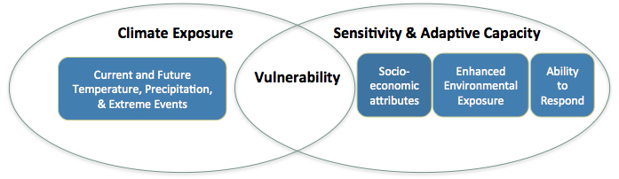
Vulnerability Framework
Adopted from peer reviewed case studies:
Weis et al. 2016 in Climatic Change
Shen, Feng, & Peng 2016 in Natural Hazards
Kumar et al 2016 in Land Use Policy
1)
2)
3)
Stakeholder Engagement
Notes:
Overall framework we are using in our assessment, which is adapted from peer reviewed literature on the topic and is really considered to be the best practice for conducting climate assessments. It is also the framing that the DEC< who funds this project is asking all of its assessments to follow so that the process of assessment is very similar across all of the assessments happening across the state.
There are three parts to the framework:
Climate exposure, where we look at the current and future trends in climate and extreme events in the region
Assess how sensitive the County is to those threats it’s exposed to
Adaptive capacity, or how ready is the County to respond to the threats it may face
All of these things together will tell us the County's overall vulnerability to climate related threats and hazards.
SO now I am going to walk you through each of these steps, or phases of our project and tell you how we are going about assessing each piece

Slide 6
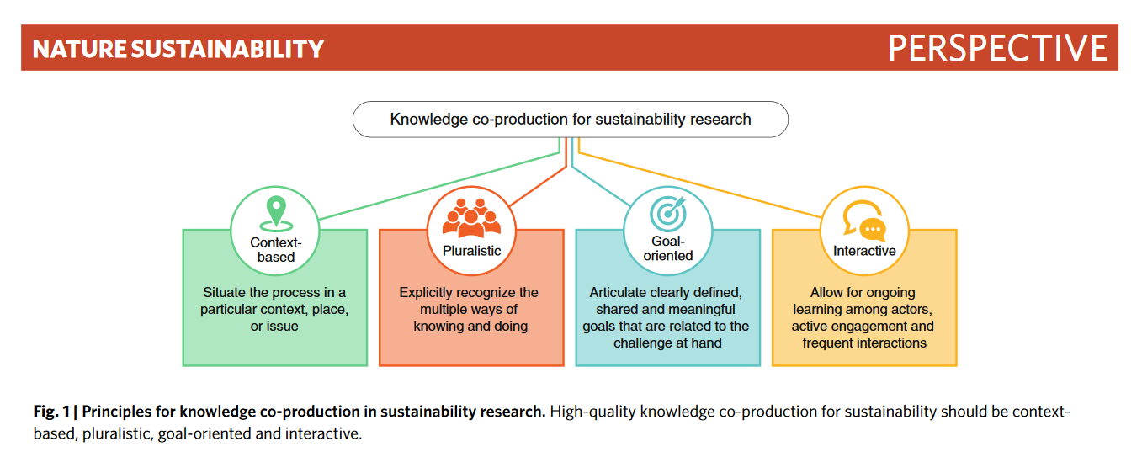
Transdisciplinary, knowledge co-production
Norström, A. V., Cvitanovic, C., Löf, M. F., West, S., Wyborn, C., Balvanera, P., ... & Campbell, B. M. (2020). Principles for knowledge co-production in sustainability research. Nature sustainability, 1-9.
Notes:
Which is known in the sustainability literature as the process of knowledge co-production with our community partners and stakeholders.
The idea here is that we are not being extractive with the community, in that we are not dolinf short-term one-off type research projects….instead we are engaged in a much longer term relationship with our partners, like Erie County, where each of our different perspectives and ways of knowing and doing are valued and we work together towards shared goals that are beneficial to all involved.

Slide 7
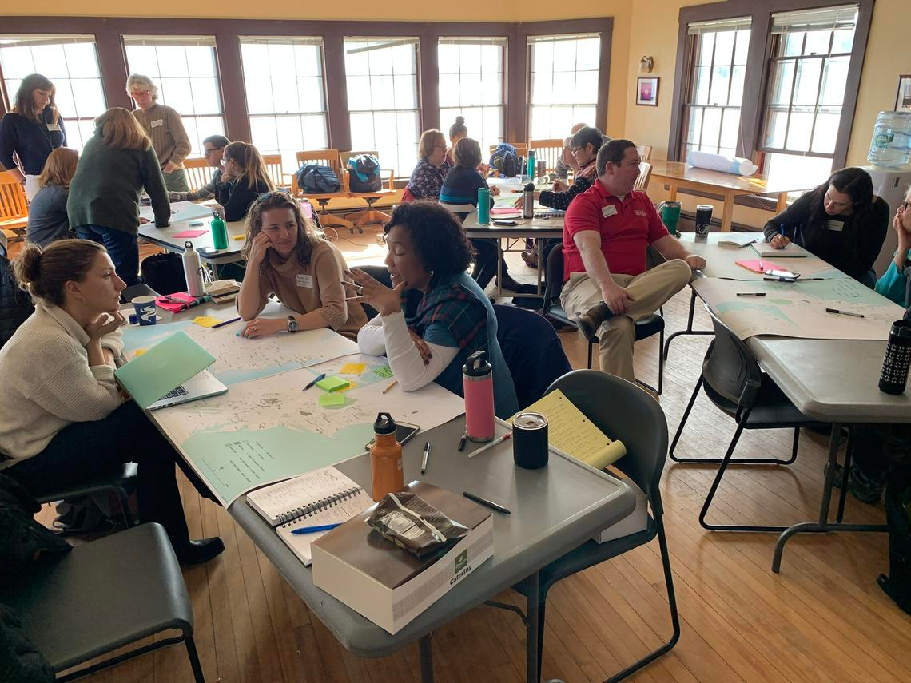
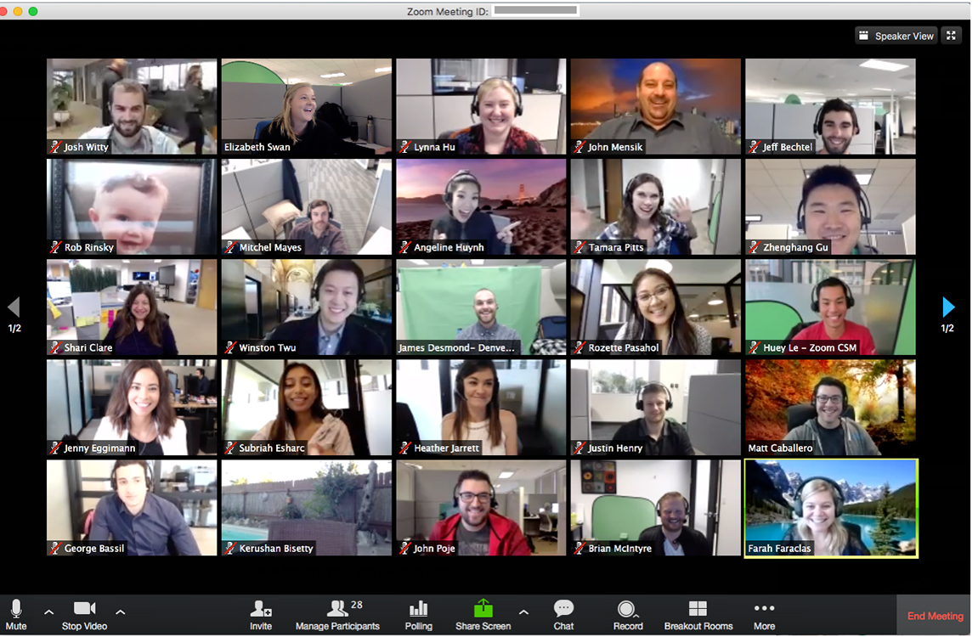
The changing nature of Stakeholder engagement…
What stakeholder engagement would typically look like….
What stakeholder engagement currently looks like….
Notes:
And with my last slide, I just wanted to say that this type of work has been a challenge but also a unique opportunity through COVID-19. The typical way we would do these things is to physically get everyone in the same room as part of a workshop….now instead we have lots of meetings that look like this….
The OUTSTEPS network has been particulary useful because, as a network with participants that are located all throughout the region, we were used to meeting virtually every week anyway. SO when COVID hit, the weekly meetings of the network continued without a problem and became a weekly way of touching base with our collaborators and partners throughout the region, whom we could learn from in these unprecended toimes.
At the beginning it felt like this was a barrier to overcome….

Slide 8
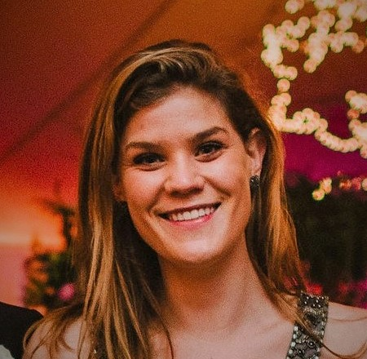
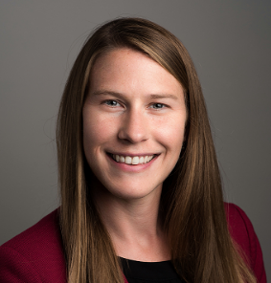
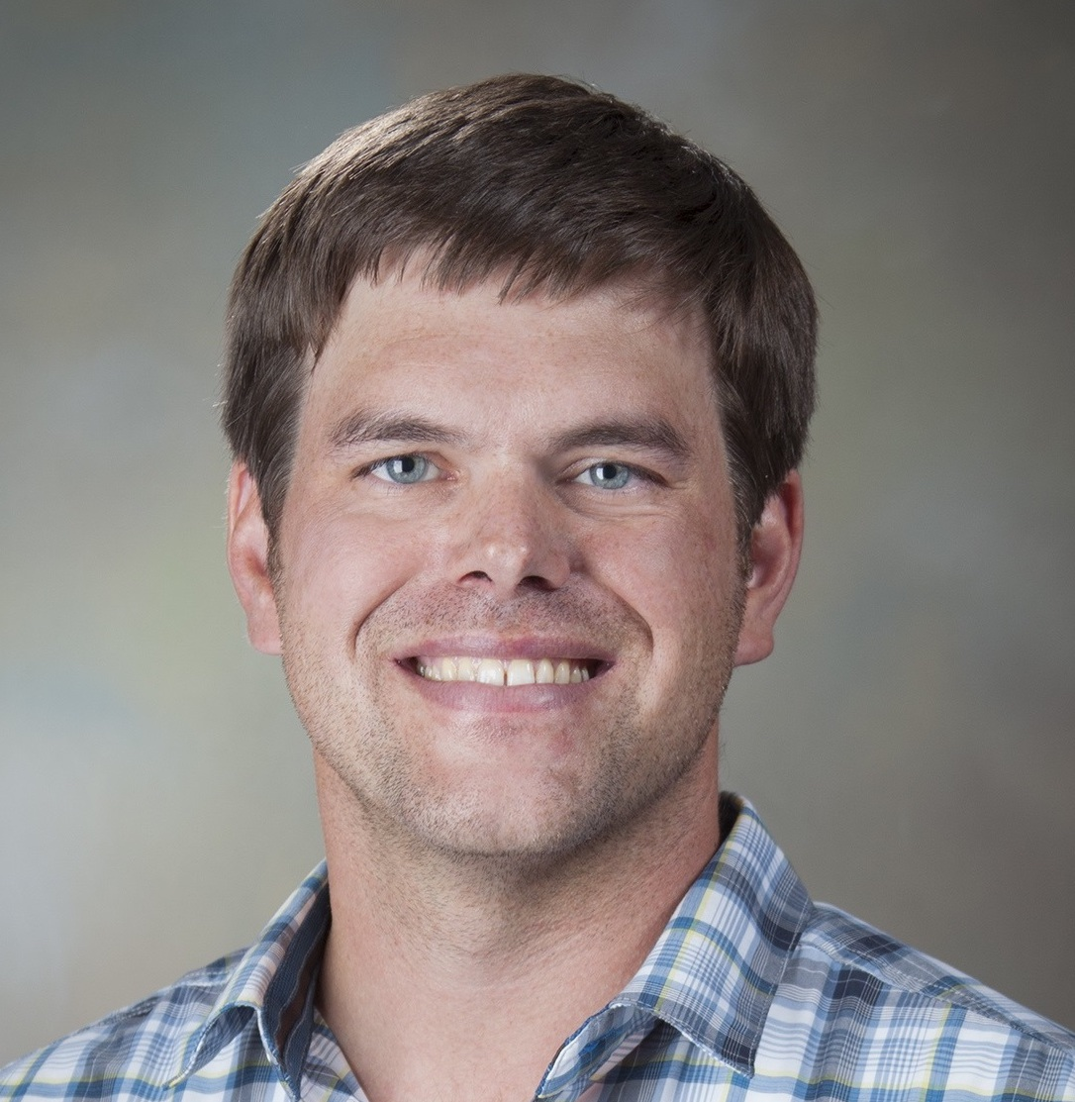
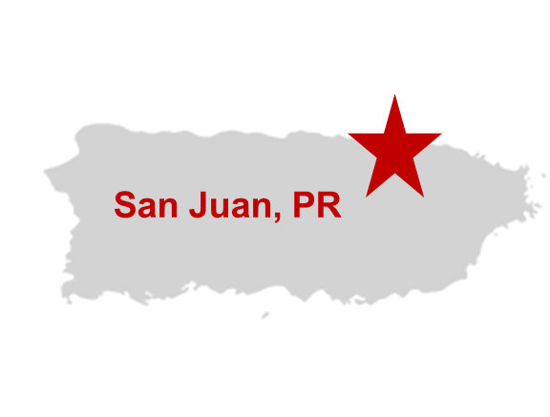


Example 2:
Estimating the social burden of attaining critical services following major power disruptions in San Juan, PR
Sara Peterson¹, Susan Spierre Clark¹, Bobby Jeffers², Mike Shelly¹
¹University at Buffalo
²Sandia National Laboratories

Slide 9
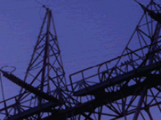
What do we lose when we lose power?
light
clean water
food storage
sewage disposal
medication storage
life support devices +
medical tech
safety systems
communication
Energy Sector
‘Enabling Function’
transportation
temperature
control
“energy is desired not for its own sake, but for the services that it produces” (Hunt & Ryan, 2015, p. 273).
Notes:
Whereas before I spoke about infrastructure more broadly, here we are more focused on the disruption of energy.
As I showed earlier in my presentation, energy is one out of 16 CI sectors identified as critical.
And the energy sector in particular is recognized as being uniquely critical because it provides an enabling function across all critical infrastructure sectors….
But from a community or household perspective, energy is important for different reasons, not because it enables the functionality of all this other infrastructure, but that it enables people to have access to things you need to survive and feel comfortable, like cooling or heating, charging your phone, refrigeration, health care, water delivery, lighting, etc.

Slide 10

Research Questions & Goal:
1. What infrastructure services do people need/depend upon the most during power outages?
2. What additional burdens are experienced during a power outage in fulfilling critical needs?
Notes:
Here are the research questions we are seeking to answer for our case study locations in this project.

Slide 11
So what? Why is this important?
Link the services that are most important to people during an outage to the infrastructure systems and local facilities that enable or support them
This link is helping us to quantify the burden to communities due to service losses, which will inform how we should prioritize resilient infrastructure investments to mitigate the impacts of future events
DOE is particularly interested in informing the siting of micro-grids with this metric in PR
In other locations, this metric will help municipalities and energy utilities better plan for and mitigate community impacts of power outages
Notes:
The notion that people are impacted differently as the result of infrastructure disruptions is not often considered in planning

Slide 12
Metric Development/Methods
Assumptions:
  During a power outage, the loss of power will cause a reduction in or loss of households’ ability to satisfy their critical needs (like food, water, heating/cooling, medicine, etc.)
  Households may be able to ameliorate the loss of services by traveling to obtain the service they typically fulfill at home OR by traveling further to obtain services they might normally fulfill locally.
  This travel creates an additional burden on households; this includes both out-of-pocket travel costs and additional time spent traveling.
  The burden depends on many factors, such as socio-economic status, mobility, age, health, etc.
Travel Cost method: sum up extra time and travel costs associated with fulfilling needs during a power outage across community households
Work closely with community partner: Caño Martín Peña Community Land Trust
Community Focus Groups and Digital Survey are being conducted to gather data to for social burden analysis
household

Slide 13
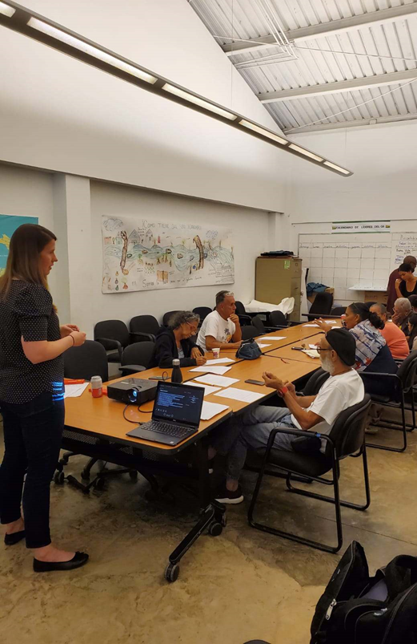
Major Takeaways/Lessons Learned:
Working with community stakeholders takes a lot of time, but the potential broader impacts of the project are huge!
Academics have a lot to offer in helping communities address sustainability and resilience issues
Community stakeholders have a lot to offer academia in making their work more relevant and useful for practice
It is important that outcomes of the project benefit/incentivize all parties involved
Academic institutions are still learning on how to work with vulnerable communities, the right way
There is a need for more academic programs to give students experience working with communities to solve sustainability & resilience problems
Focus group session in December 2019, San Juan
Notes:
At this point in the project we have started working in one case study location, in san juan PR
Although we have had the pleasure of many phone conversations with the community organization in San Juan, called ENLACE, the first time we met in person and toured the area was in December of last year.
During this trip we were able to build our relationship with the community representatives, as well as conduct a small focus group with about 10 community leaders to test out a questionnaire we developed, making sure we were asking relevant questions and that our approach was appropriate to capture needs of the community.
And the feedback we received on this trip was very positive, with residents indicating that they liked our overall approach, and they really were interested in working with us because they thought that the information that this study would inform, namey how to make their community more resilient, was very important to them. The questionnaairre that we tested also went well, although we came back with very valuable feedback in how to simplify it anf make the wording less technical and moire relevant to what the people experiences and therefore would make the questions easier to answer.
The most frequently reported needs by the people we spoke with were related to….some of which we expected. One suprise was the importance of television to this group. Whereas the theory might say that TV is not a critical need and instead serves more as a means of entertainment, the group we spoke with said that it was really important for them to stay up to date on what was happening in terms of the recovery effort as well as offered a distraction for them in a really difficult time and ultimately it was important for their mental health.
Based on the preliminary results and feedback in our December trip, we plan to go back to San Juan as soon as we can, given the current COVID-19 restrictions and safety concerns to move the project forward it may be some time.
The current plan is to work closely with the community organization, and have them help us to administer the survey to people within the community during public events when many residents would be in attendance. In future visits we plan to conduct a handful of additional small focus groups with community leaders with the new and improved questionnaire.
With this developed questionnaire that has been vetted with our experience in San Juan, we are gearing up to start working with community organizations in our other case study locations.

